Slide 1
The Book of Mormon Another Testament of Jesus Christ
Lesson 10: Mosiah 7-22
Live for the Lord
Christina G. Hibbert
christi@drchristinahibbert.com
www.LikeAWateredGarden.com
www.DrChrisitnaHibbert.com

Slide 2
Who or what do you live for?
Abinadi lived, and died, for the Lord. Through Abinadi, Alma learned to live for the Lord, and he, in turn, taught many to do likewise. As we study the teachings of Abinadi and the story of the people of Alma and Limhi, may we ask ourselves, “Would I be willing to testify, to stand boldly, and to even die for the Lord?” Or, perhaps even more importantly, “Am I willing to testify, stand boldly, and live for the Lord?”
Notes:
What do you “live” for? Do you live just because you’re alive? Do you live for your kids, your spouse, your family? Do you live for your work or career, for your hobbies or for fun? Do you live for the gospel, for truth, for the Lord?

Slide 3
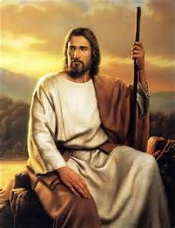
Ezra Taft Benson
“Christ changes men, and changed men can change the world.
‘Men changed for Christ will be captained by Christ…
‘...Men captained by Christ will be consumed in Christ...
‘Their will is swallowed up in His will. (see John 5:30)
‘They do always those things that please the Lord. (see John 8:29)
‘Not only would they die for the Lord, but more important they want to live for Him.” (emphasis added)
(in Conference Report, Oct 1985, 5-6)

Slide 4
Overzealous King Zeniff
Land of Lehi-Nephi
King Zeniff (Mosiah 9-1)
around 200 B.C.
King Noah (Mosiah 11-19)
around 160 B.C.
King Limhi (Mosiah 7-8,19-22)
around 121 B. C.
Land of Zarahemla
King Mosiah I
King Benjamin
King Mosiah II
Notes:
--Zeniff—a Nephite who led a group of his people to Lehi-Nephi, to try and regain some of the land where their ancestors had lived.
--He and his group left Zarahemla sometime after Mosiah 1 began his reign.
--Between Mosiah 8-9, we go back in time 80 years, approx.
--Zeniff begins recounting, in Mos 9, events recorded in Omni 1:27-30.
His first journey was with the group who went to the land of Nephi (Omni 1:27) to reclaim the land. When Zeniff saw the good in the Lamanites, he wished their leader to make a treaty with them (Mos 9:1-2) instead of destroying them, but the leader, being a “stiffnecked,”(Omni 27) and “austere and blood-thirsty”(Mos 9:2) man, instead commanded that Zeniff should be slain (9:2) and ignited a war, destroying all but 50 of their company. This group returned to the land of Zarahemla.
Zeniff then took another group back to establish a Nephite colony among the Lamanites, to possess the land of Lehi-Nephi, but he was “over-zealous.”
What does it mean to be “overzealous? What are the consequences? (poor judgments, being “slow to remember…God” (Mos 9:3) and blinded by “the cunning and craftiness of King Laman” (9:17)
But Zeniff also influenced his people for good. He encouraged them to:
Repair the city (Mos 9:8)
Raise flocks and crops (Mos 10:2, 4)
Manufacture clothing (10:5)
Defend themselves in the “strength of the Lord” (Mos 9:17)
**In fact, Brother Hugh Nibley proposes these are the main reasons King Laman made the deal with Zeniff that his people could possess the land in the first place (Mos 9:6)—because the Lamanites were a “lazy and an idolatrous people and knew the Nephites were industrious. They wanted them to come and make the city great again—and THEN, they would attack and take it back. (Commentary on the BOM, Nibley)

Slide 5
Wicked King Noah
Mosiah 11:1-15
What did King Noah do when he came into power?
How did the people respond?
Notes:
“What kind of leader was Zeniff’s son, Noah? Well, he did not walk in the ways of his father, did not keep the commandments of God, instead, he followed the desires of his own heart, had many wives and concubines, caused his people to commit sin, and did that which was abominable in the sight of the Lord (Mosiah 11:1-2). ‘
‘Noah “changed the affairs of the kingdom” (Mosiah 11:4), by taxing the people 20%, or one-fifth part of all they possessed—their gold, silver, ziff, copper, brass, and iron; also one-fifth of their fatlings and grain (Mosiah 11:3), all of this to support himself, his wives and concubines, his priests, and their wives and concubines (Mosiah 11:4). He removed all the righteous priests appointed by Zeniff and appointed those who were lifted up in the pride of their hearts. “Yea, and thus they were supported in their laziness, and in their idolatry, and in their whoredoms, by the taxes which king Noah had put upon his people; thus did the people labor exceedingly to support iniquity. They also became idolatrous, because they were deceived by the vain and flattering words of the king and priests; for they did speak flattering things unto them” (Mosiah 11:6-7). (from http://nephicode.blogspot.com/2015/09/the-unusual-men-zeniff-noah-limhi-ptii.html)
Hugh Nibley reminds us Noah was actually a “popular” king! “His judgment wasn’t the best, but we overlook the fact that the wicked Noah was an extremely popular king. He was the most popular king in the Book of Mormon. We say, ‘he was wicked; terrible Noah.’ We look at pictures…and say, ‘Ooh, what a fiend he was!’ But he wasn’t that way at all. He was very popular, as I said. Notice when it says, ‘Do that which was abominable in the sight of the Lord,’ that’s a euphemism. That’s when you use one word to cover another word, particularly a displeasing word. Where it is used here, abominable means kinky sex and whoredoms in the plural, all kinds of depravities...What’s more, we read that the people went along with it; they joined him in it. ‘And he did cause his people to commit sin, and do that which was abominable in the sight of the Lord.’ It wasn’t just in his court they were doing it; he set an example that was followed...Notice, ‘Thus did the people labor exceedingly to support iniquity.’ (11:6) The fact that they worked doesn’t sanctify their wealth or the uses of it...it doesn’t mean that it is sanctified at all. Here the people were all for the program. He was a very popular king and put on a great show.” (Commentary on the BOM, loc. 6131)

Slide 6
Prophets
“Like the prophets of old, prophets today testify of Jesus Christ and teach His gospel. They make known God’s will and true character. They speak boldly and clearly, denouncing sin and warning of its consequences. At times. They may be inspired to prophesy of future events for our benefit.”
(True to the Faith [2004], 129)
Notes:
What are 4 major responsibilities of prophets we learn about here?

Slide 7
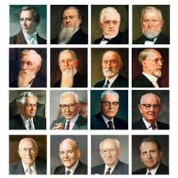
Responsibilities of Prophets
Testify of Jesus Christ and teach His gospel.
Make known God’s will and character.
Denounce sin and warn of its consequences.
Prophesy of future events.
Notes:
And ancient prophets had the same purposes. Enter Abinadi…

Slide 8
Abinadi
Notes:
--First visit… (Mos 11:20-25) (repent or God will “visit them in mine anger” (20), “deliver them into the hands of their enemies (21), be “brought into bondage and none shall deliver them except it be the Lord the Almighty God” (23), He will be “slow to hear their cries” (24), He “will not hear their prayers...”(25 READ)) The Lord “delivered him out of their hands” the first time.
--Two years transpired between his 2 visits, and he came back “in disguise”.
--How did his message change in the second visit? (prophesied because people had “hardened their hearts” from his first prophecies and “repented not”)
--Second visit...(Mosiah 12:1-8) (prophecies the people will be in bondage (2), destruction of King noah (3), afflictions, famine “howl all the day long” (4), burdens (5), “utterly destroyed” except they repent (8)) The people were angry and bound him and brought him before the king.(9)
--The people ignored his first warning. Even if they repented now, what consequences would they face? (I will visit them in my anger, yea in my fierce anger...(12:1) [see above!] How does this apply to us?

Slide 9
Abinadi’s Sermon
God Himself shall make an Atonement and redeem His people. (Mos 13-16)
Understanding and following the prophets and scriptures (12:27)
Obeying the 10 Commandments, and other commandments (12:33-37; 13:11-24)
The Atonement of Jesus Christ (13:28)
The reality that Jesus is the Christ, that he would come to earth, his life and ministry, and his intercession for us (using the words of Isaiah) (Mosiah 14)
Notes:
When Abinadi is bound and brought before the king, then begins his great sermon, one Hugh Nibley called “These chapters [12-16] are one of the most important doctrinal parts of the Book of Mormon. Chapters 15 and 16 are probably the hardest chapters in the BOM. Abinadi turned out to be a tremendous teacher, and he was a nobody.” (Commentary on the BOM, loc 6243)
1. Abinadi fulfilled his role as a prophet by testifying of the divine mission of Jesus Christ. He quotes Isaiah’s prophecy about the Savior’s atoning sacrifice in ch. 14.

Slide 10
Jeffrey R. Holland
“Surely the most sublime, the lengthiest and most lyrical declaration of the life, death, and atoning sacrifice of the Lord Jesus Christ is that found in the 53rd chapter of Isaiah, quoted in its entirety in the Book of Mormon by Abinadi as he stood in chains before King Noah” (Christ and the New Covenant, 89).

Slide 11
Mosiah 14
How do the following verses make you feel about the Savior?
In verse 2, what does the phrase “as a root out of dry ground” suggest about the general spiritual state of the people during the time of the Savior’s mortal ministry? (Many were unreceptive to His message.)
According to verse 3, how did some people treat the Savior?
According to verses 4–6, what burdens did the Savior bear?
According to verses 7–9; 11, how did Jesus Christ show His willingness to atone for our sins?

Slide 12
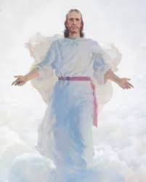
Mosiah 15-16
15:1-7 Christ is both the Father and the Son
15:10-13 The seed of Christ
15:13-20 How beautiful are the feet!
15:20-31 The first resurrection
15:25 Little children have eternal life
15:30-31 Break forth into joy!
16:1-8 Christ will redeem us from a lost and fallen state
16:9 He is the light and life of the world!
16:10-12 Christ is our judge
Notes:
-Hugh Nibley said of these chapters: “They are perhaps the hardest chapters in the Book of Mormon. They are the most important and the most condensed because here we are going to find the fullness of the gospel message that we need to be saved.”
This is the gospel of Jesus Christ—the Atonement, the Resurrection of us all, the Redemption of our fallen souls, and Christ is the One who has done it all. He is our judge. He is the Light and Life of the world, quite literally. And we have a choice here: Do we believe in His gospel? Do we believe IN Him? And do we Believe HIM? If so, how does that change US?
--Hugh Nibley quote from “Commentary on the BOM,” kindle version, loc 6490
--M. Russell Ballard: “God our Heavenly Father is the Father of our spirits; we speak of God the Son as the Father of the righteous. He is regarded as the ‘Father’ because of the relationship between Him and those who accept His gospel, thereby becoming heirs of eternal life. And the third member of the Godhead, God the Holy Ghost, has the specific mission to teach and to testify of truth as it pertains to the divinity of both God the Father and God the Son” (“Building Bridges of Understanding,” Ensign, June 1998, 66–67).
--Christ is “Father as Creator,” “Father of those who abide in His Gospel,” and “Father by Divine Investiture of Authority”—as The representative of Elohim His Father in power and authority (from Joseph F. Smith, Ensign Apr 2002)
--”Seed of Christ”—Elder Merrill J. Bateman: “The Savior, as a member of the Godhead, knows each of us personally. Isaiah and the prophet Abinadi said that when Christ would ‘make his soul an offering for sin, he shall see his seed’ (Isaiah 53:10; compare Mosiah 15:10). Abinadi explains that ‘his seed’ are the righteous, those who follow the prophets (see Mosiah 15:11). In the garden and on the cross, Jesus saw each of us and not only bore our sins but also experienced our deepest feelings so he would know how to comfort and strengthen us” (in Conference Report, Apr. 1995, 15–16; or Ensign, May 1995, 14).

Slide 13
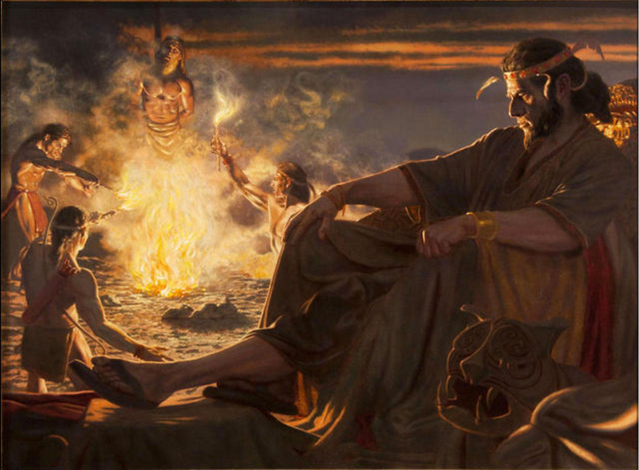
Abinadi’s Martyrdom
Sometimes the righteous suffer for their testimony of Jesus Christ.
Mosiah 17
Notes:
What is his crime? Verse 8- “Thou hast said that God himself should come down among the children of men..’
Abinadi’s response to his “crimes”: 17:9-10
Abinadi’s final words (17:15-20)

Slide 14
Robert D. Hales
“What a powerful example Abinadi should be to all of us! He courageously obeyed the Lord’s commandments—even though it cost him his life! Prophets of all dispensations have willingly put their lives on the line and, with courage, have done the will and proclaimed the word of God. The Prophet Joseph Smith went ‘like a lamb to the slaughter’ (D&C 135:4), never wavering as he fulfilled the Lord’s commandments.
“And think of our Savior’s example. … He endured to the end, fulfilling His divine mission and completing the atoning sacrifice for all mankind.… Let us follow the example of our Lord Jesus Christ and His prophets, past and present. It may not be required of us to give our lives as martyrs, as did many of the prophets. What is required is our obedience to the Lord’s commandments and our faithfulness to the covenants we have made with Him” (in Conference Report, Apr. 1996, 49; or Ensign,May 1996, 35).
Notes:
Can we follow the example of Abinadi and live for the Lord by keeping His commandments and by keeping our covenants? Will we?

Slide 15
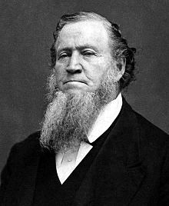
Brigham Young
“The most effectual way to establish the religion of Heaven is to live it, rather than to die for it: I think I am safe in saying that there are many of the Latter-day Saints who are more willing to die for their religion than to live it faithfully.”
(Discourses of Brigham Young, sel. John A. Widtsoe [1954], 221)

Slide 16
Alma
LIVED for the Lord
Repented and taught the people (18:1-7)
Baptized through the priesthood and the Spirit of Christ (18:8-16)
What was Alma’s desire as He prepared to do the Lord’s work? (18:12)
Notes:
Alma is certainly someone who LIVED for the Lord.
--He believed in Abinadi and was converted, tried to intervene on his behalf, and was driven out and hunted by the servants of the king. Eventually, he began to preach to the people who were willing to listen to him (he “went about privately among the people and began to teach the words of Abinadi” (18:1). He taught (v.2) of “the resurrection of the dead, and the redemption of the people…through the power and sufferings, and death of Christ, and his resurrection and ascension into heaven.”
--The people gathered near Mormon to hear the words of Alma (v. 7).
--He then baptized Helam, and the people, through the power of the Priesthood.
Pres. Joseph Fielding Smith:
“We may conclude that Alma held the priesthood before he, with others, became disturbed with King Noah. Whether this is so or not makes no difference because in the Book of Mosiah it is stated definitely that he had authority [see Mosiah 18:13].
“If he had authority to baptize that is evidence that he had been baptized. Therefore, when Alma baptized himself with Helam that was not a case of Alma baptizing himself, but merely as a token to the Lord of his humility and full repentance” (Answers to Gospel Questions, comp. Joseph Fielding Smith Jr., 5 vols. [1957–66], 3:203).

Slide 17
Alma -- Baptism
Jeffrey R. Holland: “…He asked that they ‘serve [God] and keep his commandments, that he may pour out his Spirit more abundantly’ upon them. These new disciples would also demonstrate their faith by:
“Coming into the fold of God.
“Being called his people.
“Bearing one another’s burdens.
“Mourning with those that mourn.
“Comforting those who stand in need of comfort.
“Standing as witnesses of God at all times and in all things and in all places.
“Entering into a covenant to serve God and keep his commandments.
“This declaration by Alma at the Waters of Mormon still stands as the most complete scriptural statement on record as to what the newly baptized commit to do and be”
(Christ and the New Covenant [1997], 106).
Notes:
Mosiah 18:8-10
Eventually, the king discovered thm (32) and sought to destroy them by sending his army (33), so the people of Alma departed into the wilderness (450 souls) (34-35)!

Slide 18
King Limhi & Alma
People of Limhi
Endured bondage & 50% tribute (2 yrs. Post-Abinadi)
Lamanites attacked, they fought and accepted bondage (20:7-22)
Bondage intensified(21:3-6)
People murmured & went to war
Finally, repented and turned to the Lord. Compelled to be humble.
Eventually burdens eased (21:15)
Finally delivered (22:11) & returned to Zarahemla (22:13)
People of Alma
Escaped King Noah (18:33-4)
Prospered & the Lord strengthened them (23:2-5)
Continued in peace and prosperity, living in righteousness (23:14-20)
Discovered by Lamanite army hunting Limhi’s people and brought into bondage (24:8-10)
Remained faithful and endured patiently (10-16)
The Lord eased their burdens & delivered them (24:14-20)
Notes:
Gideon sought to slay King Noah (19:1-6), but on the tower, Noah saw the Lamanites upon the people. He was really more concerned about himself, but Gideon let him go and he told the people to flee and he did also flee (9). He commanded the men to leave their wives and children and flee (11). The lamanites had compassion on the children and daughters, and took them captives. Eventually, the men were angry with the king and caused him to die by fire (19-20). His son, Limhi, becomes king. Limhi is righteous, but his people hadn’t been. They are eventually defeated by the lamanites and brought into bondage.
Eventually, Ammon finds them, and they are able to escape. The Lamanites pursue them and find Alma’s people instead. They are brought into bondage, too.

Slide 19
The Lord will deliver us…
Elder Jeffrey R. Holland said:
“There can and will be plenty of difficulties in life. Nevertheless, the soul that comes unto Christ, who knows His voice and strives to do as He did, finds a strength, as the hymn says, ‘beyond [his] own.’ [“Lord, I Would Follow Thee,” Hymns, no. 220.] …
“Brothers and sisters, whatever your distress, please don’t give up and please don’t yield to fear. …If you are lonely, please know you can find comfort. If you are discouraged, please know you can find hope. If you are poor in spirit, please know you can be strengthened. If you feel you are broken, please know you can be mended” (in Conference Report, Apr. 2006, 71–72; or Ensign,May 2006, 71).
Christ is the one who comforts, who offers hope, who strengthens, who mends us. May we turn to Him, receive of His love by receiving the power of His Atonement in our lives. May we rely upon Him through all times of life—through the blessings and the despair. May we live for Him, each and every day, is my prayer.

Slide 20
Personal Inventory
Are you willing to live for the Lord?
How will you show Him your willingness?
What will it look like in your life?

