Slide 1
The Book of Mormon Another Testament of Jesus Christ
Lesson 11: Mosiah 18-Alma 4
Experience “a Mighty Change”
Christina G. Hibbert
christi@drchristinahibbert.com
www.DrChristinaHibbert.com
www.LikeAWateredGarden.com

Slide 3
The Paradox of Personal Growth
Mosiah 25: 5-11 (Review) “The paradox of personal growth”
Have you ever felt like this? Two opposing emotions? Two seemingly opposite experiences happening at the same time? Can you think of personal or universal experiences similar to this? Share…How does it feel?
Cognitive dissonance, and “living in the paradox” This Is How We Grow, pg. 60

Slide 4
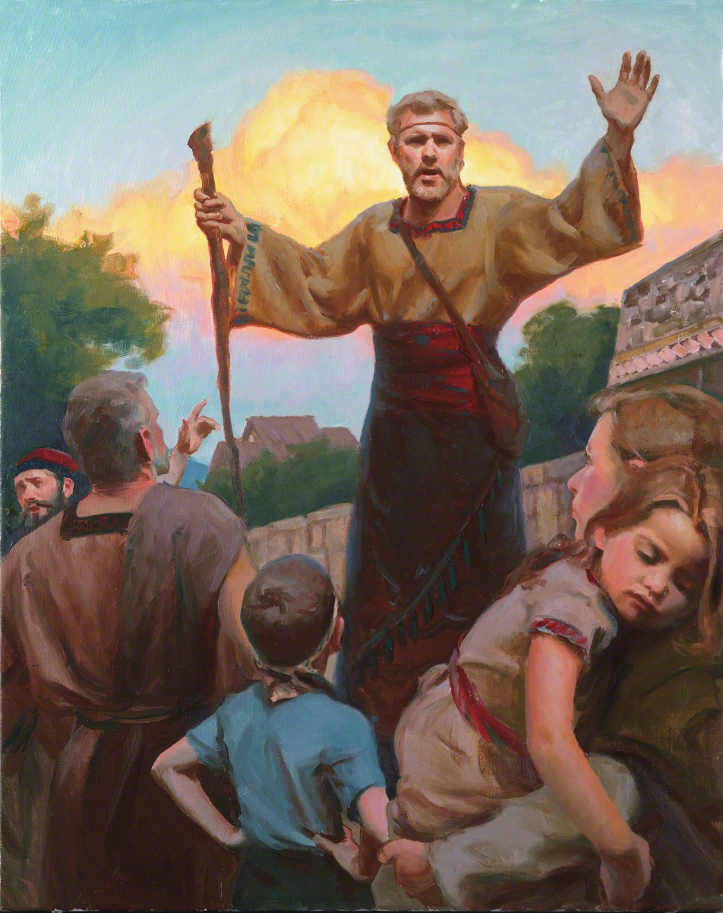
Alma
LIVED for the Lord
Repented and taught the people (18:1-7)
Baptized through the priesthood and the Spirit of Christ (18:8-16)
What was Alma’s desire as He prepared to do the Lord’s work? (18:12)
Notes:
Alma is certainly someone who LIVED for the Lord.
--He believed in Abinadi and was converted, tried to intervene on his behalf, and was driven out and hunted by the servants of the king. Eventually, he began to preach to the people who were willing to listen to him (he “went about privately among the people and began to teach the words of Abinadi” (18:1). He taught (v.2) of “the resurrection of the dead, and the redemption of the people…through the power and sufferings, and death of Christ, and his resurrection and ascension into heaven.”
--The people gathered near Mormon to hear the words of Alma (v. 7).
--He then baptized Helam, and the people, through the power of the Priesthood.
Pres. Joseph Fielding Smith:
“We may conclude that Alma held the priesthood before he, with others, became disturbed with King Noah. Whether this is so or not makes no difference because in the Book of Mosiah it is stated definitely that he had authority [see Mosiah 18:13].
“If he had authority to baptize that is evidence that he had been baptized. Therefore, when Alma baptized himself with Helam that was not a case of Alma baptizing himself, but merely as a token to the Lord of his humility and full repentance” (Answers to Gospel Questions, comp. Joseph Fielding Smith Jr., 5 vols. [1957–66], 3:203).

Slide 5
Alma -- Baptism
Jeffrey R. Holland: “…He asked that they ‘serve [God] and keep his commandments, that he may pour out his Spirit more abundantly’ upon them. These new disciples would also demonstrate their faith by:
“Coming into the fold of God.
“Being called his people.
“Bearing one another’s burdens.
“Mourning with those that mourn.
“Comforting those who stand in need of comfort.
“Standing as witnesses of God at all times and in all things and in all places.
“Entering into a covenant to serve God and keep his commandments.
“This declaration by Alma at the Waters of Mormon still stands as the most complete scriptural statement on record as to what the newly baptized commit to do and be”
(Christ and the New Covenant [1997], 106).
Notes:
Mosiah 18:8-10
Eventually, the king discovered thm (32) and sought to destroy them by sending his army (33), so the people of Alma departed into the wilderness (450 souls) (34-35)!

Slide 6
King Limhi & Alma
People of Limhi
Endured bondage & 50% tribute (2 yrs. Post-Abinadi)
Lamanites attacked, they fought and accepted bondage (20:7-22)
Bondage intensified(21:3-6)
People murmured & went to war
Finally, repented and turned to the Lord. Compelled to be humble.
Eventually burdens eased (21:15)
Finally delivered (22:11) & returned to Zarahemla (22:13)
People of Alma
Escaped King Noah (18:33-4)
Prospered & the Lord strengthened them (23:2-5)
Continued in peace and prosperity, living in righteousness (23:14-20)
Discovered by Lamanite army hunting Limhi’s people and brought into bondage (24:8-10)
Remained faithful and endured patiently (10-16)
The Lord eased their burdens & delivered them (24:14-20)
Notes:
Gideon sought to slay King Noah (19:1-6), but on the tower, Noah saw the Lamanites upon the people. He was really more concerned about himself, but Gideon let him go and he told the people to flee and he did also flee (9). He commanded the men to leave their wives and children and flee (11). The lamanites had compassion on the children and daughters, and took them captives. Eventually, the men were angry with the king and caused him to die by fire (19-20). His son, Limhi, becomes king. Limhi is righteous, but his people hadn’t been. They are eventually defeated by the lamanites and brought into bondage.
Eventually, Ammon finds them, and they are able to escape. The Lamanites pursue them and find Alma’s people instead. They are brought into bondage, too.

Slide 7
The Lord will deliver us…
Elder Jeffrey R. Holland said:
“There can and will be plenty of difficulties in life. Nevertheless, the soul that comes unto Christ, who knows His voice and strives to do as He did, finds a strength, as the hymn says, ‘beyond [his] own.’ [“Lord, I Would Follow Thee,” Hymns, no. 220.] …
“Brothers and sisters, whatever your distress, please don’t give up and please don’t yield to fear. …If you are lonely, please know you can find comfort. If you are discouraged, please know you can find hope. If you are poor in spirit, please know you can be strengthened. If you feel you are broken, please know you can be mended” (in Conference Report, Apr. 2006, 71–72; or Ensign,May 2006, 71).
Christ is the one who comforts, who offers hope, who strengthens, who mends us. May we turn to Him, receive of His love by receiving the power of His Atonement in our lives. May we rely upon Him through all times of life—through the blessings and the despair. May we live for Him, each and every day, is my prayer.”

Slide 8
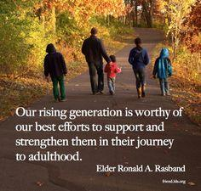
The Rising Generation
Mosiah 5:1-5 & 26:1-4
Why did many of this generation harden their hearts? (Mosiah 26:3-4)
How can we strengthen and encourage the next generation to develop a strong testimony of the gospel?
Notes:
The Rising Generation were willful—full of their own will—vs. being willing (D&C 64:34; Mos 26:18) to do the Lord’s will.

Slide 9
The Rising Generation
President Hinckley: “I have said many times that I believe we have the finest generation of young people that this Church has ever known. … They try to do the right thing. They are bright and able, clean and fresh, attractive and smart. … They know what the gospel is about, and they are trying to live it, looking to the Lord for His guidance and help” (“Your Greatest Challenge, Mother,” Liahona, Jan. 2001, 113; Ensign, Nov. 2000, 97–98).
Elder Henry B. Eyring: “Many of them are remarkable in their spiritual maturity and in their faith. But even the best of them are sorely tested. And the testing will become more severe” (“We Must Raise Our Sights, Ensign, Sept. 2004, 14)

Slide 10
Our Rising Generation
Elder Ronald A. Rasband:
“We—as members of the Church, leaders of youth, anxious fathers, [mothers], and concerned grandparents]—all need to respond to the call for “all hands on deck” as it pertains to our youth and young single adults. We must all look for opportunities to bless the youth whether or not we are currently closely associated with them. We must continue to teach and fortify fathers and mothers in their divinely declared roles with their children in the home. We must ask ourselves constantly if that extra sporting event, that extra activity or errand outside of the home is more important than families being together at home.” (Our Rising Generation, Ensign, April 2006)

Slide 11
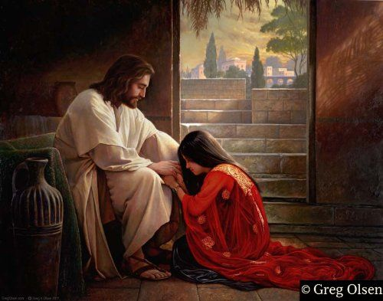
Discipline & Forgiveness
Mosiah 26: 10-13
Why was Alma so “troubled?”
How did the Lord respond? (Mos. 26:14-32)
What did Alma do with the Lord’s response? (v. 33)
What do we learn from these verses?
Notes:
As often as we repent the Lord WILL forgive! (26:30)
We are also required to forgive others (31)
Repentance is key!!

Slide 12
Discipline vs. Punishment
Elder Theodore M. Burton: “It saddens me when I hear how some of our members and even sometimes our local leaders treat people who have to be disciplined for transgression. I realize there is a tendency to equate the word discipline with the word punish, but there is a difference between these words. In English…the word discipline has the same root as the word disciple. A disciple is a student, to be taught. In dealing with transgressors, we must remember that they desperately need to be taught” (in Conference Report, Oct. 1985, 81–82; or Ensign, Nov. 1985, 65).
Disciple--> Discipline
Notes:
Alma was “troubled in his spirit” because he didn’t want to do the wrong thing. Judging others and disciplining them is a big responsibility, and one that can and should only come from God. Alma felt this responsibility, and King Mosiah reaffirmed this was his responsibility, and so rightly, he turned to the Lord for guidance.
How did the Lord respond?
What is the definition of discipline then?

Slide 13
An Angel from God!
Notes:
“The ministering of angels must be in harmony with the will of God and does not always occur according to the timetable of the petitioner. Speaking of a man who had prayed for the visitation of angels, President Wilford Woodruff (1807–98) said:
“I said to him that if he were to pray a thousand years to the God of Israel for that gift, it would not be granted, unless the Lord had a motive in sending an angel to him. I told him that the Lord never did nor never will send an angel to anybody merely to gratify the desire of the individual to see an angel. If the Lord sends an angel to anyone, He sends him to perform a work that cannot be performed only by the administration of an angel. I said to him that those were my views. The Lord had sent angels to men from the creation of the world, at different times, but always with a message or with something to perform that could not be performed without. I rehearsed to him different times when angels appeared to men. Of course, I referred to the angel visiting Joseph Smith. The Revelator John said that in the last days an angel would fly in the midst of heaven, having the everlasting Gospel to preach to them that dwelt on the earth. The reason it required an angel to do this work was, the Gospel was not on the earth. The Gospel and the Priesthood had been taken from among men. Hence God had to restore it again.
“Now, I have always said, and I want to say it to you, that the Holy Ghost is what every Saint of God needs. It is far more important that a man should have that gift than he should have the ministration of an angel, unless it is necessary for an angel to teach him something that he has not been taught” (“The Administration of Angels,” in Brian H. Stuy, comp. Collected Discourses, 5 vols. [1987–92], 5:233).” (Religion 121-122 Student Manual)

Slide 14
What does it mean to have a change of heart?
Notes:
What does it mean to have a “change of heart”?”
Read Mosiah 27:8-10, 32-37 What were Alma’s and the sons of Mosiah’s behavior like before and after their change of heart? How can we tell their change was sincere and lasting? (v. 32-37)

Slide 15
To be Born Again…
Notes:
What does it mean to be “born again?” Mosiah 27:24-29
How does LIVING the gospel change our natures?
•
President Ezra Taft Benson (1899–1994) gave us an important reminder as we seek to be born again and become like our Savior Jesus Christ:
“We must be careful, as we seek to become more and more godlike, that we do not become discouraged and lose hope. Becoming Christlike is a lifetime pursuit and very often involves growth and change that is slow, almost imperceptible. The scriptures record remarkable accounts of men whose lives changed dramatically, in an instant, as it were: Alma the Younger, Paul on the road to Damascus, Enos praying far into the night, King Lamoni. Such astonishing examples of the power to change even those steeped in sin give confidence that the Atonement can reach even those deepest in despair.
“But we must be cautious as we discuss these remarkable examples. Though they are real and powerful, they are the exception more than the rule. For every Paul, for every Enos, and for every King Lamoni, there are hundreds and thousands of people who find the process of repentance much more subtle, much more imperceptible. Day by day they move closer to the Lord, little realizing they are building a godlike life. They live quiet lives of goodness, service, and commitment. They are like the Lamanites, who the Lord said ‘were baptized with fire and with the Holy Ghost, and they knew it not.’ (3 Ne. 9:20; italics added.)” (“A Mighty Change of Heart,” Ensign, Oct. 1989, 5).

Slide 16
Being Born Again Mosiah 27:25
President Ezra Taft Benson:
“We must be careful, as we seek to become more and more godlike, that we do not become discouraged and lose hope. Becoming Christlike is a lifetime pursuit and very often involves growth and change that is slow, almost imperceptible. The scriptures record remarkable accounts of men whose lives changed dramatically, in an instant, as it were: Alma the Younger, Paul on the road to Damascus, Enos praying far into the night, King Lamoni. Such astonishing examples of the power to change even those steeped in sin give confidence that the Atonement can reach even those deepest in despair.
“But we must be cautious as we discuss these remarkable examples. Though they are real and powerful, they are the exception more than the rule. For every Paul, for every Enos, and for every King Lamoni, there are hundreds and thousands of people who find the process of repentance much more subtle, much more imperceptible. Day by day they move closer to the Lord, little realizing they are building a godlike life. They live quiet lives of goodness, service, and commitment. They are like the Lamanites, who the Lord said ‘were baptized with fire and with the Holy Ghost, and they knew it not.’ (3 Ne. 9:20; italics added.)” (“A Mighty Change of Heart,” Ensign, Oct. 1989, 5).
Notes:
Elder Jeffrey R. Holland explained we must realize that the price of sin is high and that though repentance can be difficult, the end result is always worth much more than the cost:
“We learn that repentance is a very painful process. By his own admission Alma said he wandered ‘through much tribulation, repenting nigh unto death,’ that he was consumed with an ‘everlasting burning. … I was in the darkest abyss,’ he said. ‘My soul was racked with eternal torment’ (Mosiah 27:28–29). …
“For three seemingly endless days and nights he was torn ‘with the pains of a damned soul’ (Alma 36:16), pain so real that he was physically incapacitated and spiritually terrorized by what appeared to be his ultimate fate. No one should think that the gift of forgiveness is fully realized without significant effort on the part of the forgiven. No one should be foolish enough to sin willingly or wantonly, thinking forgiveness is easily available.
“Repentance of necessity involves suffering and sorrow. Anyone who thinks otherwise has not read the life of the young Alma, nor tried personally to repent. In the process of repentance we are granted just a taste of the suffering we would endure if we failed to turn away from evil. That pain, though only momentary for the repentant, is the most bitter of cups. No man or woman should be foolish enough to think it can be sipped, even briefly, without consequence. …
“We learn that when repentance is complete, we are born again and leave behind forever the self we once were. To me, none of the many approaches to teaching repentance falls more short than the well-intentioned suggestion that ‘although a nail may be removed from a wooden post, there will forever be a hole in that post.’ We know that repentance (the removal of that nail, if you will) can be a very long and painful and difficult task. Unfortunately, some will never have the incentive to undertake it. We even know that there are a very few sins for which no repentance is possible. But where repentance is possible, and its requirements are faithfully pursued and completed, there is no ‘hole left in the post’ for the bold reason that it is no longer the same post. It is a new post. We can start again, utterly clean, with a new will and a new way of life” (However Long and Hard the Road [1985], 83–84).

Slide 17
Increased Desire to Share the Gospel
1 Nephi 8:2-12
Enos 1:1-9, 19
Mosiah 28:1-4
How are these 3 account similar?
What are the motives of the sons of Mosiah for sharing the gospel? (Mos 28:3-4)
How can we cultivate similar desires/motives?

Slide 18
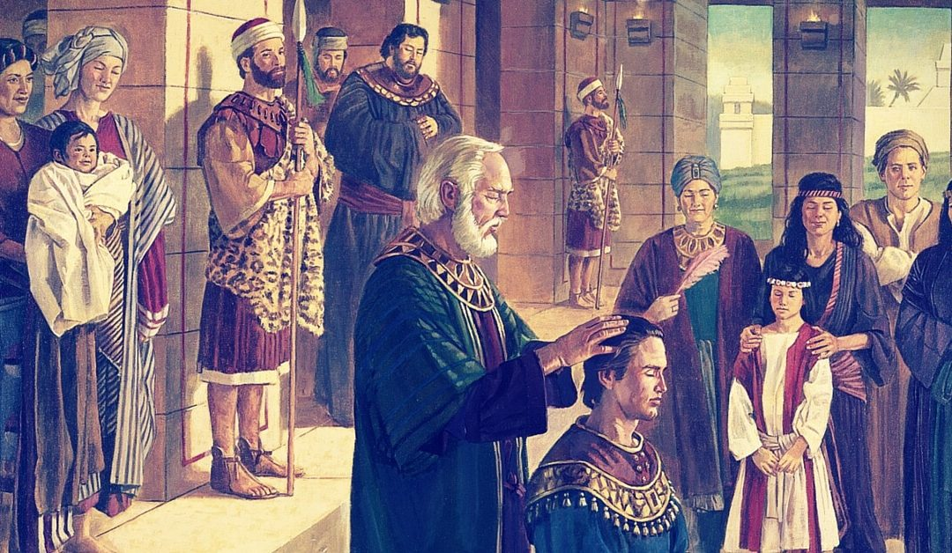
Righteous Leadership
What do we learn from the examples of King Mosiah, his sons, and Alma (Alma 4:15-18)?

Slide 19
False Leadership
What is the “way” of leadership in today’s society? In our country? In the world? How does it make you feel? What can we do about it?
We have learned by sad experience that it is the nature and disposition of almost all men, as soon as they get a little authority, as they suppose, they will immediately begin to exercise unrighteous dominion.
—Joseph Smith, D&C 121:39
Popularity, fame, fortune, “intelligence”…lead people away.
Nehor (Alma 1:1-5)
Amlici (Alma 2:1-7)

Slide 20
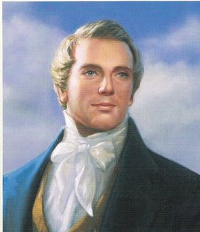
Our Duty…
Joseph Smith: “It is our duty to concentrate all our influence to make popular that which is sound and good, and unpopular that which is unsound” (in History of the Church, 5:286).
In what ways can we “make popular that which is sound and good”?

Slide 21
Pure Testimony
Pure testimony & its effect on people (Alma 4: 19-20)
What is meant by “pure testimony?”
Why did Alma give up his position, his job, to preach to the people?
What can we learn, personally, from Alma?
How can we make the biggest impact with our fellow man, in helping them “Come unto Christ?”

Slide 22
Personal Inventory
Have you experienced “a mighty change”?
If so, do you still feel it? What are you doing each day to keep this change or to bring it about?
What can you do to help “make popular that which is sound and good, and unpopular that which is unsound”? Are you doing so now? How can you start today?
Challenge: Share your thoughts/feelings about today’s lesson and/or your favorite scripture with friends, family or on social media.

