Slide 1
The Book of Mormon
Another Testament of
Jesus Christ
Lesson 9: Words of Mormon-Mosiah 6
Serve, Love, & Give Thanks to God
Christina G. Hibbert
christi@drchristinahibbert.com

Slide 2
What makes a good leader?
LEADERSHIP

Slide 3
Sherem-The AntiChrist
Tried to “overthrow the doctrine of Christ” by teaching “there should be no Christ” (Jacob 7:2
He “labored diligently that he might lead away the hearts of the people” & sought “much opportunity” to come to Jacob (3), “he was learned,” “he could use much flattery and much power of speech,” (4)
What was he trying to do here? Do we see this happening today?
What is Jacob’s response? (Read v.5;8-12)
The moral of the story? (21-23)
Notes:
--Verse 4 explains how and why he is so successful—because he worked “according to the power of the devil.”
--Verse 6-”the gospel or the doctrine of Christ”. The “gospel” IS the doctrine of Christ.
--13-Sherem asks for a sign and 14-Jacob replies “thy will, O Lord, be done, and not mine.” Great faith! His power is truly in His God, and he doesn’t need to show signs or “prove” anything, because he simply knows the truth and speaks the truth and knows God will handle what needs to be handled. And in 15, he gets his “sign” and “is nourished for the space of many days”. Nourished! The Love of God is truly the greatest of all.

Slide 4
President Ezra Taft Benson
On apostasy…
“1. What do the standard works have to say about it? …The Book of Mormon, Brigham Young said, was written on the tablets of his heart and no doubt helped save him from being deceived. …
“2. The second guide is: what do the latter-day Presidents of the Church have to say on the subject—particularly the living President? …
“3. The third and final test is the Holy Ghost—the test of the Spirit. … This test can only be fully effective if one’s channels of communication with God are clean and virtuous and uncluttered with sin. Said Brigham Young: ‘You may know whether you are led right or wrong … for every principle God has revealed carries its own convictions of its truth to the human mind. …’
“‘What a pity it would be if we were led by one man to utter destruction!’” (in Conference Report, Oct. 1963, 16–17).
Notes:
How can you apply these questions in your life to prevent deceptions from creeping in?

Slide 5
Jacob’s Farewell
7:26-7
A sad farewell (Nibley)—
His manner of writing is forward and direct and to the point. Compare against Nephi’s.
More proof of the truthfulness of the Book of Mormon

Slide 6
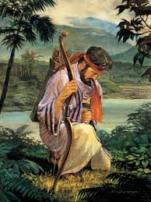
Enos’ Wrestle Before God
Enos 1:1-His father was a just man and taught him “in the nurture and admonition of the Lord”
“Wrestle before God…” (2)
Hope for parents (1,3)
“My soul hungered...”(4) “I cried unto him in mighty prayer...” “all the day long...” “and when the night came...”

Slide 7
Pres. Spencer W. Kimball
“How many of you have thus persisted? How many of you, with or without serious transgressions, have ever prayed all day and into the night? Have you ever wept and prayed for many hours? How many of you have prayed for five hours? For one? For thirty minutes? For ten?... How much do you pray, my young friends? How often? How earnestly? If you should have errors in your life, have you wrestled before the Lord? Have you found your deep forest full of solitude? How much has your soul hungered? How deeply have your needs impressed your heart? When did you kneel before your Maker in total quiet? For what did you pray—your own soul? How long did you thus plead for recognition—all day long and when the shadows fell, did you still raise your voice in mighty prayer, or did you liquidate it with some trite word and phrase? As you struggle in the spirit and cry mightily and covenant sincerely, the voice of the Lord God will come into your mind, as it did to that of Enos, ‘…Thy sins are forgiven thee, and thou shalt be blessed.’” (Prayer, BYU Speeches of the Year, 11 Oct. 1961, pp.8-9)
Notes:
Enos didn’t wrestle with God, as too many of us do. Instead, he wrestled with himself, before God. Enos’ wrestle involved “yearning to do God’s will. Such prayers are assisted and guided by the Holy Spirit, who intercedes ‘with groanings which cannot be uttered.’ Note Enos’ choice of words in these verse, ‘sunk deep’ (1:3), ‘hungered,’ “cried unto him in mighty prayer and supplication,’ ‘all the day long did I cry,’ ‘I did still raise my voice high’ (v.4).” (BOM Student Manual, 1981) Have we ever “wrestled” before God in such a way?

Slide 8
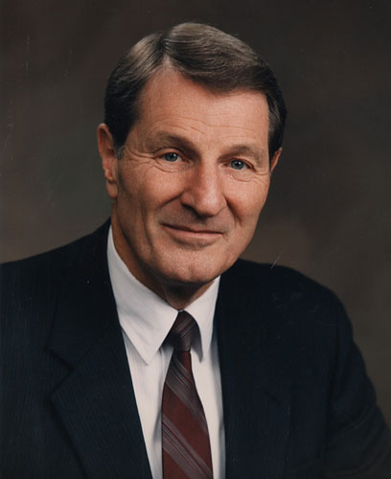
Elder Neal A. Maxwell
“Petitioning in prayer has taught me, again and again, that the vault of heaven with all its blessings is to be opened only by a combination lock. One tumbler falls when there is faith, a second when there is personal righteousness; the third and final tumbler falls only when what is sought is, in God’s judgment—not ours—right for us. Sometimes we pound on the vault door for something we want very much and wonder why the door does not open. We would be very spoiled children if that vault door opened any more easily than it does. I can tell, looking back, that God truly loves me by inventorying the petitions He has refused to grant me. Our rejected petitions tell us much about ourselves but also much about our flawless Father” (“Insights,” New Era, Apr. 1978, 6).

Slide 9
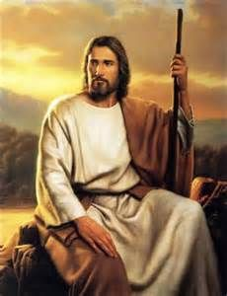
Amaleki’s Testimony
“And now, my beloved brethren, I would that ye should come unto Christ, who is the Holy One of Israel, and partake of his salvation, and the power of his redemption. Yea, come unto him, and offer your whole souls as an offering unto him, and continue in fasting and praying, and endure to the end; and as the Lord liveth ye will be saved.”
Omni 1:26
Notes:
The plates pass from Jacob to his son, Enos, to his son, Jarom (“what could I write more than my fathers have written?” Jarom 1:2), to his son, Omni (“I of myself am a wicked man, and I have not kept the statues and the commandments of the Lord as I ought” Omni 1:2), to his son, Amaron (“Inasmuch as ye shall keep the commandments yet shall not prosper in the land” Omni 1:6), to his brother Chemish (“I saw the last which he wrote, and he wrote it with his own hand” (Omni 1:9), to his son, Abinadom (“I know of no revelation save that which is written” Omni 1:11), to his son, Amaleki, who teaches of the first King Mosiah, of how he led the people out of the land of Nephi at the Lord’s warning, and came upon the people of Zarahemla, who had left from “Jerusalem at the time Zedekiah, king of Judah, was carried away” (Omni 15), how the Nephites, under Mosiah, united with the people of Zarahemla (19), taught them in their language (18), and even interpreted by the gift and power of God (20). He also tells of Coriantumr, the last of the Jaredites. Essentially foreshadowing what is to come. Could Joseph smith have done this? No. He could never have created such a tale, with so many people involved, and tied it together so remarkably, with different voices and writings. Yes, this Book of Mormon is most definitely divinely inspired, from God.

Slide 10
3 Groups of People
(Omni 1:12-17)
The Nephites
The Mulekites (Omni 1:15)
  Joined the Nephites (1:19)
The Jaredites
Notes:
•
In this short account, we learn of three groups of people whom the Lord brought to the land of promise in the Western Hemisphere. The first group mentioned was Lehi’s colony. The majority of the Book of Mormon relates their story and that of their descendants.
The Book of Mormon also identifies a second group, referred to as the people of Zarahemla, who were descendants of Mulek and who joined the Nephites (see Mosiah 25:2). Mulek, a son of King Zedekiah, left Jerusalem and traveled to the Americas after Babylon destroyed Jerusalem around 587 B.C. (see Omni 1:15). Without a scriptural record, the people of Zarahemla were a living witness of what the Spirit said to Nephi that a whole nation would dwindle in unbelief (see 1 Nephi 4:13). The Mulekites then joined with the Nephites under the rule of King Mosiah (see Omni 1:19).
The third group was the Jaredites, who came to the land of promise following the time of the “great tower” mentioned in Genesis 11. The original Jaredite colony grew into a great race. Eventually, however, they annihilated themselves in a great civil war sometime between 600 and 300 B.C., leaving only Coriantumr, their last king, and Ether, a prophet of the Lord (see Ether 15:29–34). Ether finished the record, and Coriantumr apparently wandered until he found the people of Zarahemla, where he lived “for the space of nine moons” (Omni 1:21) before dying. Little is known of the Jaredites other than what is recorded by Moroni in the book of Ether.

Slide 11
Words of Mormon
Mormon includes the small plates “for a wise purpose” in the Lord ( 1:7)
Elder Jeffrey R. Holland stated: “At least six times in the Book of Mormon the phrase ‘for a wise purpose’ is used in reference to the making, writing, and preserving of the small plates of Nephi (see 1 Nephi 9:5; Words of Mormon 1:7; Alma 37:2, 12, 14, 18). You and I know the wise purpose—the most obvious one—was to compensate for the loss of the earlier mentioned 116 pages of manuscript. But it strikes me that there is a wiser purpose than that…The key to such a suggestion of a wiser purpose is in verse 45 of Doctrine and Covenants section 10. As the Lord instructs Joseph … he says, ‘Behold, there are many things engraven upon the [small] plates of Nephi which do throw greater views upon my gospel’ (emphasis added).
“So, clearly, this was not … tit for tat, this for that—you give me 116 pages of manuscript and I’ll give you 142 pages of printed text. Not so. We got back more than we lost. And it was known from the beginning that it would be so. It was for a wiser purpose. We do not know exactly what we missed in the 116 pages, but we do know that what we received on the small plates was the personal declarations of three great witnesses [Nephi, Jacob, and Isaiah], three of the great doctrinal voices of the Book of Mormon, testifying that Jesus is the Christ…In fact, I think you could make a pretty obvious case that the sole purpose of the small plates was to give a platform for these three witnesses” (“A Standard unto My People” [Church Educational System symposium on the Book of Mormon, Aug. 9, 1994], 9–10; see LDS.org under gospel library/additional addresses/CES addresses).
Notes:
-Nephi made small plates 30 years after Lehi’s colony left Jerusalem (see 2 Nephi 5:28–31)
-He didn’t understand why he was commanded to make a second set of records, but he had faith that it was “for a wise purpose” in the Lord (1 Nephi 9:5).
-Nearly 1,000 years later the prophet Mormon echoed similar words to Nephi’s when he testified that in addition to his abridgment of the large plates of Nephi he was including the small plates of Nephi “for a wise purpose” (Words of Mormon 1:7).
-Joseph Smith started the translation of the Book of Mormon with Mormon’s abridgment of the large plates of Nephi. He had completed 116 manuscript pages when Martin Harris pleaded with Joseph to let him take the manuscript and show it to family members. Joseph asked God three different times if Martin could take the manuscript, and permission was finally given. The manuscript fell into the hands of wicked men (see D&C 10:8) and became known as lost manuscript, lost 116 pgs
-The loss of the manuscript shows why the Lord commanded Nephi to write the small plates and why Mormon was inspired to include them.
-Joseph Smith was told not to retranslate the portion he had already completed, but to replace it by translating the small plates of Nephi (see D&C 10:30, 38–45). -The translation of the 116 pages covered 600–130 B.C.—from the time of Lehi to the time of King Benjamin. The small plates also covered 600–130 B.C.— from Lehi to King Benjamin. The Lord in His omniscience had the second record, the small plates, cover the exact time period that was covered in the stolen 116 pages. This also allowed the Lord to keep His covenant with Enos that “he would preserve the records” (Enos 1:16).
(Rel 121-122 Student Manual)
--Truly, “the Lord knoweth all things which are to come” (1:7)

Slide 12
King Benjamin Quiz
King Benjamin fought with the sword of Laban against the Lamanites.
Throughout King Benjamin’s reign, all the people loved him and accepted his counsel.
King Benjamin single-handedly established righteousness among the Nephites.
King Benjamin taught his sons the language of his fathers so they could search the scriptures and know the mysteries of God.
King Benjamin called the people together to hear him speak for political and spiritual reasons.
(True; see Words of Mormon 1:13; see also Omni 1:24.)
(False; see Words of Mormon 1:16; however, see also Mosiah 1:1.)
(False; see Words of Mormon 1:17–18.)
(True; see Mosiah 1:2–4.)
(True; see Mosiah 1:10–11.)

Slide 13
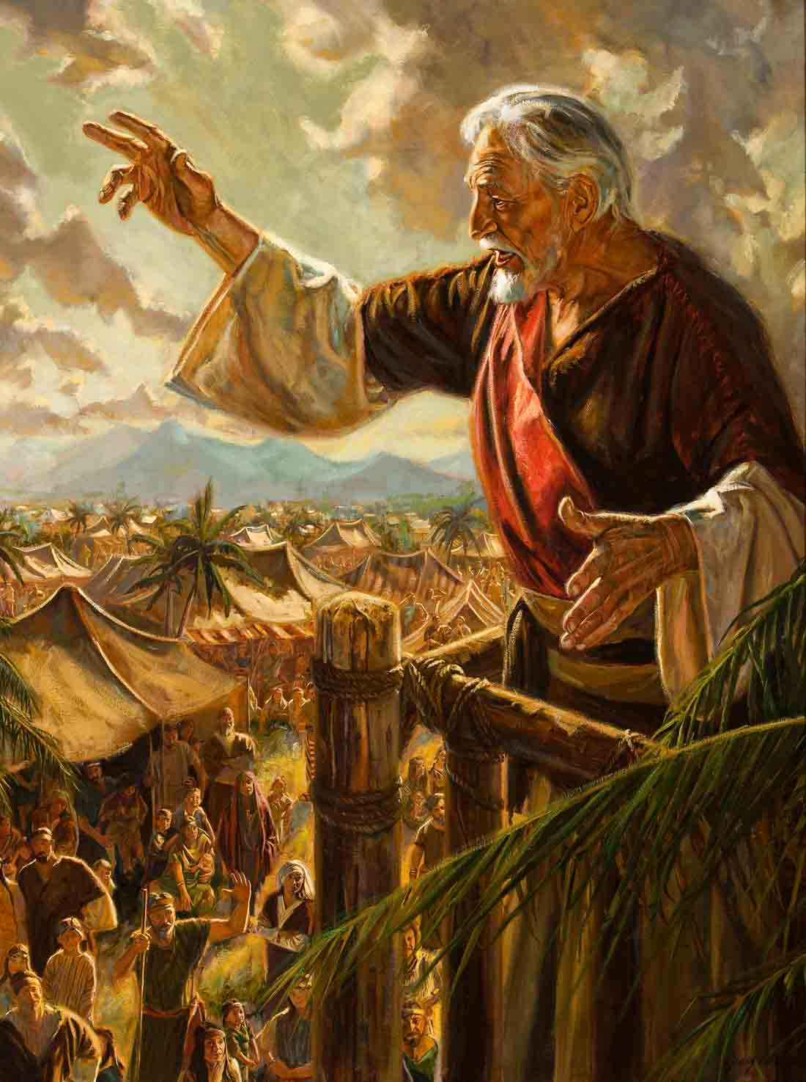
King Benjamin’s Address..
He “was a holy man and did reign over his people in righteousness.”(W of M 1:17)
Called people together to:
  Name a new king (Mosiah 1:10)
  Give the people a name and ask them to take it by covenant—the name of Christ (1:11-12)
Opens by reminding the people he was mortal, just like them, “subject to all manner of infirmities in body & mind” (2:14)
Principal themes: Service-to others and to God; Gratitude, Indebtedness to God, & Humility (“O how you ought to thank your heavenly king!”) (2:19)
Notes:
-The people pitched their tents around the temple with the doors open, facing the temple. What does this tell us about his people? What does it tell us we should do?
-The multitude was so great that they had to build a tower for him to speak, and eventually had to write and distribute his words among the people (Mosiah 2:8)
--**”Unconcerned about personal power or riches, Benjamin was a remarkably effective leader, a selfless man of solid integrity, a model king. Not only did he establish peace in his nation but he also managed to maintain it, largely by hard work and unflinching faith. Benjamin exemplified all that is best in human character.” (BOM Reference Companion, pg. 91)**

Slide 14
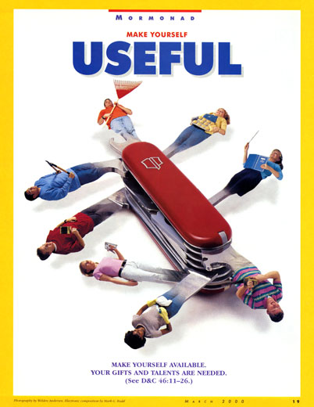
“We are accountable to God for the way we serve others.”
Mosiah 2:9-18
Notes:
In what ways have you felt your acts of service to others have also been to the Lord?
Can you think of a time when you followed a prompting to serve someone? How did you feel when responding?

Slide 15
Pres. Marion G. Romney
“By serving and lifting others … we experience the only true and lasting happiness. Service is not something we endure on this earth so we can earn the right to live in the celestial kingdom. Service is the very fiber of which an exalted life in the celestial kingdom is made.
“Knowing that service is what gives our Father in Heaven fulfillment, and knowing that we want to be where He is and as He is, why must we be commanded to serve one another? Oh, for the glorious day when these things all come naturally because of the purity of our hearts. In that day there will be no need for a commandment because we will have experienced for ourselves that we are truly happy only when we are engaged in unselfish service” (in Conference Report, Oct. 1982, 135; or Ensign, Nov. 1982, 93).
Notes:
Do you believe Pres Romney’s statement that “we are truly happy only when we are engaged in unselfish service” is true? Why?

Slide 16
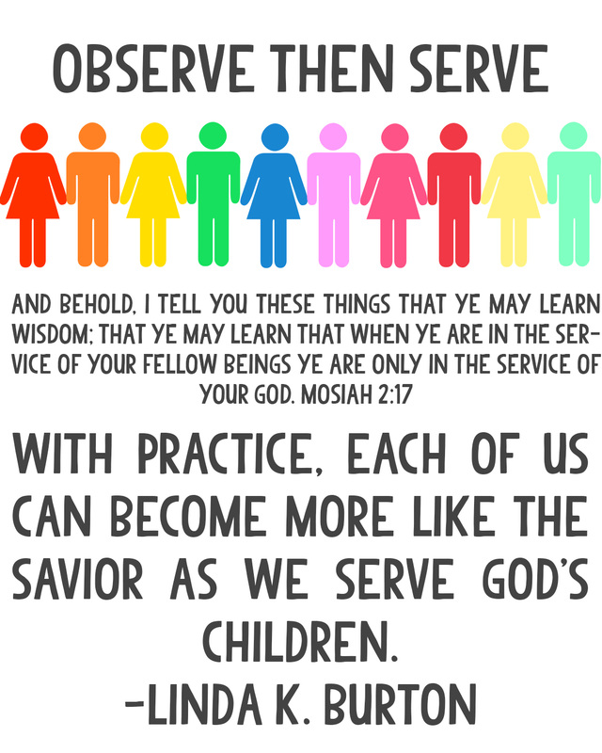

Observe, then Serve

Slide 17
We are Eternally Indebted to God
Write 5 things you’re thankful for.
Mosiah 2:19-24
  He has created, kept and preserved us; he has granted us life and peace with others in life (20; 23)
  He gives us breath, agency, and constant support (21)
  If we keep His commandments He blesses and prospers us immediately (22;24)
  “He hath paid [us], and [we] are still indebted to him…”(24)
Notes:
It’s almost Thanksgiving time, so think of and Write down 5 blessings you’re grateful for.
Then, review Mosiah 2:19-24 silently.
What blessings did King Benjamin suggest we be thankful for?

Slide 18
The words of an angel..
(Mosiah 3)
Prophesy of the coming Savior (3:5-18)
Only through Christ’s name can salvation come (17)
The “natural man is an enemy to God…unless he yields to the enticings of the Hoy Spirit...” (19)
The people believe, cry for purification through Christ, and “the Spirit of the Lord” comes upon them (4:2-3)
Benjamin returns to themes of humility and indebtedness of God & counsels the people how to maintain this state (4:11)
Teaches how to “succor those..in need of your succor” (4:16) “For…are we not all beggars?” (19-21)
Wise, important advice: 4:27 & 30
Notes:
READ 3:2-4 The Lord heard his prayers and sent this message to give “joy” to all the people
Here, Benjamin introduces the theme of salvation through Jesus Christ
He then revisits the theme of Humility in verse 19, which is essential for salvation.
The people receive his words and cry for their hearts to be purified through “the atoning blood of Christ” (4:2) and the “Spirit of the Lord comes upon them” and gives them peace of conscience and joy (4:3).

Slide 19
Benjamin’s Final Request
Do you believe? (5:1)
Have YOU experienced “a mighty change…in our hearts…to do good continually” (5:2)
Will you covenant to take upon you the name of Christ? (5:5)
Then, “ye shall be called the children of Christ, his sons and daughters…There is no other name given whereby salvation cometh; therefore I would that ye should take upon you the name of Christ...And it shall come to pass that whosever doeth this shall be found at the right hand of God, for he shall know the name by which he is called; for he shall be called by the name of Christ.” (5:7-10)
“Be steadfast and immovable...” (5:15)
Notes:
Do YOU believe? Can you respond as King Benjamin’s people did, in verse 2?
Have YOU experienced this mighty change? Why do we need a “mighty” change? Do you feel the faith the people did? (v.4)

Slide 20
Personal Inventory
Do you take upon you the name of Christ? How so?
How are you seeking to serve God and others each day?
What are you truly thankful for? Do you express your gratitude often—to the Lord and others?
How can you remember your “nothingness” while also remembering you are a “son or daughter of God?”
How will you apply King Benjamin’s words this week?

Slide 21

Next Week
Mosiah 7-24
SM Lessons 20-21

