Slide 1
The Book of Mormon Another Testament of Jesus Christ
Jacob 5-Omni
“O, Be Wise!”
The Allegory of the Olive Tree
Christina G. Hibbert
christi@drchristinahibbert.com
www.DrChristinaHibbert.com
www.LikeAWateredGarden.com

Slide 2
Knowledge vs. Understanding vs. Wisdom
Notes:
What does it mean to you to “know” something? What does it mean to “understand” something? What does it mean to you to “be wise?” Do you believe there’s a difference between knowledge, understanding, and wisdom? If so, what would that be?
In my mind, there is a difference between these related, but separate concepts. First, knowledge. To know something implies a mental comprehension of an idea or concept. However, we may know something but not understand it. Understanding takes knowing a step further—it involves the heart. It means we “get it” in a way that only knowing doesn’t always include. For example, I may know the theory of relativity and be able to repeat it, but still not “get it.”
Wisdom goes another step further. Wisdom involves knowing in the head, feeling in the heart, and communing with God in the soul. Wisdom is a vertical process, involving our Higher Power.

Slide 3
“Speak with the tongue of angels”
2 Nephi 32:2
What does this mean?
Boyd K. Packer: “Nephi explained that angels speak by the power of the Holy Ghost, and you can speak with the tongue of angels, which simply means that you can speak with the power of the Holy Ghost. It will be quiet. It will be invisible. There will not be a dove. There will not be cloven tongues of fire. But the power will be there” (“The Gift of the Holy Ghost: What Every Member Should Know,” Ensign, Aug. 2006, 49–50).

Slide 4
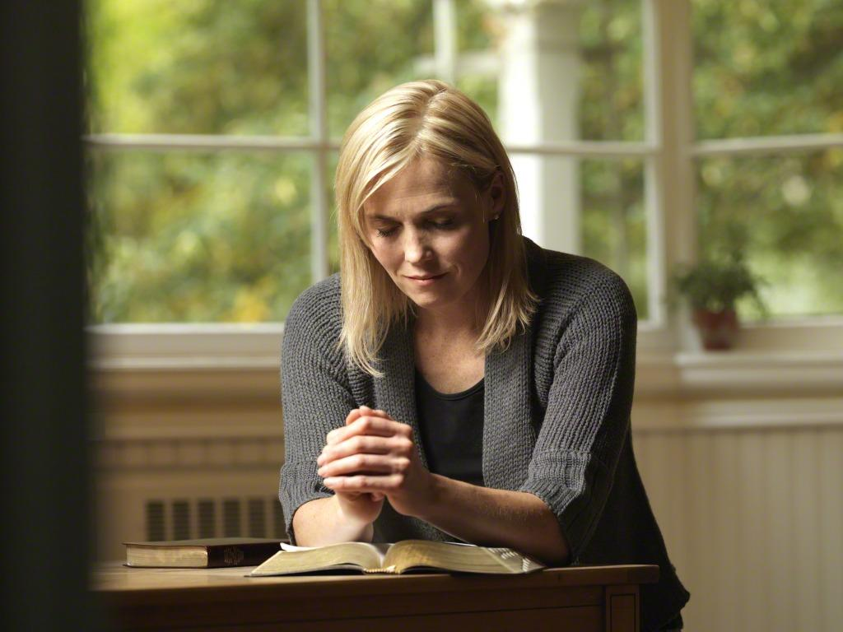
“Pray Always”
2 Nephi 32:9
Can we pray too much or often? (Nephi’s example- 33:3)
What prevents us from “praying always?”
What does 32:8 tell us of neglecting to pray?

Slide 5
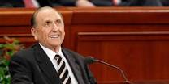
Pres. Thomas S. Monson
“Men and women of integrity, character, and purpose have ever recognized a power higher than themselves and have sought through prayer to be guided by such power.”
Notes:
Do you feel this way? What are you doing about it, if so? If not, what is one thing you can do to desire and seek this “power” of prayer?

Slide 6
“Carried unto the heart”
Elder David A. Bednar:
“Please notice how the power of the Spirit carries the message unto but not necessarily into the heart. A teacher can explain, demonstrate, persuade, and testify, and do so with great spiritual power and effectiveness. Ultimately, however, the content of a message and the witness of the Holy Ghost penetrate into the heart only if a receiver allows them to enter” (“Seek Learning by Faith” [an evening with Elder David A. Bednar, Feb. 3, 2006]
Notes:
2 Nephi 33:1

Slide 7
Dallin H. Oaks
“President Hinckley stated an important corollary to the command to teach by the Spirit when he issued this challenge:
“‘We must … get our teachers to speak out of their hearts rather than out of their books, to communicate their love for the Lord and this precious work, and somehow it will catch fire in the hearts of those they teach’ [Teachings of Gordon B. Hinckley (1997), 619–20].
“That is our objective—to have love of God and commitment to the gospel of Jesus Christ ‘catch fire’ in the hearts of those we teach” (in Conference Report, Oct. 1999, 103; or Ensign, Nov. 1999, 80).
Notes:
Have you experienced this, as a teacher or a learner? How can we encourage the gospel of Jesus Christ to “catch fire” in our hearts and others’?

Slide 8
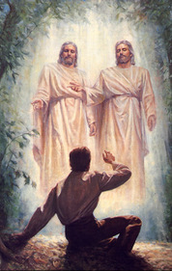
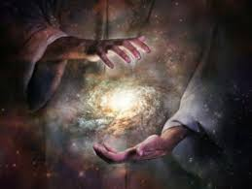
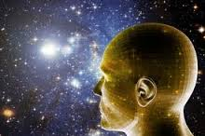
What May we Gain?
2 Nephi 32:7; 1 Nephi 10:19
If we are willing to “search knowledge,” then we will be blessed with “understanding” “great knowledge!”
Notes:
We can know the “mysteries of god”! It’s what we are here for, and we will be taught line upon line as we make ourselves ready to receive.

Slide 9
Love & Example of Nephi
33:3 Great love for his people
Weakness becomes strength through Christ (4) (Ether 12:27)
Nephi’s farewell (33:10)
V.11 We shall meet Nephi!
V.12 He prays for all=great love
V. 13 “A voice crying from the dust”
Jacob 1:12 Nephi dies, having loved, protected, defended, and labored all his days for his people. (10)
They name all future kings after him because they love him so.
Notes:
Jacob & Moroni made very similar comments (Jacob 6:13; Moroni 10:27)
Hugh Nibley: “…Nephi says in verse 11: ‘and you and I shall stand face to face before this bar’ [and I think that is true—I have reason for believing that’s literally so].” (loc 3744, Commentary on the Book of Mormon)
Nephi’s Farewell: Hugh Nibley says “(READ 2 ne 33:13-15 first)...Can you imagine a sadder ending than that? He was of a cheerful disposition—terribly optimistic, as you know. He was always dragging the family through dirty situations. But here he says, “For thus hath the Lord commanded me, and I must obey. Amen.” (loc 3750, Commentary..)

Slide 10
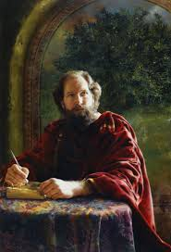
Jacob
Jacob’s purpose (1:1-4;7-8; 19)
What kind of man is he? Elder Jeffrey Holland:
“No prophet in the Book of Mormon, by temperament or personal testimony, seems to have gone about that work of persuasion any more faithfully than did Jacob. He scorned the praise of the world, he taught straight, solid, even painful doctrine, and he knew the Lord personally. His is a classic Book of Mormon example of a young man’s decision to suffer the cross and bear the shame of the world in defense of the name of Christ. Life, including those difficult early years when he saw the wickedness of Laman and Lemuel bring his father and mother down to their graves in grief, was never easy for this firstborn in the wilderness” (Christ and the New Covenant [1997], 62–63).
Notes:
He fulfills his Purpose but with great anxiety: READ Jacob 1:4, 8 Nibley, “This is his writing. Its PROTREPTIC, it’s a SUASORIA. That’s a type of writing that’s devoted to persuading somebody to do something. PROTREPTIC is to enjoin somebody; a SUASORIA is to change your way of life, your behavior. It’s an appeal, and that’s what Jacob is [doing] here.” (Commentary on BOM, loc 3767)
Wikipedia: “In rhetoric, protrepsis (Greek: πρότρεψις) …[is a] style[s] of exhortation that [was] employed by moral philosophers.
“Suasoria is an exercise in rhetoric; a form of declamation in which the student makes a speech which is the soliloquy of a historical figure debating how to proceed at a critical junction in their life.^{[1]}
The exercise was used in ancient Rome, where it was, with the controversia, the final stage of a course in rhetoric at an academy.
“
Called of God, Obedient to Nephi, Magnifies his calling, Obeys the Lord, Strong speaker, courageous and straightforward

Slide 11
Jacob’s Sermon
Has to speak of their wickedness. He doesn’t want to, but he obeys. (Jacob 2:2-11)
Pride (13,16) (#1 Sin in the Book of Mormon)
“Seek the kingdom of God” and riches “to do good” (17-19)
“Grosser crime”- Whoredoms (23)
The Lord delights in chastity (28)
He is mindful of our pain/suffering (33)
Notes:
Nibley, Commentary on the BOM:
Jacob really doesn’t want to have to do this. “This is like pulling teeth; he hates it. Boy, does he hate it, but he has to go through with it…He must declare the word
“Jacob 2:9,10” A CONSOLATIO (like latin), a consolation; they wanted to be cheered up. We find out pretty soon that the women were overworked. They were practically captives and were under strain while their husbands gallivanted around collecting the gold, etc. Their children suffered accordingly, and they came to the temple to hear the consoling word of God and to be comforted. But what do they have to hear? He says. They have to hear this talk that is terrible. He said that is made him ashamed of himself. But he said that he had received from God a strict commandment”. It was not his idea.” (loc 3817)
The Lord knows our pains and sorrows and suffering and will send help and comfort through the Atonement
Nibley “Notice the male chauvinism in verses 31-33. ‘For behold, I, the Lord, have seen the sorrow, and heard the mourning of the daughters of [Israel]…because of the wickedness and abominations of their husbands...For they shall not lead away captive the daughters of my people [the women are practically prisoners; they have a ver male oriented, chauvinistic society; the women have to do all the cooking and set up the tepee and everything else]...for they shall not commit whoredoms, like them of old, saith the Lord of Hosts...Jacob 2:35 That’s a verse I like. It’s very appropriate: “Behold ye have done greater iniquities than the lamanites our brethren. Ye have broken the hearts of your tender wives, and lost the confidence of your children [they wrecked the family], because of your bad examples before them;...And because of the strictness of the word of God, which cometh down against you, many hearts died, pierced with deep wounds.” Notice that the word of God had specifically forbidden it, and because of that it was even more painful on the women and the children. The gospel had always taught them that you shouldn’t do those things. The disruption of LDS families is doubly tragic, and it does happen too. “Many hearts died, pierced with deep wounds,” knowing of these lusts. The word of God is strict, and breaking it compounds the disaster...” “Are we going to get anything cheerful out of Jacob?...” (loc 3873)

Slide 12
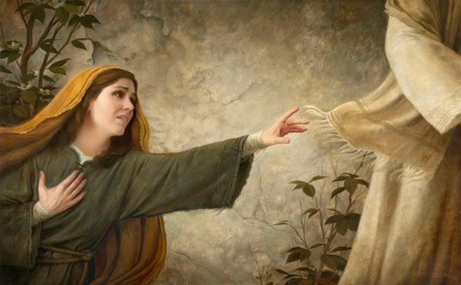
A lesson about anxiety… (Jacob 1:5)
Notes:
Jacob 1:5
Faith AND great anxiety= learning, growth, understanding

Slide 13
“Before ye seek for riches”
Notes:
Read: Jacob 2:18-19

Slide 14
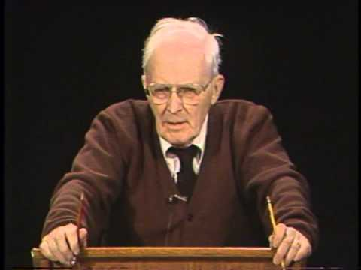
“Arouse the faculties of your souls”!
“You have to make an effort; it’s exactly like a drugged sleep that you get into. You get deeper and deeper, and it takes you right out of this world. To be wakened up is going to take an awful lot of black coffee, walking back and forth, and shaking your shoulders. This awakening isn’t gentle. It’s rude, decisive, and urgent, but it must be done, he says. You’ve got to wake up to this…”
~Hugh Nibley
(Commentary on the Book of Mormon, loc. 3931)
Notes:
Jacob 3:11-”Arouse the faculties of your souls; shake yourselves that ye may awake from the slumber of death and loose the pains of hell..”!

Slide 15
Purposes of Scriptures
Jacob 4:4-8
All generations have known and worshipped Christ (4-5)
The scriptures “point our souls to him” (5)
Help us “search the prophets” and “revelations” and obtain the “spirit of prophecy” to “obtain a hope” and have “faith…unshaken” (6)
Teaches us how to be like Christ, even to “command in the name of Jesus” (6)
Remind us of His grace (7) and teach us “the mysteries of him” (8)
To teach us of Christ’s Atonement (12)
Notes:
--It wasn’t easy for the prophets of old to keep these records upon the plates. Though they knew they would last this way, it was hard work and they had limited space. (Jacob 4:1-3)
--

Slide 16
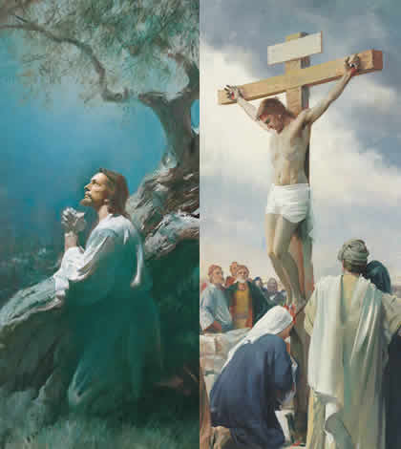
The Atonement
Jacob wraps up this part of his sermon by showing HOW to overcome these sins—The Atonement
Jacob 4:12
Speak of Christ, gain a “perfect knowledge” of Him
At-one-ment
Speaks to the “pure in heart” (3:1-2) Beautiful!!**

Slide 17
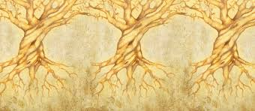
Allegory of the Olive Tree
What is an “allegory?” What does the allegory of the olive tree teach us of Jesus Christ? Of ourselves?
Notes:
“Jacob recorded Zenos’ allegory of the olive trees, illustrating the Lord’s constant effort to save the house of Israel (see Jacob 5). As you teach this allegory, you can emphasize that the Lord “stretches forth his hands … all the day long” for our salvation (Jacob 6:4).” Teacher’s Manual Rel 121-122

Slide 18
Jeffrey R. Holland
“This allegory as recounted by Jacob is from the outset intended to be about Christ. …Even as the Lord of the vineyard and his workers strive to bolster, prune, purify, and otherwise make productive their trees in what amounts to a one-chapter historical sketch of the scattering and gathering of Israel, the deeper meaning of the Atonement undergirds and overarches their labors.
“In spite of cuttings and graftings and nourishings that mix and mingle trees in virtually all parts of the vineyard, it is bringing them back to their source that is the principal theme of this allegory. Returning, repenting, reuniting—at-one-ment—this is the message throughout.’“… At least fifteen times the Lord of the vineyard expresses a desire to bring the vineyard and its harvest to his ‘own self,’ and he laments no less than eight times, ‘It grieveth me that I should lose this tree.’ One student of the allegory says it should take its place beside the parable of the prodigal son, inasmuch as both stories ‘make the Lord’s mercy so movingly memorable.’
“Clearly this at-one-ment is hard, demanding, and, at times, deeply painful work, as the work of redemption always is. There is digging and dunging. There is watering and nourishing and pruning. And there is always the endless approaches to grafting—all to one saving end, that the trees of the vineyard would ‘thrive exceedingly’ and become ‘one body; … the fruits [being] equal,’ with the Lord of the vineyard having ‘preserved unto himself the … fruit.’ From all the distant places of sin and alienation in which the children of the Father find themselves, it has always been the work of Christ (and his disciples) in every dispensation to gather them, heal them, and unite them with their Master” (Christ and the New Covenant[1997], 165–66).

Slide 19
Background
Notes:
See Nibley “Commentary on the Book of Mormon,” loc 4137-4171.
Nibley began with a text called Biblical Antiquities, attributed to an unknown author “Pseudo-Philo.” Though Biblical Antiquities was written around the time of Christ, it likely contains considerably older material. Biblical Antiquities gives a history of the Jews from the Creation to the destruction of Jerusalem. It includes stories about a great prophet-leader named Cenez. In some versions of the text, the name Cenez is spelled Zenec or Zenez (variants of the name Cenez).
See video “Is anything known of the prophet Zenos outside the Book of Mormon?” from Book of Mormon Central.

Slide 20
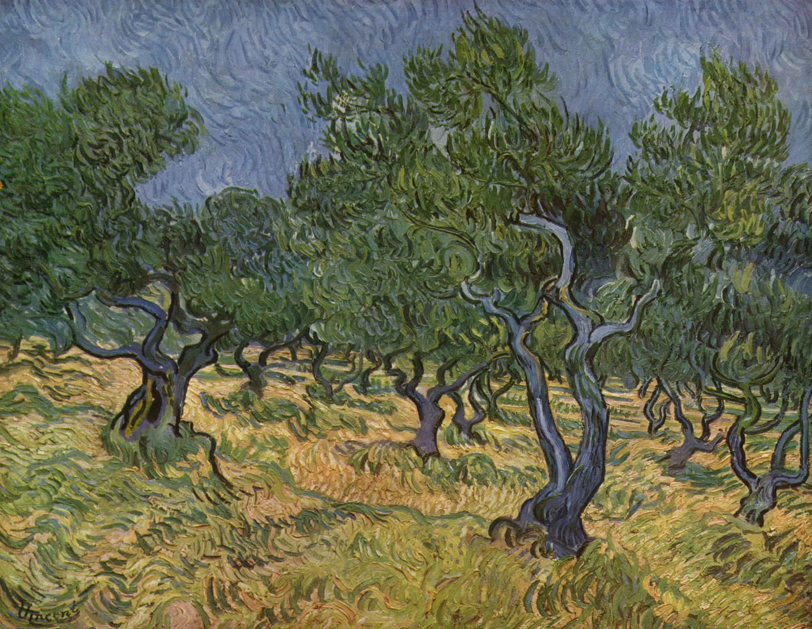
Symbols
Review Jacob 5:3-9 What symbols do you find?
The Vineyard- The world
Tame olive tree- House of Israel
Wild olive tree- Gentiles
Branches- Groups of people
Roots of Tame tree- Gospel covenants/promises
Fruit- The lives or works of men
Digging, pruning, fertilizing- The Lord’s work w His children
Transplanting branches- scattering groups throughout the world, or restoring them
Grafting- The process of spiritual rebirth through which one is joined to the covenant
Decaying branches- Wickedness/apostasy
Casting branches into the fire- The judgment of God
Notes:
Wild—later, the wild branches represent apostate Israel

Slide 21
4 “Times”
Notes:
If we break it down, there were actually 4 visits to the Vineyard. Let’s look at each.
Jacob 5: 3-14 The Scattering of Israel
15-28 The Time of Christ
29-49 The Great Apostasy
50-77 The Gathering of Israel
As you read these verses, what do you learn about the Savior? What do you learn about the plan of salvation? What do you learn about your own life?

Slide 22
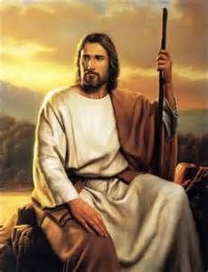
What does this mean for us?
The Lord will “Nourish” us--prune, dig, dung, (4; 64)
Our day—5:51-53 (Israel—Gathering of, Restoration of)
61-72 Our “call” to “labor with all our might” Will we be chosen? (70)
Our purpose/House of Israel’s goal= become one (74)
All are equal in the Lord
Christ will reign for eternity! (75)
The World will end (77)

Slide 23
The Parable of Zenos
“The parable of Zenos, recorded by Jacob in chapter five of his book, is one of the greatest parables ever recorded. This parable in and of itself stamps the Book of Mormon with convincing truth. No mortal man, without the inspiration of the Lord, could have written such a parable. It is a pity that too many of those who read the Book of Mormon pass over and slight the truths which it conveys in relation to the history, scattering, and final gathering of Israel” (Answers to Gospel Questions, comp. Joseph Fielding Smith Jr., 5 vols. [1957–66], 4:141).

Slide 24
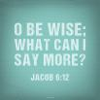
“O, be wise!”
Jacob 6:1—5
“O, be wise…” 6:12
Notes:
“O Be Wise…”
“…What can I say more?” (Jacob 6:12) Such a simple, yet powerful verse. How can we “be wise?” What does this look like on a daily basis for you? How can we help our children “be wise?” Truly, the only real wisdom comes from the Savior, from knowing Him, and especially from following Him. What can you do to know and follow the Savior more wisely?

Slide 25
Sherem-The AntiChrist
Tried to “overthrow the doctrine of Christ” by teaching “there should be no Christ” (Jacob 7:2
He “labored diligently that he might lead away the hearts of the people” & sought “much opportunity” to come to Jacob (3), “he was learned,” “he could use much flattery and much power of speech,” (4)
What was he trying to do here? Do we see this happening today?
What is Jacob’s response? (Read v.5;8-12)
The moral of the story? (21-23)
Notes:
--Verse 4 explains how and why he is so successful—because he worked “according to the power of the devil.”
--Verse 6-”the gospel or the doctrine of Christ”. The “gospel” IS the doctrine of Christ.
--13-Sherem asks for a sign and 14-Jacob replies “thy will, O Lord, be done, and not mine.” Great faith! His power is truly in His God, and he doesn’t need to show signs or “prove” anything, because he simply knows the truth and speaks the truth and knows God will handle what needs to be handled. And in 15, he gets his “sign” and “is nourished for the space of many days”. Nourished! The Love of God is truly the greatest of all.

Slide 26
President Ezra Taft Benson
On apostasy…
“1. What do the standard works have to say about it? …The Book of Mormon, Brigham Young said, was written on the tablets of his heart and no doubt helped save him from being deceived. …
“2. The second guide is: what do the latter-day Presidents of the Church have to say on the subject—particularly the living President? …
“3. The third and final test is the Holy Ghost—the test of the Spirit. … This test can only be fully effective if one’s channels of communication with God are clean and virtuous and uncluttered with sin. Said Brigham Young: ‘You may know whether you are led right or wrong … for every principle God has revealed carries its own convictions of its truth to the human mind. …’
“‘What a pity it would be if we were led by one man to utter destruction!’” (in Conference Report, Oct. 1963, 16–17).
Notes:
How can you apply these questions in your life to prevent deceptions from creeping in?

Slide 27
Jacob’s Farewell
7:26-7
A sad farewell (Nibley)—
His manner of writing is forward and direct and to the point. Compare against Nephi’s.
More proof of the truthfulness of the Book of Mormon

Slide 28
Enos’ Wrestle Before God
Enos 1:1-His father was a just man and taught him “in the nurture and admonition of the Lord”
“Wrestle before God…” (2)
Hope for parents (1,3)
“My soul hungered...”(4) “I cried unto him in mighty prayer...” “all the day long...” “and when the night came...”

Slide 29
Pres. Spencer W. Kimball
“How many of you have thus persisted? How many of you, with or without serious transgressions, have ever prayed all day and into the night? Have you ever wept and prayed for many hours? How many of you have prayed for five hours? For one? For thirty minutes? For ten?... How much do you pray, my young friends? How often? How earnestly? If you should have errors in your life, have you wrestled before the Lord? Have you found your deep forest full of solitude? How much has your soul hungered? How deeply have your needs impressed your heart? When did you kneel before your Maker in total quiet? For what did you pray—your own soul? How long did you thus plead for recognition—all day long and when the shadows fell, did you still raise your voice in mighty prayer, or did you liquidate it with some trite word and phrase? As you struggle in the spirit and cry mightily and covenant sincerely, the voice of the Lord God will come into your mind, as it did to that of Enos, ‘…Thy sins are forgiven thee, and thou shalt be blessed.’” (Prayer, BYU Speeches of the Year, 11 Oct. 1961, pp.8-9)
Notes:
Enos didn’t wrestle with God, as too many of us do. Instead, he wrestled with himself, before God. Enos’ wrestle involved “yearning to do God’s will. Such prayers are assisted and guided by the Holy Spirit, who intercedes ‘with groanings which cannot be uttered.’ Note Enos’ choice of words in these verse, ‘sunk deep’ (1:3), ‘hungered,’ “cried unto him in mighty prayer and supplication,’ ‘all the day long did I cry,’ ‘I did still raise my voice high’ (v.4).” (BOM Student Manual, 1981) Have we ever “wrestled” before God in such a way?

Slide 30
Amaleki’s Testimony
“And now, my beloved brethren, I would that ye should come unto Christ, who is the Holy One of Israel, and partake of his salvation, and the power of his redemption. Yea, come unto him, and offer your whole souls as an offering unto him, and continue in fasting and praying, and endure to the end; and as the Lord liveth ye will be saved.”
Omni 1:26
Notes:
The plates pass from Jacob to his son, Enos, to his son, Jarom (“what could I write more than my fathers have written?” Jarom 1:2), to his son, Omni (“I of myself am a wicked man, and I have not kept the statues and the commandments of the Lord as I ought” Omni 1:2), to his son, Amaron (“Inasmuch as ye shall keep the commandments yet shall not prosper in the land” Omni 1:6), to his brother Chemish (“I saw the last which he wrote, and he wrote it with his own hand” (Omni 1:9), to his son, Abinadom (“I know of no revelation save that which is written” Omni 1:11), to his son, Amaleki, who teaches of the first King Mosiah, of how he led the people out of the land of Nephi at the Lord’s warning, and came upon the people of Zarahemla, who had left from “Jerusalem at the time Zedekiah, king of Judah, was carried away” (Omni 15), how the Nephites, under Mosiah, united with the people of Zarahemla (19), taught them in their language (18), and even interpreted by the gift and power of God (20). He also tells of Coriantumr, the last of the Jaredites. Essentially foreshadowing what is to come. Could Joseph smith have done this? No. He could never have created such a tale, with so many people involved, and tied it together so remarkably, with different voices and writings. Yes, this Book of Mormon is most definitely divinely inspired, from God.

Slide 31
Offer Your Whole Souls
Omni 1:25-26
What do you feel is the relationship between coming unto Christ and offering our “whole souls as an offering unto him”?
The following statement by President Ezra Taft Benson offers an idea: “God loves us. He is watching us. He wants us to succeed. We will know someday that He has not left one thing undone for the eternal welfare of each of us. … This is our day to show what we can do—what life and sacrifice we can daily, hourly, instantly make for God. If we give our all, we will get His all from the greatest of all” (“Jesus Christ—Gifts and Expectations,” Ensign, Dec. 1988, 6).

Slide 32
Final Inspiration…
Elder Neal A. Maxwell taught the meaning of offering ourselves to the Lord:
“Real, personal sacrifice never was placing an animal on the altar. Instead, it is a willingness to put the animal in us upon the altar and letting it be consumed!” (in Conference Report, Apr. 1995, 91; or Ensign, May 1995, 68). On the same topic, Elder Maxwell later taught: “As you submit your wills to God, you are giving Him the only thing you can actually give Him that is really yours to give” (in Conference Report, Apr. 2004, 48; or Ensign, May 2004, 46).

Slide 33
Personal Inventory
In what ways can we serve the Lord in this final gathering? Specifically, what can you do? What will you do? When will you begin?
How can we “be wise?” What does this look like on a daily basis for you? How can we help our children “be wise?”
How do you feel as you read these verses? Do you feel the Lord’s love for all His people? For you? Why or why not? Write about this in your journal.
Why must we offer our “whole souls” to receive the blessings of salvation? What can you sacrifice this week to come unto the Savior more completely?

