Slide 1
The Book of Mormon Another Testament of Jesus Christ
Lesson 7: 2 Nephi 31-32 & Jacob 1-4
The Doctrine of Christ
Christina G. Hibbert
christi@drchristinahibbert.com
www.DrChristinaHibbert.com
www.LikeAWateredGarden.com

Slide 2
Nephi
Notes:
What did Nephi do for his people and for us?
BOM Reference:

Slide 3
The Doctrine of Christ
What is the “Doctrine of Christ?” 2 Ne 31: (2; 9-12)
Faith in the Lord Jesus Christ (13; 19)
Repentance (11; 13)
Baptism (as Jesus Christ was) (11; 13; 5)
Gift of the Holy Ghost (13)
Endure to the End (15-16)
Notes:
Faith—follow Him “with full purpose of heart” (v. 13)
Baptism—”witness” we are “willing to take upon [us[ the name of Christ” (13)
RECEIVE the Holy Ghost. Are you receiving this gift each day?
Endure to the End—in what? “Following the example of the Son of the living God” (16) (
V. 17- “Do the things…the Lord..should do...”
Is a cycle—daily, weekly, monthly, yearly process for us to follow and live.

Slide 4
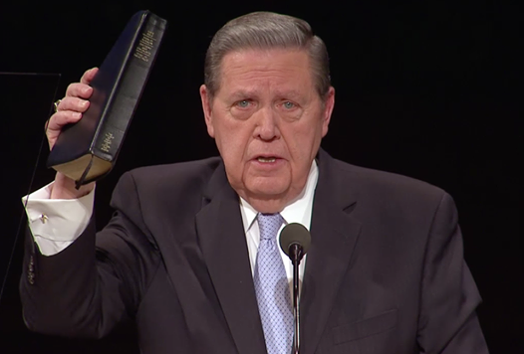
Jeffrey R. Holland
“The ‘doctrine of Christ’ as taught by Nephi in his grand, summational discourse focuses on faith in the Lord Jesus Christ, repentance, baptism by immersion, receiving the gift of the Holy Ghost, and enduring to the end. ... As used in the Book of Mormon, ‘the doctrine of Christ’ is simple and direct. It focuses on the first principles of the gospel exclusively, including an expression of encouragement to endure, to persist, to press on. Indeed, it is in the clarity and simplicity of ‘the doctrine of Christ’ that its impact is found... The doctrine of Christ is not complicated. It is profoundly, beautifully, single-mindedly clear and complete” (Christ and the New Covenant: The Messianic Message of the Book of Mormon [1997],49–50, 56).

Slide 5
“Endure to the End”
2 Nephi 31:16
In “following the example of the Son of the living God.
Is a process.
Is an active process.
Is a lifelong process.
How do we do this?

Slide 6
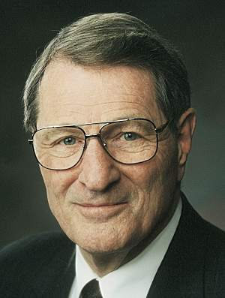
Neal A. Maxwell “Endure it Well”
“Patient endurance is to be distinguished from merely being “acted upon.” Endurance is more than pacing up and down within the cell of our circumstance; it is not only acceptance of the things allotted to us, it is to “act for ourselves” by magnifying what is allotted to us. (See Alma 29:3, 6.)
‘If, for instance, we are always taking our temperature to see if we are happy, we will not be. If we are constantly comparing to see if things are fair, we are not only being unrealistic, we are being unfair to ourselves.
‘Therefore, true enduring represents not merely the passage of time, but the passage of the soul—and not merely from A to B, but sometimes all the way from A to Z. To endure in faith and doeth God’s will. (See D&C 63:20; D&C 101:35) therefore involves much more than putting up with a circumstance….”

Slide 7
The Doctrine of Christ= A Model for Progress
Faith
Endure
Repentance
Holy Ghost
Baptism
Notes:
Following the Doctrine of Christ is actually the key to “enduring it well.” It is a model for how to become more like the Savior.
This doctrine is a cycle we repeat over and over until our earthly experience is complete. We exercise faith, repent, renew our baptismal covenants each week, and hopefully live by the power of the Holy Ghost. In doing these things, we will have what we need to “endure to the end.” Do we understand, remember, and follow the doctrine of Christ in our daily lives?

Slide 8
1) “Press Forward w/a Steadfastness in Christ”
2 Nephi 19, 20, 21
What does it mean to “press forward?” What does “steadfastness” mean? (20)
What do we need to do this? (20)
“A perfect brightness of hope”
“Love of God and all men”
How can we “press forward with a steadfastness in Christ?”
“Feast upon the word of Christ”
Endure to the End
Follow “the plan!”
Notes:
See footnote for “steadfastness”= ”commitment, dedication, perseverance, walking with God.” Beautiful!
To do this, we don’t have to be perfect! We don’t have to be 100% obedient or never falter. No. Christ never expects that of us. Instead, what we need is to hope in Christ and to LOVE Him. It says this over and over in the scriptures--That sincerely loving God is all we truly need to begin and endure. (see v. 20) The pure love of Christ, Charity, then leads to obedience, faith, repentance, etc.
HOW? V. 20—AND then, Use “the doctrine of Christ” model and the “Creation, Fall, Atonement” model. In short, use the Atonement of Jesus Christ. AND use the scriptures…

Slide 9
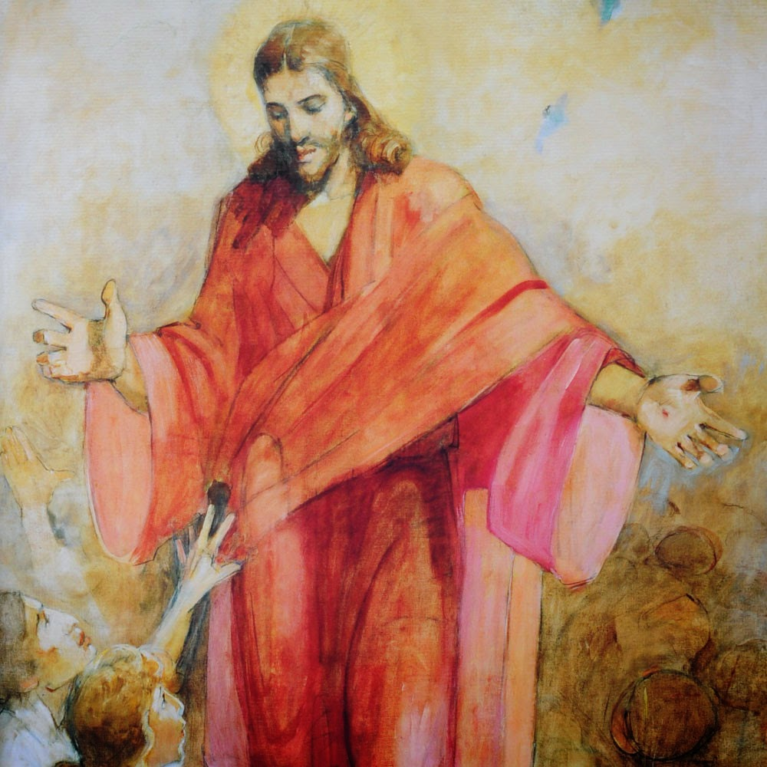
2) “Feast Upon the Words of Christ”
2 Nephi 32:2-3
In what ways does feasting on the words of Jesus Christ help us have a “perfect brightness of hope, and a love of God and of all men”?
How can our love of the scriptures help us endure to the end?

Slide 10
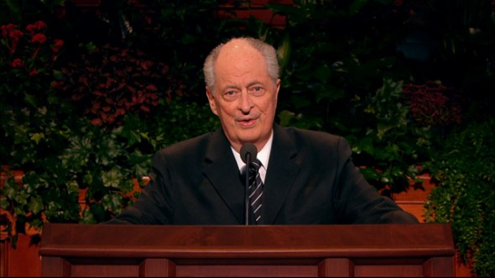
Robert D. Hales
“If you and I are to feast upon the words of Christ, we must study the scriptures and absorb His words through pondering them and making them a part of every thought and action
(in Conference Report, Oct. 1998, 16; or Ensign, Nov. 1998, 15).
Notes:
• What have you done to make your daily scripture study a meaningful experience?
• How have the scriptures become a feast for you?

Slide 11
3) Receive & USE the Holy Ghost= (i.e. Personal Revelation)
2 Nephi 32:5
The Holy Ghost will tell us “ALL things” that we should do. How is this possible? Have you seen this work in your life? Are you willing to experiment and see if it works in your life?
How can we tell when the Holy Ghost is telling us what to do vs. our own thoughts?
How can we RECEIVE and USE the Holy Ghost more effectively?
Notes:
The words of Christ and the Holy Ghost tell us all things we must do:
1) How do the words of Christ and the guidance of the Holy Ghost relate to one another?
How to discern between the Holy Ghost and something else, by Brother John Pontius:
How to USE the Holy Ghost: Ask, Seek, Listen, Obey (quote from Pontius)

Slide 12
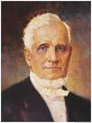
Personal Revelation
President John Taylor:
“I well remember a remark Joseph Smith made to me upwards of forty years ago. Said he, ‘Elder Taylor, you have been baptized, you have had hands laid upon your head for the reception of the Holy Ghost, and you have been ordained to the holy Priesthood. Now, if you will continue to follow the leadings of that spirit, it will always lead you right. Sometimes, it might be contrary to your judgment; never mind that, follow its dictates; and if you be true to its whisperings it will in time become in you a principle of revelation, so that you will know all things.” (Journal of Discourses, 19:153-54)
Notes:
John Pontius explains: “Hearing and obeying the voice f the conscience/Holy Spirit is the most important and powerful step you can take…Perhaps the hardest thing to learn about personal revelation is that it begins as the voice of the conscience [the light of Christ]...Every person knows what it is like to be prompted to not do something by their conscience. Fewer ever recognize the promptings to do something. It is the positive promptings which are the beginnings, the seeds of revelation...The only way you know it is actually revelation is that it prompts you to do good, such as to say your prayers, to do some kindness, to share, to give, to expand and grow.” (Following the light of Christ, p. 27-8)

Slide 13
What prevents personal revelation?
Brother John M. Pontius:
“A person stalled on a spiritual plateau must analyze his life and consider what it is he is unwilling to do…If you prayerfully examine your life, you will quickly find it. There is something stopping you, and God will give you the power to remove it, if you let Him. The Holy Spirit almost always prompts us to do something other than what we were planning.” (Following the Light of Christ, p. 26-7)

Slide 14
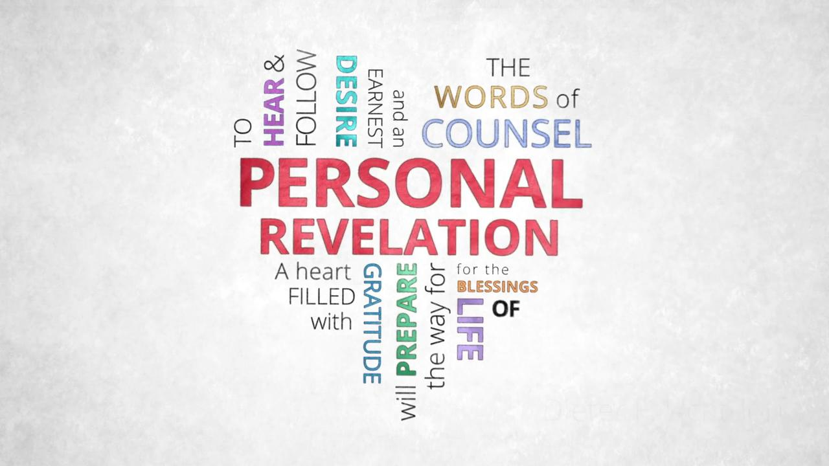
The “3 Voices”
Brain (body)
Mind (body + spirit)
Conscience (Spirit of Christ)
Satan’s voice (id)
Own Mind (ego)
God’s voice (superego)
Notes:
See Pontius, Following the Light of Christ, pgs. 36-40

Slide 15
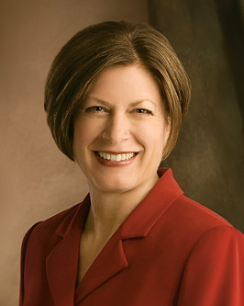
Julie B. Beck

Slide 16
“Speak with the tongue of angels”
2 Nephi 32:2
What does this mean?
Boyd K. Packer: “Nephi explained that angels speak by the power of the Holy Ghost, and you can speak with the tongue of angels, which simply means that you can speak with the power of the Holy Ghost. It will be quiet. It will be invisible. There will not be a dove. There will not be cloven tongues of fire. But the power will be there” (“The Gift of the Holy Ghost: What Every Member Should Know,” Ensign, Aug. 2006, 49–50).

Slide 17
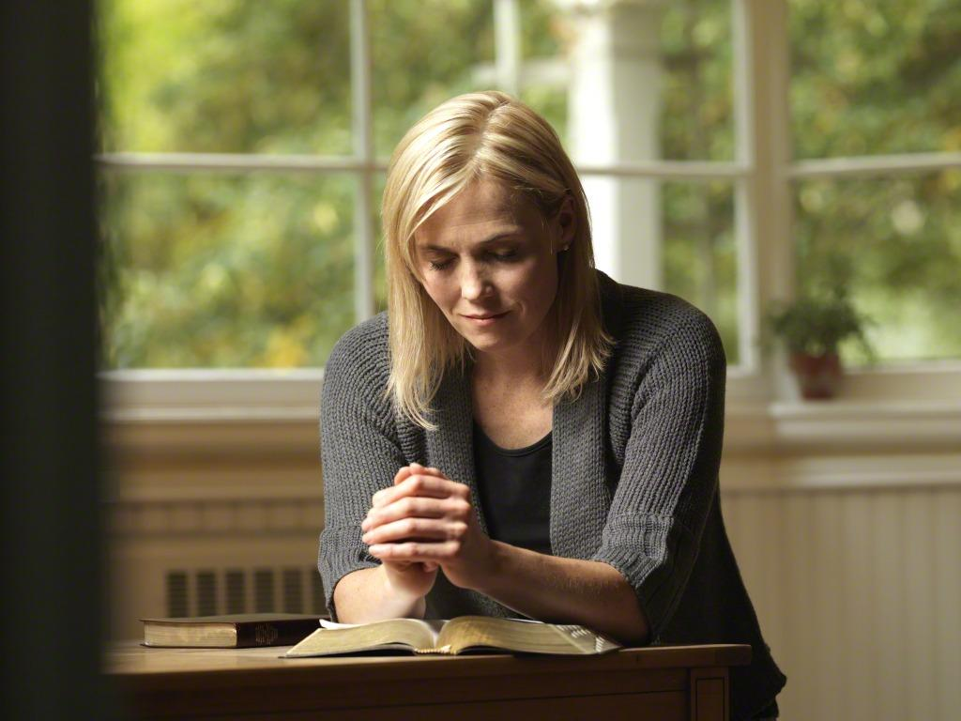
4) “Pray Always”
2 Nephi 32:9
Can we pray too much or often? (Nephi’s example- 33:3)
What prevents us from “praying always?”
What does 32:8 tell us of neglecting to pray?

Slide 18
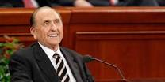
Pres. Thomas S. Monson
“Men and women of integrity, character, and purpose have ever recognized a power higher than themselves and have sought through prayer to be guided by such power.”
Notes:
Do you feel this way? What are you doing about it, if so? If not, what is one thing you can do to desire and seek this “power” of prayer?

Slide 19
“Carried unto the heart”
Elder David A. Bednar:
“Please notice how the power of the Spirit carries the message unto but not necessarily into the heart. A teacher can explain, demonstrate, persuade, and testify, and do so with great spiritual power and effectiveness. Ultimately, however, the content of a message and the witness of the Holy Ghost penetrate into the heart only if a receiver allows them to enter” (“Seek Learning by Faith” [an evening with Elder David A. Bednar, Feb. 3, 2006]
Notes:
2 Nephi 33:1

Slide 20
Dallin H. Oaks
“President Hinckley stated an important corollary to the command to teach by the Spirit when he issued this challenge:
“‘We must … get our teachers to speak out of their hearts rather than out of their books, to communicate their love for the Lord and this precious work, and somehow it will catch fire in the hearts of those they teach’ [Teachings of Gordon B. Hinckley (1997), 619–20].
“That is our objective—to have love of God and commitment to the gospel of Jesus Christ ‘catch fire’ in the hearts of those we teach” (in Conference Report, Oct. 1999, 103; or Ensign, Nov. 1999, 80).
Notes:
Have you experienced this, as a teacher or a learner? How can we encourage the gospel of Jesus Christ to “catch fire” in our hearts and others’?

Slide 21
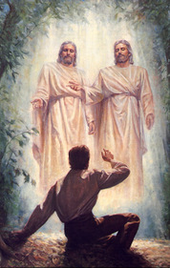
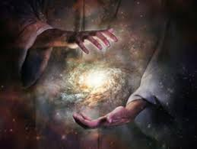
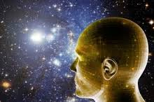
What May we Gain?
2 Nephi 32:7; 1 Nephi 10:19
If we are willing to “search knowledge,” then we will be blessed with “understanding” “great knowledge!”
Notes:
We can know the “mysteries of god”! It’s what we are here for, and we will be taught line upon line as we make ourselves ready to receive.

Slide 22
Love & Example of Nephi
33:3 Great love for his people
Weakness becomes strength through Christ (4) (Ether 12:27)
Nephi’s farewell (33:10)
V.11 We shall meet Nephi!
V.12 He prays for all=great love
V. 13 “A voice crying from the dust”
Jacob 1:12 Nephi dies, having loved, protected, defended, and labored all his days for his people. (10)
They name all future kings after him because they love him so.
Notes:
Jacob & Moroni made very similar comments (Jacob 6:13; Moroni 10:27)
Hugh Nibley: “…Nephi says in verse 11: ‘and you and I shall stand face to face before this bar’ [and I think that is true—I have reason for believing that’s literally so].” (loc 3744, Commentary on the Book of Mormon)
Nephi’s Farewell: Hugh Nibley says “(READ 2 ne 33:13-15 first)...Can you imagine a sadder ending than that? He was of a cheerful disposition—terribly optimistic, as you know. He was always dragging the family through dirty situations. But here he says, “For thus hath the Lord commanded me, and I must obey. Amen.” (loc 3750, Commentary..)

Slide 23
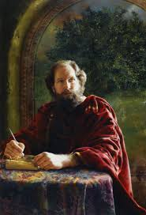
Jacob
Jacob’s purpose (1:1-4;7-8; 19)
What kind of man is he? Elder Jeffrey Holland:
“No prophet in the Book of Mormon, by temperament or personal testimony, seems to have gone about that work of persuasion any more faithfully than did Jacob. He scorned the praise of the world, he taught straight, solid, even painful doctrine, and he knew the Lord personally. His is a classic Book of Mormon example of a young man’s decision to suffer the cross and bear the shame of the world in defense of the name of Christ. Life, including those difficult early years when he saw the wickedness of Laman and Lemuel bring his father and mother down to their graves in grief, was never easy for this firstborn in the wilderness” (Christ and the New Covenant [1997], 62–63).
Notes:
He fulfills his Purpose but with great anxiety: READ Jacob 1:4, 8 Nibley, “This is his writing. Its PROTREPTIC, it’s a SUASORIA. That’s a type of writing that’s devoted to persuading somebody to do something. PROTREPTIC is to enjoin somebody; a SUASORIA is to change your way of life, your behavior. It’s an appeal, and that’s what Jacob is [doing] here.” (Commentary on BOM, loc 3767)
Wikipedia: “In rhetoric, protrepsis (Greek: πρότρεψις) …[is a] style[s] of exhortation that [was] employed by moral philosophers.
“Suasoria is an exercise in rhetoric; a form of declamation in which the student makes a speech which is the soliloquy of a historical figure debating how to proceed at a critical junction in their life.^{[1]}
The exercise was used in ancient Rome, where it was, with the controversia, the final stage of a course in rhetoric at an academy.
“
Called of God, Obedient to Nephi, Magnifies his calling, Obeys the Lord, Strong speaker, courageous and straightforward

Slide 24
A word about anxiety…
Jacob 1:5
Faith AND great anxiety= learning, growth, understanding

Slide 25
Jacob’s Sermon
Has to speak of their wickedness. He doesn’t want to, but he obeys. (Jacob 2:2-11)
Pride (13,16) (#1 Sin in the Book of Mormon)
“Seek the kingdom of God” and riches “to do good” (17-19)
“Grosser crime”- Whoredoms (23)
The Lord delights in chastity (28)
He is mindful of our pain/suffering (33)
Notes:
Nibley, Commentary on the BOM:
Jacob really doesn’t want to have to do this. “This is like pulling teeth; he hates it. Boy, does he hate it, but he has to go through with it…He must declare the word
“Jacob 2:9,10” A CONSOLATIO (like latin), a consolation; they wanted to be cheered up. We find out pretty soon that the women were overworked. They were practically captives and were under strain while their husbands gallivanted around collecting the gold, etc. Their children suffered accordingly, and they came to the temple to hear the consoling word of God and to be comforted. But what do they have to hear? He says. They have to hear this talk that is terrible. He said that is made him ashamed of himself. But he said that he had received from God a strict commandment”. It was not his idea.” (loc 3817)
The Lord knows our pains and sorrows and suffering and will send help and comfort through the Atonement
Nibley “Notice the male chauvinism in verses 31-33. ‘For behold, I, the Lord, have seen the sorrow, and heard the mourning of the daughters of [Israel]…because of the wickedness and abominations of their husbands...For they shall not lead away captive the daughters of my people [the women are practically prisoners; they have a ver male oriented, chauvinistic society; the women have to do all the cooking and set up the tepee and everything else]...for they shall not commit whoredoms, like them of old, saith the Lord of Hosts...Jacob 2:35 That’s a verse I like. It’s very appropriate: “Behold ye have done greater iniquities than the lamanites our brethren. Ye have broken the hearts of your tender wives, and lost the confidence of your children [they wrecked the family], because of your bad examples before them;...And because of the strictness of the word of God, which cometh down against you, many hearts died, pierced with deep wounds.” Notice that the word of God had specifically forbidden it, and because of that it was even more painful on the women and the children. The gospel had always taught them that you shouldn’t do those things. The disruption of LDS families is doubly tragic, and it does happen too. “Many hearts died, pierced with deep wounds,” knowing of these lusts. The word of God is strict, and breaking it compounds the disaster...” “Are we going to get anything cheerful out of Jacob?...” (loc3873)

Slide 26
“Before ye seek for riches”

Slide 27
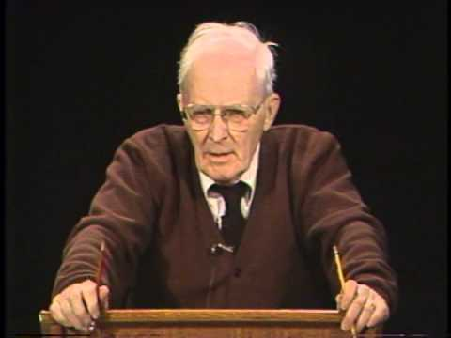
“Arouse the faculties of your souls”!
“You have to make an effort; it’s exactly like a drugged sleep that you get into. You get deeper and deeper, and it takes you right out of this world. To be wakened up is going to take an awful lot of black coffee, walking back and forth, and shaking your shoulders. This awakening isn’t gentle. It’s rude, decisive, and urgent, but it must be done, he says. You’ve got to wake up to this…”
~Hugh Nibley
(Commentary on the Book of Mormon, loc. 3931)
Notes:
READ 2 Nephi 3:11-”Arouse the faculties of your souls; shake yourselves that ye may awake from the slumber of death and loose the pains of hell..”!

Slide 28
Purposes of Scriptures
Jacob 4:4-8
All generations have known and worshipped Christ (4-5)
The scriptures “point our souls to him” (5)
Help us “search the prophets” and “revelations” and obtain the “spirit of prophecy” to “obtain a hope” and have “faith…unshaken” (6)
Teaches us how to be like Christ, even to “command in the name of Jesus” (6)
Remind us of His grace (7) and teach us “the mysteries of him” (8)
To teach us of Christ’s Atonement (12)
Notes:
--It wasn’t easy for the prophets of old to keep these records upon the plates. Though they knew they would last this way, it was hard work and they had limited space. (Jacob 4:1-3)
--

Slide 29
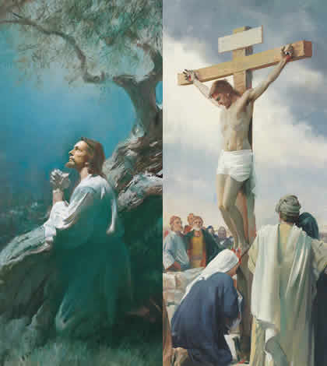
The Atonement
Jacob wraps up this part of his sermon by showing HOW to overcome these sins—The Atonement
Jacob 4:12
Speak of Christ, gain a “perfect knowledge” of Him
At-one-ment
Speaks to the “pure in heart” (3:1-2) Beautiful!!**

Slide 30
Personal Inventory
Do I understand the Doctrine of Christ? How can I better understand it?
Am I using it as a model for each day, to become “perfected in Him?”
Am I “feasting” upon the words of Christ? What can I do to improve?
What is one thing I may need to do differently to receive the Holy Ghost more fully in my life? Commit to prayerfully seeking this answer.

Slide 31
Next Week
Jacob 5-Words of Mormon
SM Lessons 16-17

