Slide 1
The Book of Mormon Another Testament of Jesus Christ
Lesson 6: Isaiah
2 Nephi 11-30
“Great are the words of Isaiah!”
Christina G. Hibbert
christi@drchristinahibbert.com
www.DrChristinaHibbert.com www.LikeAWateredGarden.com
Notes:
2 Nephi is known for its difficulty. Many never get past these chapters, but we will see today how great the words of Nephi, Jacob, and Isaiah are, what they have to offer each of us, and why they are placed at the front of this incredible book. My prayer is that, through studying Isaiah today, you will strengthen your testimony of the Book of Mormon, of God’s great plan of happiness and love for each soul throughout time, and of the love and mission of the Savior, Jesus Christ.

Slide 2
Imagine…
Notes:
Imagine living at the time of the American Revolution, which began In 1619, almost exactly 400 years ago. How would you describe today’s world? It’s culture? Politics? Religion? Technology? Values? Would you have the words to describe it?

Slide 3
Now imagine…
Notes:
Now, imagine 2800 years from now. If the world were still standing, what might it look like? It’s culture, technology, religion, values? How might you describe something so foreign to you?
Isaiah lived over 2800 years ago, yet he saw and prophesied about our day—the last days. Imagine trying to describe today’s world, 2800 years ago! This is one reason Isaiah is so challenging to understand. He also wrote with great symbolism and poetry, which can be difficult for our modern-day minds to interpret.

Slide 4
Understanding Isaiah
Poetic writing (using metaphor, parallelism, beautiful language)
Two main themes:
Current and future happenings of God’s covenant people
Ministry and mission of Christ
Nephi’s keys to understanding:
Understand “the manner of the Jews” (2 Ne 25:2)
Be “filled with the spirit of prophecy” (2 Ne 25:4)
Be familiar with the regions round about Jerusalem (2 Ne 25:6)
Live during the days that the prophecies of Isaiah are fulfilled
Even Jesus Christ quoted & commanded us to “search” the words of Isaiah (3 Ne 23:1; 20:11)
Notes:
From Book of Mormon Reference Companion, p.343
More on Isaiah’s day:
Explain that in Isaiah’s day, the house of Israel was
divided into two kingdoms. The tribes of Judah and
Benjamin, headquartered in the city of Jerusalem,
formed a kingdom that was known as Judah. Isaiah
was part of that kingdom. The other ten tribes formed
a kingdom to the north, headquartered in the city of
Shechem, which was in Samaria. They became known
as the kingdom of Israel. They were also known as
Ephraim, which was the dominant group among
them. At the same time, the kingdom of Assyria was
increasing in power. (See Bible Dictionary, pages
637–39 for a chart showing some of the history of the
kingdoms of Judah and Israel.)
Explain that after more than 200 years of wickedness, the ten tribes in the kingdom of Israel were conquered by the Assyrians, who took many of the people captive into Assyria. Those ten tribes became known as the lost ten tribes. The Assyrians also suffered consequences of their wickedness. Although they were a mighty people, they were never able to build a stable government, and they were eventually conquered by the Medes and Babylonians.

Slide 5
Isaiah & YOU
1 Ne 19:23
How can we “liken all scriptures unto us?”
Ask, “How do the words of Isaiah apply to me, personally? What promises do they contain for me? What warnings? What can I learn from these things, today, and how might it impact my life for the better?”

Slide 6
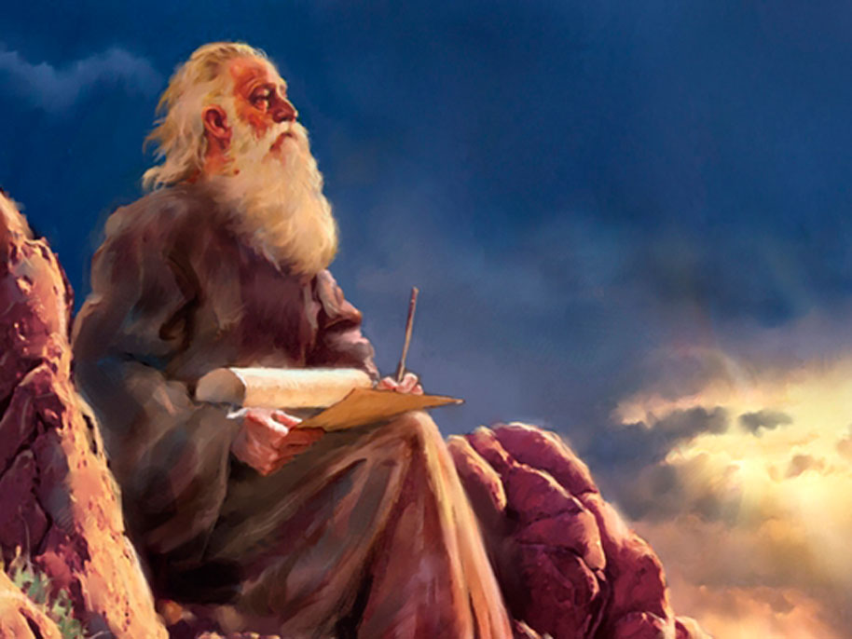
1) Isaiah the Prophet
Name=“Jehovah is salvation”
Most quoted prophet in BOM
Ministered in Judah, 740-701 B.C.- Time of political unrest, war, apostasy
Labored to turn people back to Jehovah; Rejected by majority
Witnessed the conquering/removal of Israel and conquest of Judah by Assyrian empire & unsuccessful siege of Jerusalem (2 Kgs. 15-21)
High social standing; counsel sought by king Hezekiah
Married, at least two children; died by being sawed in half by Hezekiah's wicked son, Menasseh.
Notes:
Most quoted-- BOM (~35% of OT writings quoted by Nephite prophets); Most quoted by Jesus Christ in NT, also quoted by Savior to the Nephites (3 Ne 23:1)
Time of unrest-- Two warring kingdoms-Israel, north; Judah, south
Legend has it that Hezekiah was Isaiah’s son-in-law (BOM RC, 340)

Slide 7
2) Testimony of Three
2 Ne 11:1-3 Who are the three?
Nephi, Jacob & Isaiah
wrote 135 of the 143 small plates pages
All three saw their Redeemer
All three serve as witnesses of Jesus Christ
What other “3 witnesses” can you think of?
Notes:
In fact, of the 143 pages in the small plates, these three prophets wrote 135 of them!
Read D&C 17 section intro- Connects the three witnesses in the Book of Mormon to the 3 witnesses of the BOM, Martin Harris, Oliver Cowdery, and David Whitmer.
Elder Jeffrey R. Holland: “The Lord’s manner of teaching and affirming, especially when it involves a covenant, has always provided more than one testimony. His admonition has always been that ‘in the mouth of two or three witnesses shall every word be established.’ Indeed, when the Book of Mormon was to come forth through the inspired hand of the Prophet Joseph Smith, it was prophesied that ‘three shall . . . be shown [the plates] by the power of God. . . . And in the mouth of three witnesses shall these things be established. . . . “Those three witnesses were to be Oliver Cowdery, David Whitmer, and Martin Harris. . . . “In keeping with this same covenantal principle, it is interesting to note that there were three earlier witnesses—special witnesses—not only of the divine origins of the Book of Mormon but also of Divinity himself. These early witnesses were Nephi, Jacob, and Isaiah, and it is not by coincidence that their testimonies appear so conspicuously at the beginning of this ancient record. . . . “. . . These three doctrinal and visionary voices make clear at the very outset of the Book of Mormon why it is ‘another testament of Jesus Christ.’ . . . “One could argue convincingly that the primary purpose for recording, preserving, and then translating the small plates of Nephi was to bring forth to the dispensation of the fullness of times the testimony of these three witnesses… By the time one has read Nephi, Jacob, and Isaiah in these first pages, a strong foundation has been laid for what Nephi called ‘the doctrine of Christ’” (Christ and the New Covenant, [1997] 33-35)

Slide 8
3) Isaiah as a Whole & Type- For their day & ours
3 main time periods:
Isaiah’s day/people
The Nephite/Laminites’ day/people
Our day/people
Main themes: (2 Ne 11:4-8)
Life/ministry of Jesus Christ (types)
Reminders of the covenants the Lord has made
That Christ shall save His people; He has come
Future prophecies of destruction and salvation
Notes:
One way to comprehend Isaiah more completely is to read his words as a whole. In fact, I suggest reading the chapter headings or listening to these chapters on audio. Doing so, for me, has helped me see the bigger picture—that Isaiah is testifying of Jesus Christ, and that in these chapters he speaks of three main times: 1) his day and people, 2) the Nephites/Lamanites’ day and people, and 3) our day and people.
Elder Dallin H. Oaks: “The book of Isaiah contains numerous prophecies that seem to have multiple fulfillments. One seems to involve the people of Isaiah’s day or the circumstances of the next generation. Another meaning, often symbolic, seems to refer to events in the meridian of time. . . . Still another meaning or fulfillment of the same prophecy seems to relate to the events attending the Second Coming of the Savior. The fact that many of these prophecies can have multiple meanings underscores the importance of our seeking revelation from the Holy Ghost to help us interpret them” (“Scripture Reading and Revelation,” Ensign, Jan. 1995, 8).
Furthermore, Isaiah taught the following: “Through a series of remarkable revelations, Isaiah learned about the Savior’s birth and Second Coming, the conditions on the earth in the last days, the peace and joy that will come in the Millennium, and the ultimate failure of the adversary. These revelations, written according to ‘the manner of prophesying among the Jews’ (2 Nephi 25:1), also told of coming events in Isaiah’s day. Although the revelations help us understand conditions in Isaiah’s day, [we can also] focus on their latter-day significance. We can read them with full confidence that they contain messages for us in the last days—messages of warning, peace, and hope.” (BOM Teacher’s Manual)
Typifying: “represent, reminder, emblem, instruct”

Slide 9
Abrahamic Covenant
Notes:
See BOM Reference, p. 25

Slide 10
4) The “spirit of prophecy” (2 Ne 11-24)
2 Ne 25:1,4-5,7-8
What does Nephi teach about how we can understand Isaiah’s words?
What does “the spirit of prophecy” mean?” (Rev 19:10)
Notes:
Rev 19:10= Having a testimony of Christ

Slide 11
The “spirit of prophecy”
“Obtaining the spirit of prophecy, that is, obtaining personal revelation through the Holy Ghost, is an essential feature of the restored gospel of Jesus Christ, and is generally experienced beyond the application of the basic principles of the gospel. Its dependence upon the spiritual growth and worthiness of the person receiving it renders its full treatment unnecessary here. Let it suffice to say that the Prophet Joseph Smith described the workings of the Holy Ghost upon the mind as “strokes of pure intelligence flowing into you,” while Doctrine and Covenants 9:8 depicts the action of the Holy Ghost as a burning in the bosom which serves to confirm whether a thing is right and true. In the same light, Paul maintains that the things of God are known only by the Spirit of God, and that for mortals to comprehend the words written or uttered under the influence of the Holy Ghost, they too must be touched by and possess that same Spirit (1 Cor 2:10-16). Although less dramatic in its operation, the spirit of prophecy may be compared to the gift of tongues and to that of the interpretation of tongues. Both are gifts of the same Spirit, the prophet exercising the first for our sake, and we the second if we would avail ourselves of it.” (Avraham Gileadi, Isaiah: Four Latter-Day Keys to an Anxiety Book, in Isaiah and the Prophets, p. 120.)

Slide 12
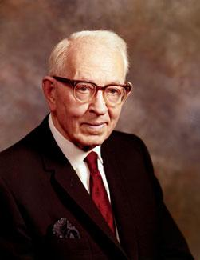
Joseph Fielding Smith
“Revelation may be given to every member of the Church. The Prophet said that every man should be a prophet; that the testimony of Jesus is the spirit of prophecy. It is not only the privilege but the duty of each member of the Church to know the truth which will make him free. This he cannot know unless it is revealed to him. . . . “The gift of the Holy Ghost is given to the members of the Church so that they may have the spirit of prophecy and revelation. Let it be understood however, that they will not receive revelation for the guidance of the Church” (Church History and Modern Revelation, 2 vols. [1953], 2:217–18)

Slide 13
Prophecies of Isaiah
God will bring about judgment and peace in the last days (2 Ne 12-14)
“House of Jacob” (12:5, 13:1-15)- famine (13:1), removal of leaders/honorable men (13:2-4), disrespect for others (13:5), Jerusalem will be ruined & Judah will fall (8), wicked and righteous will be “rewarded” (13:9-11); Lord will judge (13-15)
“Daughters of Zion” (13:16-26)- “discover their secret parts” (put them to shame) (13:7), take away things (18-24), men will be killed in war (25), people will become desolate (26)
“Them that are escaped”(14:2-6)- will be beautiful and glorious (14:2), fruit of the earth excellent for their sake (2), called holy (3), the Lord will wash away their filth (4), the Lord will bless them with protection and refuge (5-6)
Notes:
“House of Jacob”- House of Israel (all, in his day and ours)
“Daughters of Zion”= Members of the Church who become prideful and worldly
“Them that are escaped”=members of house of Israel who accept Christ and through His Atonement and their own righteousness, will escape the judgments that come upon the wicked (Righteous members of House of Israel in millennial day)
2 Ne 14:1= not about plural marriage, but about war described in 13:25)

Slide 14
Prophecies of Isaiah
The Lord will lift an “ensign” to gather Israel (2 Ne 12:1-3; 15:13-30)
What is an “ensign?”
The children of Israel become captive, physically
How do our sins make us captive? How can we be released from captivity?
Warnings of Isaiah “Wo!” (2 Ne 15:18-23)
Do you see these things in our world today?
See also 2 ne 28:3-31
Notes:
Pres. Gordon B. Hinckley: “I believe and testify that it is the mission of this Church to stand as an ensign to the nations and a light to the world. We have had placed upon us a great, all-encompassing mandate from which we cannot shrink nor turn aside. We accept that mandate and are determined to fulfill it, and with the help of God we shall do it” (in Conference Report, Oct. 2003, 86; or Ensign, Nov. 2003, 82–83).
Do not shrink: Elder Maxwell “It’s more important to not shrink than to survive” Elder Bednar-Talk to Young Adults

Slide 15
Prophecies of Isaiah
Savior’s birth and second coming (2 Ne 17-24)
Jesus Christ was born to reign as the “Prince of Peace” (2 ne 17-18; 19:1-7) “5 Titles for Christ” (19:6-7)
The wicked will be destroyed at the second coming (19:8-21; 20)
The millennium will be a 1000 year period of peace and joy (2 Ne 22)
Satan’s opposition to God will ultimately fail (2 ne 24)
24:1 (Have mercy), 2 (Bring his people to lands of promise), 3 (give people rest from sorrow, fear, bondage, 4 (put an end to the power of the wicked!)
Notes:
1)Read chapter headings to get a feel for all Isaiah taught (Elder Bruce R. McConkie wrote the chapter headings in the BOM)
2) Other names for Him—”5 titles”
Read Elder Holland: p. 86, SM

Slide 16
Nephi’s Testimony
2 Ne 25
19 Christ will come
20 “No other name given… whereby man can be saved”
23 “saved by grace after all we can do”
26 “We talk of Christ...”
28-29 “stand as a testimony...” “the right way is to believe in Christ”

Slide 17
Dallin H. Oaks
“In our day we are experiencing an explosion of knowledge about the world and its people. But the people of the world are not experiencing a comparable expansion of knowledge about God and his plan for his children. On that subject, what the world needs is not more scholarship and technology but more righteousness and revelation. I long for the day prophesied by Isaiah when ‘the earth shall be full of the knowledge of the Lord’ (Isaiah 11:9; 2 Nephi 21:9).”

Slide 18
Bruce R. McConkie on Isaiah
“Read, ponder, and pray—verse by verse, thought by thought, passage by passage, chapter by chapter! As Isaiah himself asks: ‘Whom shall he teach knowledge? And whom shall he make to understand doctrine?’ His answer: ‘they that are weaned from the milk, and drawn from the breasts. For precept must be upon precept, precept upon precept; line upon line; here a little, and there a little.’ (Isa. 28:9-10)” (Bruce R. McConkie, “10 Keys to Understanding Isaiah,” Ensign, Oct 1973, pp. 80-83)

Slide 19
Personal Inventory
Do I delight in the words of Isaiah? Why? Why not?
How can I deepen my understanding of his words, as Christ Himself has asked me to do?
Am I willing to devote myself to regular, conscientious study of Isaiah and other scriptures?
What can the words of Isaiah do for me today?

Slide 20
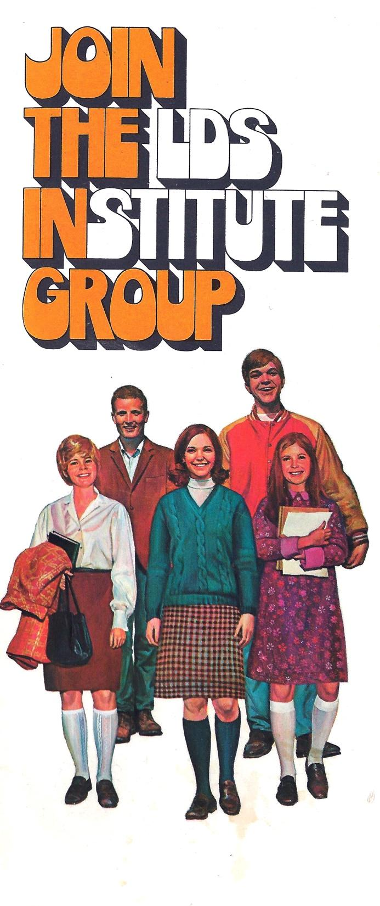
Next Week
2 Ne. 31-33 & Jacob 1-4

