Slide 1
The Book of Mormon Another Testament of Jesus Christ
Lesson 5: 2 Ne 1-10
Live “After the Manner of Happiness”
Christina G. Hibbert
www.DrChristinaHibbert.com
www.LikeAWateredGarden.com

Slide 2
Lehi’s Final Sermon
Lehi’s major teachings:
Dream of the tree of life
Prophecies of destruction of Jerusalem, captivity, return of Jews; John the Baptist’s ministry; coming of Christ, his rejection, death, resurrection, ministry to the Gentiles; scattering/gathering of Israel (1Ne 10:3-14)
“All mankind in a lost/fallen state..save they rely on Christ” (1Ne10:6)
Prophetic pronouncements of promised land (2 Ne 1:5-11)
God has provide a plan for his children (2 Ne 2:4-10)
The necessity of “opposition in all things”(2 ne 2:11-13,15)
The purpose of the Fall, role of the devil in the Fall, and idea of “free to choose” (2 Ne 2:14-27)
Prophecies of Joseph of Egypt concerning Joseph Smith & restoration (2Ne3)
Book of Mormon Reference Companion, 510

Slide 3
“Awake” and “Arise”
“Awake from a deep sleep” (2 Ne 1:13)
“Awake! And arise from the dust and hear the words of a trembling parent…” (2Ne 1:14)
“Arise from the dust, my sons, and be men...” (v. 21)
“Awake...put on the armor of righteousness.” (23)
Are we living up to our true potential?

Slide 4
Russell M. Nelson
“…these stalwart women have shown the strength and courage that covenant-keeping women always demonstrate.² It would be impossible to measure the influence that such women have, not only on families but also on the Lord’s Church, as wives, mothers, and grandmothers; as sisters and aunts; as teachers and leaders; and especially as exemplars and devout defenders of the faith.³ This has been true in every gospel dispensation since the days of Adam and Eve. Yet the women of this dispensation are distinct from the women of any other because this dispensation is distinct from any other.⁴ This distinction brings both privileges and responsibilities…My dear sisters, whatever your calling, whatever your circumstances, we need your impressions, your insights, and your inspiration. We need you to speak up and speak out in ward and stake councils. We need each married sister to speak as “a contributing and full partner”¹⁰ as you unite with your husband in governing your family. Married or single, you sisters possess distinctive capabilities and special intuition you have received as gifts from God. We brethren cannot duplicate your unique influence. We know that the culminating act of all creation was the creation of woman!¹¹ We need your strength!... My dear sisters, nothing is more crucial to your eternal life than your own conversion. It is converted, covenant-keeping women…whose righteous lives will increasingly stand out in a deteriorating world and who will thus be seen as different and distinct in the happiest of ways. So today I plead with my sisters of The Church of Jesus Christ of Latter-day Saints to step forward! Take your rightful and needful place in your home, in your community, and in the kingdom of God—more than you ever have before. I plead with you to fulfill President Kimball’s prophecy. And I promise you in the name of Jesus Christ that as you do so, the Holy Ghost will magnify your influence in an unprecedented way!” (“A Plea to My Sisters,” Gen. Conf. Oct 2015)
Notes:
How do you feel when you read this? What does it tell you about your own divine purpose, calling and mission here on earth? What does it whisper about your part in the “great plan of happiness” and bringing salvation to the world? Will we stand up and “be men” and “women” of Christ?

Slide 5
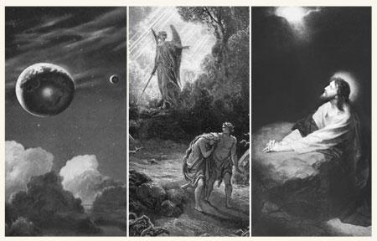
(The Creation, the Fall, and the Atonement
“The Creation, the Fall, and the Atonement were planned long before the actual work of the Creation began” (Ensign, May 2000, 84). Elder Russell M. Nelson
Notes:
READ Russell M. Nelson quote- TM, p. 26
“Do I find happiness in ‘The Plan of Happiness?’”

Slide 6
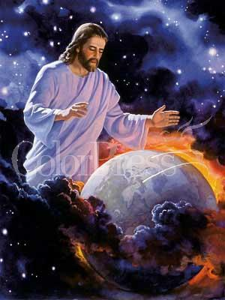
The Creation
Read 2 Nephi 2:11-14.
What are the purposes of the Creation expressed in these verses?
Why do we need “opposition in all things?”
Notes:
(Some answers might include agency, opposition, to know happiness, life, death, knowledge, purpose, the eternal purposes of God!)
Verse 16 reiterates that agency, and specifically opposition, are central to the creation! Without opposition, the plan would not work. Likewise, learning, evolution, and growth are all part of the Creation. Do we remember this when faced with opposition, trials, and our own weaknesses or mistakes? Do we remember that it’s an essential part of the plan of happiness?

Slide 7
The Fall (2 NE 2:17-25)
Before the Fall
Adam and Eve would not have had children.
Adam and Eve would not have known joy or misery.
They would not have done good or evil.
They would have remained in the Garden of Eden forever.
After the Fall
They had children.
They could experience both joy and misery.
They could do good, and they could also sin.
They were cast out of the Lord’s presence and out of the Garden of Eden. They became fallen and mortal—subject to physical death (see also Moses 6:48).
Notes:
The Fall was another essential element of the plan of happiness. Without “falling,” we could not bear children and would not, consequently, know misery (v. 23—this always makes me laugh!). But also, we would not have known joy without children. We would not have known work or personal growth or salvation. In essence, we not only become subject to the natural laws that bring death to our bodies, but the Fall also allowed the Savior to fulfill His divine mission—to fulfill the Atonement.
As Elder Bruce C. Hafen said:
“The Fall was not a disaster. It wasn’t a mistake or an accident. It was a deliberate part of the plan of salvation. We are God’s spirit ‘offspring,’ sent to earth ‘innocent’ of Adam’s transgression. Yet our Father’s plan subjects us to temptation and misery in this fallen world as the price to comprehend authentic joy. Without tasting the bitter, we actually cannot understand the sweet. We require mortality’s discipline and refinement as the ‘next step in [our] development’ toward becoming like our Father. But growth means growing pains. It also means learning from our mistakes in a continual process made possible by the Savior’s grace, which He extends both during and ‘after all we can do’” (in Conference Report, Apr. 2004, 100; or Ensign, May 2004, 97; in this statement, Elder Hafen quotes the following sources: Acts 17:28; D&C 93:38; Jeffrey R. Holland, Christ and the New Covenant: The Messianic Message of the Book of Mormon [1997], 207; 2 Nephi 25:23 with italics added).
Read 2 Ne 2:25 and memorize!!

Slide 8
The Atonement
“Our salvation depends on believing in and accepting the Atonement. Such acceptance requires a continual effort to understand it more fully. The Atonement advances our mortal course of learning by making it possible for our natures to become perfect. ‘… Any increase in our understanding of His atoning sacrifice draws us closer to Him. Literally, the Atonement means to be ‘at one’ with Him. The nature of the Atonement and its effects is so infinite, so unfathomable, and so profound that it lies beyond the knowledge and comprehension of mortal man. …
‘We long for the ultimate blessing of the Atonement—to become one with Him, to be in His divine presence, to be called individually by name as He warmly welcomes us home with a radiant smile, beckoning us with open arms to be enfolded in His boundless love. How gloriously sublime this experience will be if we can feel worthy enough to be in His presence! The free gift of His great atoning sacrifice for each of us is the only way we can be exalted enough to stand before Him and see Him face-to-face. The overwhelming message of the Atonement is the perfect love the Savior has for each and all of us. It is a love which is full of mercy, patience, grace, equity, long-suffering, and, above all, forgiving” (in Conference Report, Oct. 2001, 19, 22; or Ensign, Nov. 2001, 18, 20). Elder James E. Faust
Notes:
How do you feel when you read Elder Faust’s words? Do you “long” to “become one with Him?” If not, what is standing in your way?

Slide 9
The 4 Josephs
“The Lord foreordained … Joseph Smith, Sr., who is spoken of in the holy scriptures, to be one of the earthly parents of the Prophet. Joseph of Egypt prophesied that the latter-day seer whom God would raise up to do his work would be ‘called Joseph’ (Joseph Smith Translation, Genesis 50:33), and his name would ‘be after the name of his father’ (2 Nephi 3:15). The heavenly messenger Moroni admonished young Joseph to go to his father following a glorious night of sacred instruction. In Joseph’s words, this messenger ‘commanded me to go to my father and tell him of the vision and commandments which I had received. I obeyed; I returned to my father in the field, and rehearsed the whole matter to him. He replied to me that it was of God, and told me to go and do as commanded by the messenger’ Joseph Smith—History 1:49–50)” (Elder M. Russell Ballard, in Conference Report, Oct. 1991, 4; or Ensign, Nov. 1991, 5–6).
Notes:
How does understanding this impact your testimony of the restoration? Do you rejoice and find happiness in the restoration?

Slide 10
“Does my soul ‘delight in the scriptures?’”
Read 2 Nephi 4: 15-16 and ask yourself the following questions (from the Student Manual)
•What did Nephi treasure? How can you tell that he treasured these things?
•What can we do to treasure the scriptures and the things of the Lord?
•How do you think Nephi’s love of the scriptures influenced his trust in God?
•In what ways has your love of the scriptures influenced your trust in God?
Notes:
Do we look forward to reading the scriptures? Do we study and ponder them? Do we “feast upon” and “delight” in them?

Slide 11
Psalm of Nephi
The Prophet Joseph Smith explains: “the nearer man approaches perfection, the clearer are his views, and the greater his enjoyments, till he has overcome the evils of his life and lost every desire for sin’ (History of the Church, 2:8). Perhaps Nephi felt burdened by what we might consider trivial weaknesses to the point where they caused him sorrow, and he sought to be free from any vestige of sin.” (BOM Student Manual, chapter 8)
Notes:
Do you ever feel like Nephi felt—“Awake, my soul, no longer droop in sin!”? How so? What do you do about it? How does it feel to see your weaknesses? What helps you understand and strengthen your weaknesses?

Slide 12
Agency…
“Elder Dallin H. Oaks of the Quorum of the Twelve Apostles taught that, regardless of a person’s susceptibility or tendency, we have an obligation to exercise our agency to overcome our personal weaknesses: ‘…We are all responsible for the exercise of our free agency…Most of us are born with thorns in the flesh, some more visible, some more serious than others. We all seem to have susceptibilities to one disorder or another, but whatever our susceptibilities, we have the will and the power to control our thoughts and our actions. This must be so. God has said that he holds us accountable for what we do and what we think, so our thoughts and actions must be controllable by our agency. Once we have reached the age or condition of accountability, the claim ‘I was born that way’ does not excuse actions or thoughts that fail to conform to the commandments of God. We need to learn how to live so that a weakness that is mortal will not prevent us from achieving the goal that is eternal. God has promised that he will consecrate our afflictions for our gain (see 2 Nephi 2:2). The efforts we expend in overcoming any inherited weakness build a spiritual strength that will serve us throughout eternity. Thus, when Paul prayed thrice that his ‘thorn in the flesh’ would depart from him, the Lord replied, ‘My grace is sufficient for thee: for my strength is made perfect in weakness.’ [2 Corinthians 12:9]” (“Free Agency and Freedom,” in Monte S. Nyman and Charles D. Tate Jr., ed., The Book of Mormon: Second Nephi, the Doctrinal Structure [1989], 13–14).” (BOM Student Manual, Chapter 8)
Notes:
How can we learn to see and to overcome our weaknesses? Our “thorns in the flesh?” Look at 2 Ne 4:15-35 for answers.

Slide 13
“Do I separate myself from wickedness as Nephi did?”(2 Ne 5:5-9)
Elder Richard G. Scott said:
“Avoid worldly wickedness. Know that God is in control. In time, Satan will completely fail and be punished for his perverse evil. God has a specific plan for your life. He will reveal parts of that plan to you as you look for it with faith and consistent obedience. His Son has made you free—not from the consequences of your acts, but free to make choices. God’s eternal purpose is for you to be successful in this mortal life. No matter how wicked the world becomes, you can earn that blessing. Seek and be attentive to the personal guidance given to you through the Holy Spirit. Continue to be worthy to receive it. Reach out to others who stumble and are perplexed, not certain of what path to follow” (Elder Richard G. Scott, in Conference Report, Apr. 2004, 103–4, 106; or Ensign, May 2004, 100, 102). ” (BOM Student Manual, Chapter 8)
Notes:
Are there things in your life from which you need to “flee”(entertainment, friends, work, media, etc)? How can we live “in the world but not of the world?” Read 2 Ne 5:1-7 and look for details about Nephi’s departure. How do these things apply to us?

Slide 14
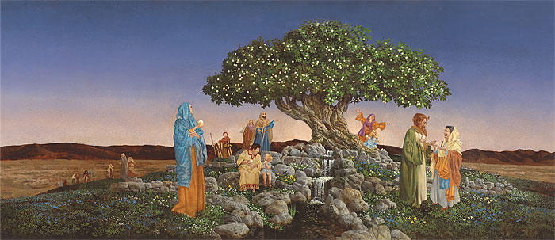
“Do I live ‘after the manner of happiness?” 2 Ne 5:10-18, 26-27
The Prophet Joseph Smith explained that there is a path that leads to happiness: “Happiness is the object and design of our existence; and will be the end thereof, if we pursue the path that leads to it; and this path is virtue, uprightness, faithfulness, holiness, and keeping all the commandments of God” (History of the Church, 134–35).

Slide 15
Happiness…
President Gordon B. Hinckley taught similarly about happiness: “The Lord wants us to be happy. Nephi said a great thing: ‘And … we lived after the manner of happiness.’ (2 Ne. 5:27.) What a wonderful thing. I want my children to be happy. I want them to do well. I want them to live well and live rightly, properly; and, in the same way, except that my Father in Heaven’s love reaches beyond any power of love that I have. I think He wants His sons and daughters to be happy. Happiness comes of righteousness. ‘Wickedness never was happiness.’ (Alma 41:10.) Sin never was happiness. Selfishness never was happiness. Greed never was happiness. Happiness lies in living the principles of the gospel of Jesus Christ” (“Fast-Paced Schedule for the Prophet,” Church News, Apr. 20, 1996, 3).

Slide 16
Happiness How to…
Ponder President Hinckley’s advice: “Keep balance in your lives. Beware of obsession. Beware of narrowness. Let your interests range over many good fields while working with growing strength in the field of your own profession.” (“Four Imperatives for Religious Educators, Sept 15, 1978.) Then, read 2 Ne 5: 10-18, 26-27 looking for principles to help you make a greater contribution, in your unique and predestined way, to the world.

Slide 17
Jacob teaches from Isaiah (2 Ne 6-9)
“Do I ‘walk in the light of my own fire?’” 2 Ne 7:10-11
Do we ever do things our way instead of the Lord’s way? What prevents us from letting the Lord lead us? What, specifically, do you need to do to let the Lord be your “light in the wilderness,” instead of walking “in the light of your own fire?”

Slide 18
Do I ‘At-one’ with Christ? 2 Nephi Chapter 9
Chapter 9, verse 3 reads “Behold, my beloved brethren, I speak unto you these things that ye may rejoice, and lift up your heads forever, because of the blessings which the Lord God shall bestow upon your children.” Do you “rejoice” in the Gospel? Do you rejoice in the incredible blessings of the Lord? The greatest of His gifts is the Atonement.

Slide 19
Jacob’s Testimony
Elder Jeffrey R. Holland states:
“Jacob’s testimony was that ‘the Mighty God’ will always deliver ‘his covenant people,’ and that the Mighty God is, by his own divine declaration, the Lord Jesus Christ, the ‘Savior and … Redeemer, the Mighty One of Jacob.’
“Jacob reflected on such teachings—especially those contained in the writings of Isaiah—so that his current audience and future readers ‘might know concerning the covenants of the Lord that he has covenanted with all the house of Israel,’ giving the parents of every generation cause to ‘rejoice’ and to ‘lift up [their] heads forever, because of the blessings which the Lord God shall bestow upon [their] children.’ “At the heart of that covenant and the reason for such rejoicing is the atoning sacrifice of that ‘Mighty God’ who is the Savior and Redeemer of the world” (Christ and the New Covenant [1997], 66–67).

Slide 20
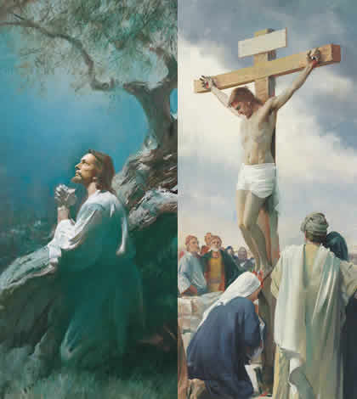
The Great Love of God Chapter 8
“The Lord shall comfort Zion…” Read Chapter 8, searching for evidence of God’s great love.

Slide 21
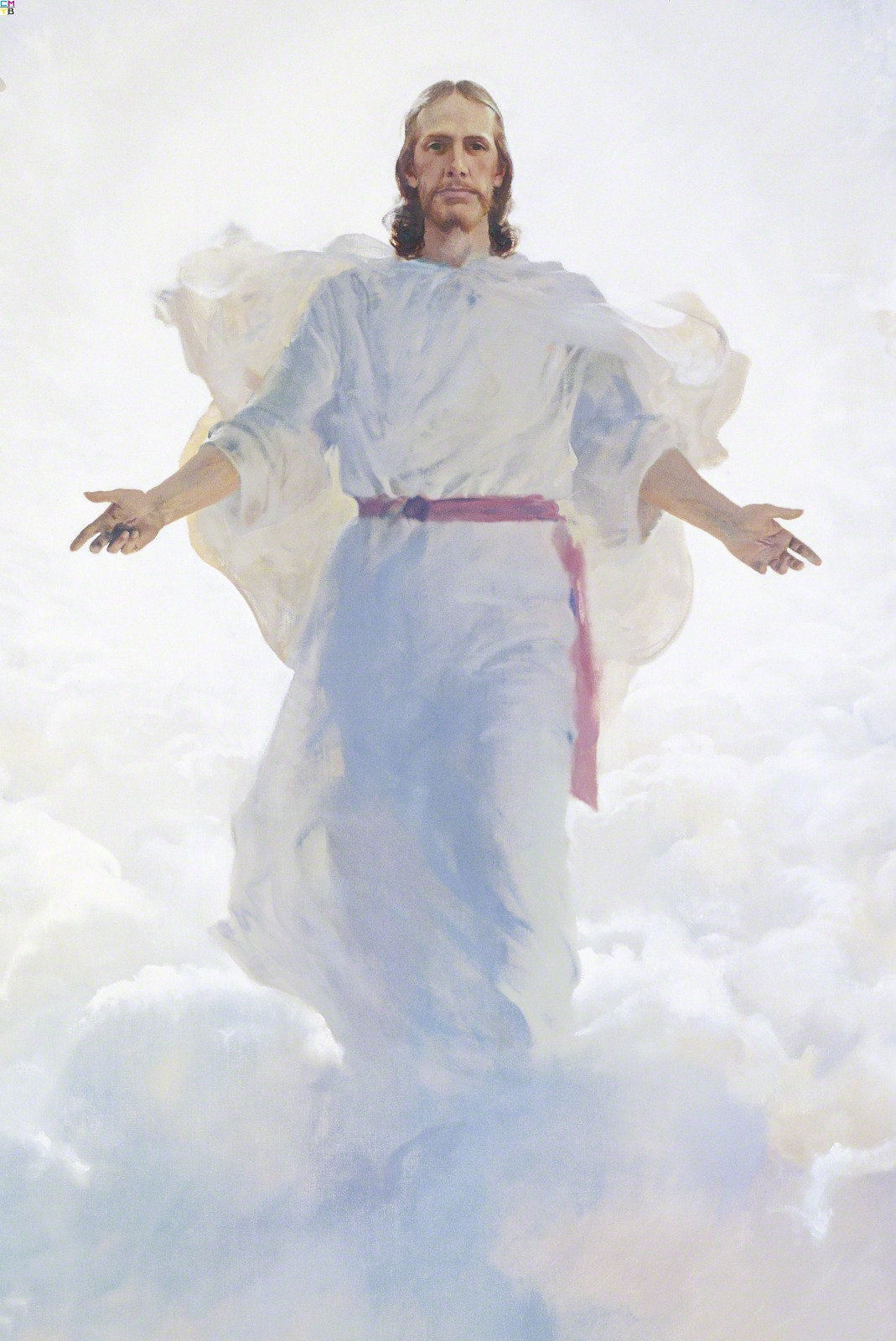
The “O how great’s” of Jacob
O how great… (2 Ne 9)
“…the wisdom of God, his mercy & grace!” (8)
“…the goodness of our God, who prepareth a way...” (10)
“...the plan of our God!” (13)
“...the greatness and the justice of our God!” (17)
“..the greatness of the mercy of our God...!” (19)
“...the holiness of our God!” (20)
Notes:
Chapter 9
13- We shall have a perfect knowledge of our guilt or righteousness. How does this impact you?
18- “they who have endured the crosses of the world…shall inherit the kingdom of God...and their joy shall be full forever!”
20- “holiness” FN-”committed, consecrated” BD- “set apart for a sacred purpose; the opposite of holy is therefore common, or profane”
20- “for he knoweth all things, and there is not anything save he knows it.” Neal A. Maxwell: “In a very real sense, all we need to know is that God knows all!” (All these things shall give thee experiences, [1979], 14-15, 21)
“Those who try to qualify God’s omniscience fail to understand that He has no need to avoid ennui [tedium] by learning new things. Because God’s love is also perfect, there is, in fact, divine delight in that ‘one eternal round’ which, to us, seems to be all routine and repetition. God derives His great and continuing joy and glory by increasing and advancing His creations, and not from new intellectual experiences.
“There is a vast difference, therefore, between an omniscient God and the false notion that God is on some sort of post-doctoral fellowship, still searching for additional key truths and vital data. Were the latter so, God might, at any moment, discover some new truth not previously known to Him that would restructure, diminish, or undercut certain truths previously known by Him. Prophecy would be mere prediction. Planning assumptions pertaining to our redemption would need to be revised. Fortunately for us, however, His plan of salvation is constantly underway—not constantly under revision. …
“In a very real sense, all we need to know is that God knows all!” (All These Things Shall Give Thee Experience[1979], 14–15, 21).

Slide 22
The “wo’s” of Jacob
“Wo unto…” (2 Ne 9)
“...him that has the law given..and transgrsseth them...for awful is his state!”(27)
“...the rich...for..they despise the poor...”(30)
“...the deaf that will not hear; for they shall perish”(31)
“...the blind that will not see; for they shall perish also (32)
“...the uncircumsized of heart...” (33) “...the liar...”(34)
“...the murderer...”(35) “...them who commit whoredoms”(36)
“...those that worship idols..”(37) “And, in fine...unto all who die in their sins”(38)
Notes:
Read 2 Ne 9:28-9 Hearken unto God’s counsels!
First, the harsh reality. Then, the love and the instruction. (Read

Slide 23
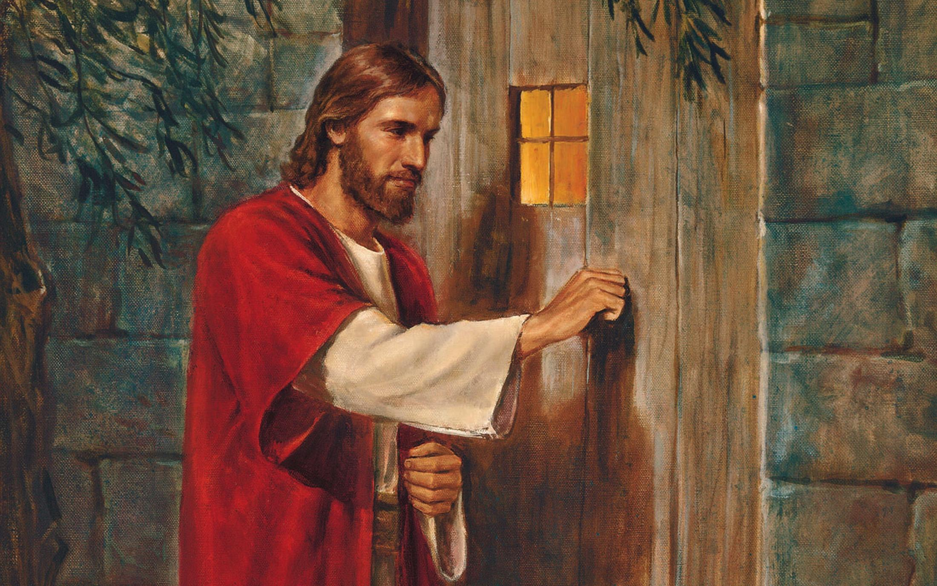
“Let your hearts rejoice”
After Jacob warns the people with his “wo’s,” he reminds them of God’s true love for them and for us.
Review 2 Ne 9:40-54, searching for evidence of God’s great love
Then, do as Jacob suggests and let your heart rejoice; let Him in.

Slide 24
“Cheer up Your Hearts…”
Prophecies: Jews will crucify their God, will be scattered, America is a land of liberty,
2 Ne 10: 23-25
“…cheer up your hearts...” (23)
“...remember that ye are free to act for yourselves...”(23)
“…reconcile yourselves to the will of God...”(24)
“...remember...it is only in and through the grace of God that ye are saved...”(24)
“...praise him through grace divine...”(25)

Slide 25
“Live after the manner of happiness…”
Through turning to and accepting Jesus Christ’s mercy, grace, power, and love.

Slide 26
Personal Inventory
Do I live “after the manner of happiness?”
What stands in my way?
How can I better understand and use the Atonement in my life?

Slide 27
Next Week
2 Ne 11-30, Student Manual chapters 10-13

