Slide 1
The Book of Mormon Another Testament of Jesus Christ
Lesson 1: Introduction
“The What, How, & Why of the Book of Mormon”
Christina G. Hibbert
christi@drchristinahibbert.com
www.DrChristinaHibbert.com
www.LikeAWateredGarden.com

Slide 2
The Book of Mormon…
“...should be considered the most remarkable and important religious text to be revealed since the writings of the New Testament were compiled nearly two millennia ago.
Indeed, in its role of restoring plain and precious biblical truths that had been lost, while adding scores of new truths about Jesus Christ and preparing the way for the complete restoration of his gospel and the triumphant day of his millennial return,
the Book of Mormon may be considered the most remarkable and important religious text ever given to the world.”
(Jeffrey R. Holland, Christ and the New Covenant [1997], 9–10, emphasis added)

Slide 3
Gordon B. Hinckley
“I promise you that if each of you will [read the Book of Mormon], regardless of how many times you previously may have read the Book of Mormon, there will come into your lives and into your homes an added measure of the Spirit of the Lord, a strengthened resolution to walk in obedience to His commandments, and a stronger testimony of the living reality of the Son of God.”
(“A Testimony Vibrant and True,” Ensign, Aug. 2005, 6)

Slide 4
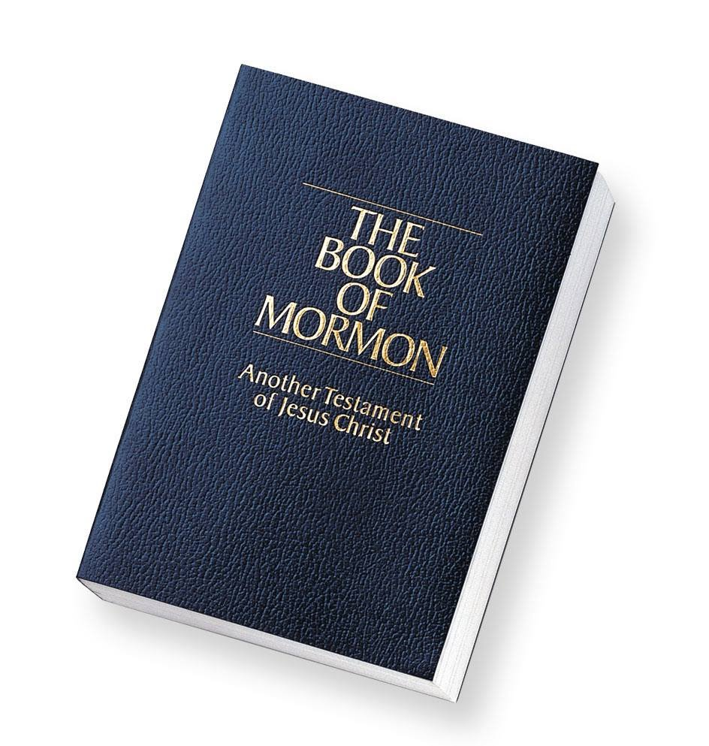
What IS the Book of Mormon?
What is it, historically?
What is it, spiritually?
What is it, personally, to you?

Slide 5
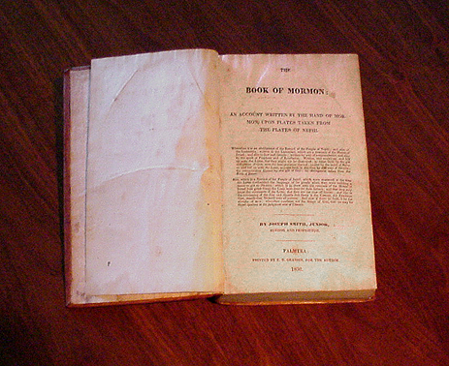
The Book of Mormon
An ancient record brought forth through the power of God & many witnesses have testified of its truthfulness
Another Testament of Jesus Christ
The Keystone of our Religion
We will draw closer to the Lord as we prayerfully study it
Notes:
Historically, it is an ancient record…
Spiritually, it is another testament and the keystone, just as Christ is the center of our faith.
Personally, it is our way to 1) Know God, and to 2) Become Like Him.
Joseph Smith: “If men do not comprehend the character of God, they do not comprehend themselves.” (Words of JS, 340)

Slide 6
Richard G. Scott
“…The Book of Mormon contains messages that were divinely placed there to show how to correct the influence of false tradition and how to receive a fulness of life. It teaches how to resolve the problems and challenges that we face today that were foreseen by the Lord. In that book he has provided the way to correct the serious errors of life, but this guidance is of no value if it remains locked in a closed book.”
(Ensign, Nov. 1988, p. 76)

Slide 7
Ezra Taft Benson
“Perhaps there is nothing that testifies more clearly of the importance of this modern book of scripture than what the Lord Himself has said about it.
‘By His own mouth He has borne witness (1) that it is true (D&C 17:6), 2) that it contains the truth and His words (D&C 19:26), 3) that it was translated by power from on high (D&C 20:8), 4) that it contains the fullness of the gospel of Jesus Christ (D&C 20:9, 42:12), 5) that it was given by inspiration and confirmed by the ministering of angels (D&C 20:10), 6) that it gives evidence to the fact that the holy scriptures are true (D&C 20:11), and 7) that those who receive it in faith shall receive eternal life (D&C 20:14)”
(Ensign, Nov 1986, p. 4)

Slide 8
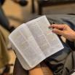
Joseph Smith
“Sunday, 28—I spent the day in the Council with the Twelve Apostles at the house of President Young, conversing with them upon a variety of subjects. Brother Joseph Fielding Smith was present, having been absent four years on a mission to England. I told the brethren that the Book of Mormon was the most correct of any book on earth, and the keystone of our religion, and a man would get nearer to God by abiding by its precepts than by any other book.”
(HC, 4:461)

Slide 9
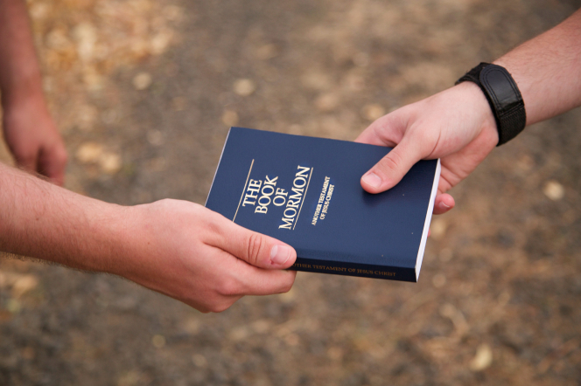
Bruce R. McConkie
“…There is no greater issue ever to confront mankind in modern times than this: Is the Book of Mormon the mind and will and voice of God to all men?”
(Mellenial Messiah, SLC: Deseret Book Co. 1982, p. 170)
Notes:
Is it? It is up to each of us to discover this for ourselves, and the beautiful part is that the Book of Mormon is created to tell us! It is a witness of itself, as we read in Moroni 10:3-5.

Slide 10
The Book of Mormon Comes Forth…
Notes:
Summarize how the Book of Mormon was written, abridged, and hidden and then brought forth again in our time.
Read selections of Joseph Smith’s testimony:
“He called me by name…and said that God had a work for me to do.” This is when Joseph Smith defines his call. It’s not until he prays to know what his call is (read JSH 1:28-30)
Read “He said there were deposited...” and “Also, that there were...”

Slide 11
Bro. Terryl Givens
Joseph Smith provides an example of doubt honestly acknowledged, honestly engaged, and powerfully profitable. He tells us that even after a heavenly vision, even after being told by Jesus Christ that his sins were forgiven, he again fell into doubt about his spiritual standing before the Lord.
He sought assurance and clarity, and the result was an angelic visitation, a divine commission, and the start of his prophetic career (which he dated to Moroni, not the First Vision).
Imagine the trajectory of the restoration, if someone had told young Joseph—stop worrying and asking questions.

Slide 12
Boyd K. Packer
“Perhaps no other book has been denounced so vigorously by those who have never read it as
The Book of Mormon.”
(Ensign, May 1986, p. 59)

Slide 13
Parley Pratt
At a meeting on June 28, 1874…Elder Pratt told his audience about being “present many times” when Joseph Smith “was translating the New Testament.” Seeing no interpretive instruments in use during the translation process, he wondered why Joseph “did not use the Urim and Thummim, as in translating the Book of Mormon.”
As Elder Pratt watched the Prophet translate, “Joseph, as if he read his thoughts, looked up and explained that the Lord gave him the Urim and Thummim when he was inexperienced in the Spirit of inspiration. But now he had advanced so far that he understood the operations of that Spirit, and did not need the assistance of that instrument.”²¹

Slide 14
Emma Smith Last Testimony of Sister Emma," The Saints' Herald 26 (Oct 1879): 289-90
Question. What of the truth of Mormonism? Answer. I know Mormonism to be the truth; and believe the Church to have been established by divine direction. I have complete faith in it. In writing for your father I frequently wrote day after day, often sitting at the table close by him, he sitting with his face buried in his hat, with the stone in it, and dictating hour after hour with nothing between us.
Question. Had he not a book or manuscript from which he read, or dictated to you? Answer. He had neither manuscript nor book to read from.
Question. Could he not have had, and you not know it? Answer. If he had had anything of the kind he could not have concealed it from me.
Question. Are you sure that he had the plates at the time you were writing for him? Answer. The plates often lay on the table without any attempt at concealment, wrapped in a small linen tablecloth, which I had given him to fold them in. I once felt of the plates, as they thus lay on the table, tracing their outline and shape. They seemed to be pliable like thick paper, and would rustle with a metallic sound when the edges were moved by the thumb, as one does sometimes thumb the edges of a book.
Question. Could not father have dictated the Book of Mormon to you, Oliver Cowdery and the others who wrote for him, after having first written it, or having first read it out of some book? Answer. Joseph Smith could neither write nor dictate a coherent and well-worded letter, let alone dictate a book like the Book of Mormon. And, though I was an active participant in the scenes that transpired, and was present during the translation of the plates, and had cognizance of things as they transpired, it is marvelous to me, "a marvel and a wonder," as much so as to anyone else.
Notes:
Questions asked by her son, shortly before her death.

Slide 15
Notes:
Quote L. Tom Perry-Speaker’s Sourcebook p. 35
Orson Pratt, p. 37-8

Slide 16
Hugh Nibley
“There are three possible explanations for the origin of the Book of Mormon. One is that it is a product of spontaneous generation. Another is that it came into existence in the way Joseph Smith said it did, by special messengers and gifts from God. The third is the hypothesis that Joseph Smith or some other party or parties simply made it all up. No experiments have ever been carried out for testing any of these theories. The first has not even been considered, the second has been dismissed with a contemptuous wave of the hand, and the third has been accepted without question or hesitation.
‘And yet the third theory is quite as extravagant as the other two, demanding unlimited gullibility and the suspension of all critical judgment in any who would accept it. It is based on the simple proposition that since people have written books, somebody, namely Smith or a contemporary, wrote this one. But to make this thesis stick is to show not only that people have written big books, but that somebody has been able to produce a big book like this one. But no other such book exists. Where will you find another work remotely approaching the Book of Mormon in scope and daring?”

Slide 17
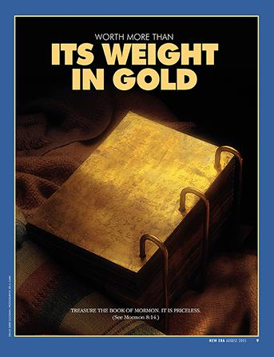
Mark E. Peterson
“The Book of Mormon is a literary and a religious masterpiece, and is far beyond even the fondest hopes or abilities of any farm boy. It is a modern revelation from end to end. It is God-given.”
(Ensign, Nov 1977, p.2)

Slide 18
Testimony of 3 & 8 Witnesses
Oliver Cowdery
David Whitmer
Martin Harris
Notes:
Read testimonies of 3 and 8

Slide 20
Witnesses of the BOM
President Heber J. Grant:
“I do not believe that in any court of justice in the world if a man was being tried for murder and twelve reputable citizens testified of their knowledge of the circumstances leading to the murder, and there was no one who could testify against what they said, there would be a failure to convict the man. We have the testimony of Joseph Smith and the testimony of three witnesses to the effect that God gave them a knowledge regarding the Book of Mormon, that an angel of God declared from heaven that the book had been translated by the gift and power of God. These men were Oliver Cowdery, David Whitmer and Martin Harris. They left the Church, but to the day of their death they maintained their testimony regarding the declaration of the angel, and that they were commanded to bear witness of the divinity of this book, and they did so. Eight men, some of whom were excommunicated from the Church, maintained their testimony that they had seen and handled the plates from which the Book of Mormon was translated, and they remained true to that testimony to the day of their death. The disbelief of all the world does not prove that those men did not tell the truth, because there are no witnesses on the other side” (in Conference Report, Apr. 1929, 128).

Slide 21
WHY The Book of Mormon?
3 Great Reasons
“There are 3 great reasons why Latter-day Saints should make the study of the Book of Mormon a lifetime pursuit.
‘The first is that the Book of Mormon is the keystone of our religion…the keystone of our testimony, the keystone of our doctrine, and the keystone in the witness of our Lord and Savior.
‘The second...is that it was written for our day....
‘The third...[is] it helps us draw nearer to God more than any other book....”
~Ezra Taft Benson (Ensign, November 1986, pp. 5-7)
Personal Reasons

Slide 22
1) Keystone of our Religion
Notes:
But is it the Keystone of our lives? Is it our guide? Our center? Our inspiration? Each day?

Slide 23
2) Written for US.
Ancient record written for modern-day use. Why?
The Book of Mormon focuses on modern-day issues
Concerns: Family, Life stress, Relationships, Doubt, Fear, Worldliness, Wayward children, Marriage, Parenting, Pride, Financial stressors, Perfectionism, Depression, Anxiety, War/political strife, Death/loss/grief, Heartache, Contention, Distractions, Addictions, Overcoming challenges...
Hopes: Faith, Happiness, Joy, Character development, Personal Growth,Self-improvement, Lifelong & Eternal progression, Charity, Love, Service, Leadership, Health, Mental Health/wellness, Refuge from life’s storms, Peace, How to know Heavenly Father & Jesus Christ, How to become like Heavenly Father & Jesus Christ....

Slide 24
3) Will help us draw Nearer to God.
“If men do not comprehend the character of God, they do not comprehend themselves.” ~Joseph Smith
“The very power of God is found in His attributes of godliness. We seek these attributes.” ~Elder Gene R. Cook
How can the Book of Mormon help us draw nearer to God?
1 Nephi 11:22-3

Slide 25
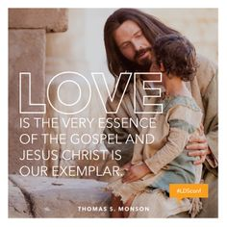
Jeffrey R. Holland
“The Book of Mormon teaches, both by what it is and what it says, that Jehovah will never forget us.”
(Ensign, Sept 1976, p. 10)

Slide 26
What is YOUR “Why?”
Notes:
Hugh Nibley quote- Class Summary

Slide 27
Personal Inventory
Do I know the Book of Mormon to be the word of God?
If not, am I ready to find out for myself?
If so, how do I know? How can I remember what I know? Am I ready for the next level of my understanding, conversion, and progression?
“Therefore, what?”
What will you do? What do you envision for your learning and growth from this class?

Slide 28
What will you choose?
“The experience of the presence of God is available and within at all times, but awaits choice. That choice is made only by surrendering everything other than peace and love to God.”
~David R. Hawkins

Slide 29
Ezra Taft Benson
“There is a power in the book [of Mormon] which will begin to flow into your lives the moment you begin a serious study of the book. You will find greater power to resist temptation. You will find the power to avoid deception. You will find the power to stay on the strait and narrow path. The scriptures are called “the words of life” (see D&C 84:85), and nowhere is that more true than it is of the Book of Mormon. When you begin to hunger and thirst after those words, you will find life in greater and greater abundance.”
(Ensign, Nov 1986, p. 7, emphasis added)

Slide 30
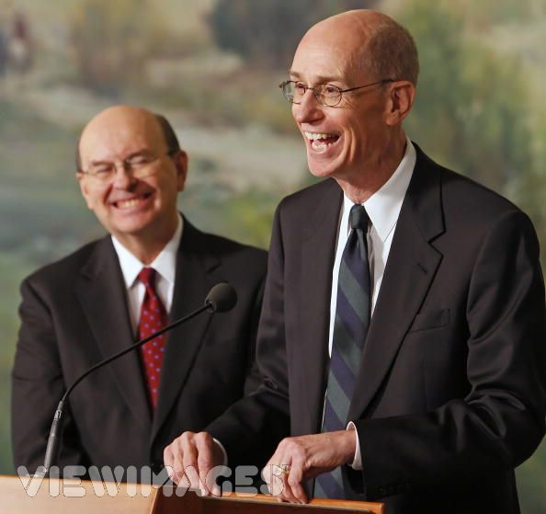
Henry B. Eyring
“The Book of Mormon is the most powerful written testimony we have that Jesus is the Christ. What did Nephi say was the basis for receiving the Holy Ghost? Faith in the Lord Jesus Christ. Will reading the Book of Mormon now and then ensure faith in the Lord Jesus Christ? You wouldn't count on it if you read Nephi carefully.
‘He said this "is the gift . . . to all those who diligently seek him." Diligently surely means regularly. And it surely means pondering and praying. And the praying will surely include the fervent pleading to know the truth. Anything less would hardly be diligent. And anything less will not be enough for you and for me.”

