Slide 1
The Book of Mormon Another Testament of Jesus Christ
Lesson 2: 1 Nephi 1-11
Choose God: A Christ-Centered Vision
Christina G. Hibbert
christi@drchristinahibbert.com
www.drchristinahibbert.com
www.likeawateredgarden.com

Slide 2
1 Nephi 1
V.1 “I, Nephi…” What do we learn from just this first verse?
“Goodly parents,” well-educated (secular & spiritual), “many afflictions,” “highly favored of the Lord,” knew the “mysteries of god,” now he’s making a record for us
V.5-14, 18 What do we learn from Lehi?
V.20 What is Nephi’s purpose, right from the start?
Show us “the tender mercies of the Lord are...”
“Over all whom he hath chosen”
Teach us of the power of deliverance
Notes:
Summarize 5-13 and read verse 14.
Lehi shows us how to know “the mysteries of God,” how to be a true disciple, increase faith, be obedient, and be delivered.

Slide 3
Background
600 BC=“pivotal year, everything turned on its hinges and there was an entirely new world.” (Nibley, Lecture 4, 47)
“Remember the Book of Mormon is a tragic book; it is ‘a voice from the dust.’” (Nibley Lecture 5, 62)
Lehi’s contemporaries:
“Gautama Buddha, Confucius, Laotze, Vardhaman Mahavira (founder of Jainism), Zarathustra, and Pythagoras were all of Lehi’s day” (Nibley, Lecture 4, 47)
Jeremiah “Being a very influential man and being of the party of Jeremiah, Lehi would have known Jeremiah…” (Nibley, Lecture 5, 67)
Notes:
Nibley, Lecture 4 Intro (47) “The sacral kingship went out of the window, and there was revolution everywhere. Suddenly, the founders of most of the world’s great religions appeared. They are all strictly contemporary with Lehi.”
…”It’s very sad, as you know. It begins on a note of destruction and ends on a note of destruction. It begins with lone survivors in the wilderness and ends with a lone survivor. There’s nothing more sad than survival; it’s a dirty word.” (Nibley, Lecture 5, 62)
BOM mentions destruction 456 times- it’s “the theme,” according to Nibley. Repent mentioned 360 times. “They are almost always mentioned in the same breath,” Nibley writes, “as they are here (1 Ne 1:4). You have your choice: You can repent, or you can be destroyed.” (Lec 8, 106)
“Lehi counted among his contemporaries not only the greatest first names in science, politics, and business, but also the most illustrious religious founders known to history…” (Lecture 4, 47)
Jeremiah: Prophesied in the 13th year of Josiah until after the downfall of Jerusalem, over 40 years (626-586). He faced much opposition, insult, mobs, cruelty, and After the fall of jerusalem, the Jews who escaped into Egypt “took Jeremiah with them as a kind of fetish (43:6), and at last, according to tradition, stoned him to death.” (Bible Dictionary)

Slide 4
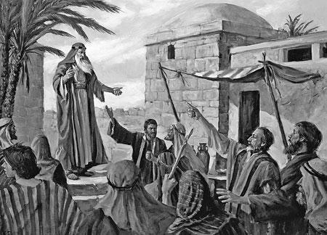
Pattern of Prophets
Prophets of All Ages
Lehi
Pray
Receive revelation, including meeting the Savior
Warn the people
Rejected by those warned
Many seek to take away life
Repeat
1 Nephi 1:5-20
1 Nephi 1:4-11 Lehi hears prophets testifying & believes
1 Ne 1:12-17 Prays on behalf of his people
1 Ne 1:6-12 & 14-15 Vision
Warns people, rejected, they seek his life
The Lord warns him to leave

Slide 5
George Q. Cannon
“Every man to whom the heavens have been opened and who has received revelations from God has been hated by his fellows. His life has been sought, and he has had no peace on the earth. No matter how numerous such personas have been they have been hunted and driven. So true is this that Stephen the martyr, when being stoned to death, taunted the Jews with their unbelief and the acts of their ancestors. Said he, ‘which of the prophets have not your fathers persecuted?’ and they have slain them which showed before the coming of the Just One.”

Slide 6
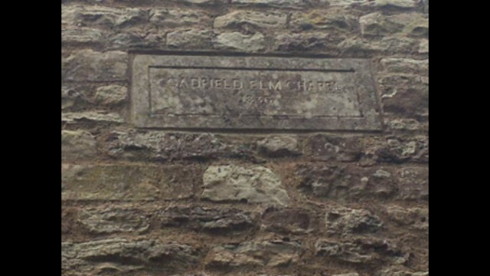
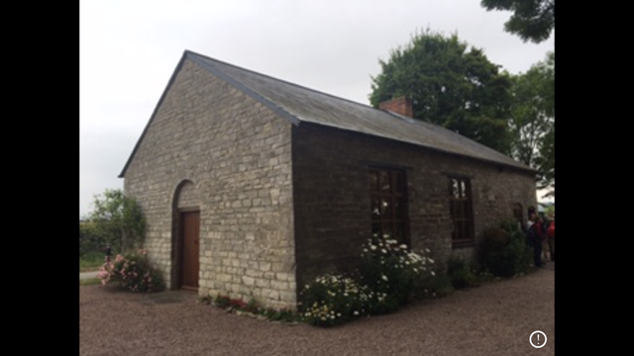
1st Chapel in British Isles
“The nearer a person approaches the Lord, a greater power will be manifested by the adversary to prevent the accomplishment of His purposes.” ~Joseph Smith
Notes:
Garfield Elm Chapel- first in England

Slide 7
Heber C. Kimball
Notes:
Read Millet “Questions, loc 66”

Slide 8
Tender Mercies of the Lord
1 Nephi 1:20 What are the tender mercies of the Lord?
“… The Lord’s tender mercies are the very personal and individualized blessings, strength, protection, assurances, guidance, loving-kindness, consolation, support, and spiritual gifts which we receive from and because of and through the Lord Jesus Christ. Truly the Lord suits ‘his mercies according to the conditions of the children of men’ (D&C 46:15).
“… One of the ways whereby the Savior comes to each of us is through His abundant and tender mercies. For instance, as you and I face challenges and tests in our lives, the gift of faith and an appropriate sense of personal confidence that reaches beyond our own capacity are two examples of the tender mercies of the Lord. Repentance and forgiveness of sins and peace of conscience are examples of the tender mercies of the Lord. And the persistence and the fortitude that enable us to press forward with cheerfulness through physical limitations and spiritual difficulties are examples of the tender mercies of the Lord”
(Elder David A. Bednar, in Conference Report, Apr. 2005, 105; or Ensign, May 2005, 99–100).
Notes:
1) What are some instances in the first 5 chapters of Nephi that show the Lord’s tender mercies? Blessings that are “personal and individualized”?
2) According to 1 Ne 1:20, who receives the Lord’s tender mercies? (all those whom he hath chosen)
3) What does Nephi say qualified people to be chosen? (faith)

Slide 9
“Chosen”
“It is our hearts and our aspirations and our obedience which definitively determine whether we are counted as one of God’s chosen…
‘The fundamental purposes for the gift of agency were to love one another and to choose God. Thus we become God’s chosen and invite His tender mercies as we use our agency to choose God.”
David A. Bednar, in Conference Report, Apr. 2005, 107; or Ensign, May 2005, 101; italics in original)
Notes:
We are chosen as we 1) love one another, and 2) choose God.
What do you think it means to “choose God?”
How does loving others help us “choose God” and become “chosen” to receive his tender mercies?
When/how have you recognized the Lord’s tender mercies or deliverance in your life/the life of someone you know?

Slide 10
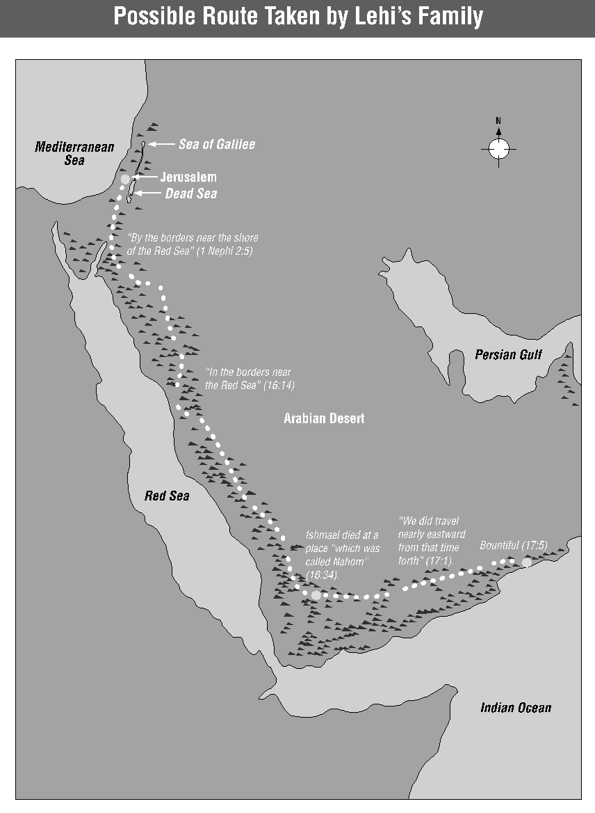
The Journey…
Lehi’s family’s journey (2:4-10)
We, too, are traveling through the wilderness.
Laman & Lemuel’s Response? (2:11-13)
Lehi’s Response? (Ne 2:14)
They couldn’t complain, but did they change their minds?
Nephi’s Response? (Ne 2:16-18)
Did he like the idea? No. BUT he desired to know, he prayed, & received revelation
Convinced his brother, Sam & Prayed for his other brothers
What would OUR response be?
Notes:
Nibley, loc 796-7
What IS our response when faced with the ‘wilderness?”

Slide 11
“I will go and do…” We can do hard things
Returning to Jerusalem, part 1 (1Ne 3 & 4)
Why did Laman & Lemuel say this command was a “hard thing?”
Approx 180 miles from Jerusalem to Red Sea
Lehi & family traveled 3 days beyond this
At least 12-14 day trip, one way
What was Nephi’s response? (1 Ne 3:7)
How did Nephi know God would “prepare a way?”
Notes:
Read 1 Ne 1 3:7 (Memorize!)
How did Nephi know God would prepare a way?
personal connection to Jesus Christ, just like Joseph Smith’s testimony—He knew God would answer (JSH-pray and then Moroni’s visit)
He believed the stories of the scriptures
Faith of Nephi (Ne 4:6-7)
Sariah (Ne 5:8)
What experiences have shown you the truth of Nephi 3:7?

Slide 12
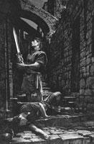
“I was led by the Spirit...”
Nephi & Laban (1 Ne 4:6-7)
“Nevertheless, I went forth…”

Slide 13
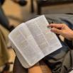
The Scriptures…
Preserve History, Genealogy, the Word of God
The brass plates “were ‘the record of the Jews’ (1 Ne. 3:3), a record of many of the prophecies from the beginning down to and including part of those spoken by Jeremiah. On them was the law of Moses, the five books of Moses, and the genealogy of the Nephite forebears. (1 Ne. 3:3, 20;4:15–16; 5:11–14. There was more on them than there is in the Old Testament as we now have it. (1 Ne. 13:23.) The prophecies of Zenock, Neum, Zenos, Joseph the son of Jacob, and probably many other prophets were preserved by them, and many of these writings foretold matters pertaining to the Nephites. 1 Ne. 19:10, 21; 2 Ne. 4:2, 15; 3 Ne. 10:17.)…”
~Bruce R. McConkie

Slide 14
The Scriptures…
Preserve Faith
“The value of the Brass Plates to the Nephites cannot be overestimated. By means of them they were able to preserve the language (1 Ne. 3:19), most of the civilization, and the religious knowledge of the people from whence they came. (1 Ne. 22:30.) By way of contrast, the Mulekites, who were led out of Jerusalem some 11 years after Lehi’s departure, and who had no record equivalent to the Brass Plates, soon dwindled in apostasy and unbelief and lost their language, civilization, and religion. (Omni 14–18.) ~Bruce R. McConkie (Mormon Doctrine, 2nd ed. [1966], 103).
Bring us Closer to Christ
Lehi’s response to the scriptures (1 Ne 5:17)
How did Nephi & Lehi show they valued the scriptures? (1 Ne 5:20-1)
Notes:
2. “More than 300 years after Lehi and family left Jerusalem, his descendants discovered a group of people whose ancestors had also fled Jerusalem. These people, who now lived in a city they called Zarahemla, had not carried written scriptures.” ™
READ Omni 1:14-17
No records= Lose faith and language
Eventually, Nephites joined with these people (Mulekites) united under leadership of Mosiah. Hi s son, Benjamin became king and taught from the scriptures. (Mosiah 1:3-we must have suffered “not knowing the mysteries of God”)

Slide 15
Plates of Brass
Like Old Testament but more extensive
Actually made of bronze
Came to Laban’s hands possibly through ancestors from N. tribes who settled in Jerusalem
Written in Egyptian (Mosiah 1:4)
Writings of Isaiah, Zenos, Zenock, Neum, Esias
Christ-centered, straightforward about atoning work of the Savior, & “distinct natures of God the Father and his beloved Son (1 Ne 19:7-12; Alma 33:3; Hel 8:18-20; 3Ne 10:15-16)
Also prophecies of Joseph of old (2 Ne 3; 4:1-2)
Notes:
**BOM Reference Companion, p. 643: “Scriptural records were not accessible to all people at the time of Lehi and Laban. Prior to the Assyrian captivity in 722 BC, the brass plates may have been kept by the northern tribes, from whom Lehi and Laban descended (Millet, 208-9). Perhaps the records were carried by Lehi and Laban’s ancestors who escaped the Assyrian deportation and settled in Jerusalem.”
--Written in Egyptian, “perhaps attesting to the influencer of such notable prophets as Joseph and Moses, both of whom had spent many years in Egypt.” (RC, 643)

Slide 16
Bruce R. McConkie
Of the brass plates, Elder McConkie “suggested that in a future day, ‘the Lord will raise up a prophet, who will also be a seer and a translator, to whom he will give the brass plates that they may be translated for the benefit and blessing of those in all nations.”
(McConkie, Bruce R. ‘The Doctrinal Restoration.’ The Joseph Smith Translation: The Restoration of plain and precious things. Provo, UT, Religious Studies Center, Brigham Young University, 1985, 16; in BOM Reference Companion, p. 644)

Slide 17
The Book of Mormon Brings Us Unto Christ
1 Ne 6:3-4 “For the fulness of mine intent is that I may persuade men to come unto the God of Abraham and the God of Isaac, and the God of Jacob, and be saved.”
President Ezra Taft Benson: “The Book of Mormon brings men to Christ…It tells in plain manner of Christ and HIs gospel. It testifies of His divinity and of the necessity for a Redeemer and the need of our putting trust in Him. It bears witness of the Fall and the Atonement and the first principles of the gospel, including our need of a broken heart and a contrite spirit and a spiritual rebirth. It proclaims we must endure to the end in righteousness and live the moral life of a Saint.” (“We Add our Witness,” Ensign Mar. 1989, 5)
Notes:
Why does it say “Abraham and Isaac and Jacob?” Reminds us this is THE Christ! The Creator, The God of Abraham, Isaac, Jacob, and more! He lived before His earthly ministry,a and He lives again! (President Benson)

Slide 18
Lehi’s Vision
Dark and dreary wasteland (8:7); Large and spacious field (8:9,20)
The tree with white fruit (8:10-11)
The river of filthy water (8:13; 12:16)
The rod of iron (8:19)
Mists of Darkness (8:23)
The great and spacious building in the air (8:26)
World (1 Ne 8:20)
Love of God (11:21-22)
Hell/depths (12:16; 15:26-36)
Word of God (11:25; 15:23-5)
Temptations (12:17)
Pride, worldly wisdom and vanity (11:35-6; 12:18)

Slide 19
4 Types of People in Lehi’s Vision
People who start on the path to the tree but are lost in the mist (8:21-3).
1) Multitudes who heard Jesus but “cast him out” (11:28), 2) People who crucified Jesus even after He healed the sick and cast out devils (11:31-33), 3) Multitudes who gathered together in a large and spacious building to fight against the 12 Apostles of the Lamb (11:34-36), 4) Nephites and Lamanites who were gathered together to battle and were slaughtered in war (12:1-4,13-15), 5) Nephites who, because of pride, were destroyed by the Lamanites and dwindle in unbelief (12:19-23)
People who make it to the tree and taste the fruit by holding onto the rod but fall away when they are mocked (8:24-5, 28)
People who desire the great and spacious building more than the tree (8:26-7, 31-33)
People who held onto the rod and partook of the fruit; they ignored the mockers and did not fall away (8:30,33)
These are those who partake of the greatest of all God’s gifts—eternal life (15:36)

Slide 20
The Sower & Lehi’s Vision
The Parable of the Sower (Matt 13:3-9; Mark 4:3-9; Luke 8:5-8)
Interpretation of the Parable, by the Savior (Matt 13:18-23; Mark 4:13-20; Luke 8:11-15

Slide 21
Parable of the Sower…
“Observe that the prominent feature of the story is that of the prepared or unprepared condition of the soil. The seed was the same, whether it fell on good ground or bad, on mellow mold or among the stones and thistles…
‘...Though commonly known as the Parable of the Sower, the story could be expressively designated as the Parable of the Four Kinds of Soil. It is the ground upon which the seed is cast to which the story most strongly directs our attention, and which so aptly is made to symbolize the softened or the hardened heart, the clean or the thorn-infested soil...”~James E. Talmage
(Jesus the Christ, p. 283-5)
Notes:
4 grades of soil, in increasing order of their fertility:
“…The compacted highway, the wayside path, on which, save amounting to a miracle, no seed can possibly strike root or grow;”
“the thin layer of soil covering an impenetrable bed-rock, wherein seed may sprout yet can never mature;”
“the weed-encumbered field, capable of producing a rich crop but for the jungle of thistles and thorns; and”
“the clean rich mold receptive and fertile. Yet even soils classed as good are of varying degrees of productiveness, yielding an increase of thirty, sixty, or even a hundred fold, with many inter-gradations.” (Jesus the Christ, p. 285)

Slide 22
4 Grades of Soil
4 grades of soil, in increasing order of their fertility:
“…The compacted highway, the wayside path, on which, save amounting to a miracle, no seed can possibly strike root or grow;”
“the thin layer of soil covering an impenetrable bed-rock, wherein seed may sprout yet can never mature;”
“the weed-encumbered field, capable of producing a rich crop but for the jungle of thistles and thorns; and”
“the clean rich mold receptive and fertile. Yet even soils classed as good are of varying degrees of productiveness, yielding an increase of thirty, sixty, or even a hundred fold, with many inter-gradations.” (James E. Talmage, Jesus the Christ, p. 285)

Slide 23
The Tree of Life
“The Spirit made explicit that the Tree of Life and its precious fruit are symbols of Christ’s redemption.” ~Jeffrey R. Holland (Christ and the New Covenant [1997], 160)
“The tree of life…is the love of God (1 Ne 11:25). The love of God for His children is most profoundly expressed in His gift of Jesus as our Redeemer: ‘God so loved the world, that he gave his only begotten Son’ (John 3:16). To partake of the love of God is to partake of Jesus’ Atonement and the emancipations and joys which it can bring.” ~Neal A. Maxwell (Ensign, Nov 1999, 8)

Slide 24
Personal Inventory
Which type of person am I? (Lehi’s vision; Parable of the Sower) How can I be more like Lehi, Sariah, Nephi?
In what ways do I prevent the Lord from blessing me with all He hath?
Do I accept God’s love? Do I treasure it as the greatest gift, most joyous to my soul? How might I improve?
Do I treasure the scriptures? Am I doing as Nephi and Lehi did with my scriptures—search, find them valuable, obey? (1 Ne 5:20-1) How can I increase my understanding and love of the word of God?

Slide 25
Elder Lowell M. Snow
“Life is full of many intersecting roads and trails. There are so many paths to follow, so many voices calling out ‘lo, here’ or ‘lo, there’ (JSH 1:5). There is such a variety and volume of media flooding our personal space, most of it intent on herding us down a path that is broad and traveled by many. When pondering which of these voices to listen to or which road among the many is right, have you ever asked yourself, as Joseph Smith did: ‘What is to be done? Who of all these [voices and roads is] right; or, are they all wrong together? If any of them be right, which is it, and how shall I know it?’ (JSH 1:10) “My witness to you is that Jesus Christ continues to mark the path, lead the way, and define every point on our journey. His path is strait and narrow and leads toward ‘light and life and endless day’ [Hymns, no.195]”
(Ensign, Nov. 2005, 96)
Notes:
Challenge/Goal: Study, ponder, pray about the Book of Mormon daily and read or reread the entire Book of Mormon as part of this course.
Option: Write in your journal about what you feel when you faithfully study the Book of Mormon—how you feel about the book, about the people and stories in the book, about the Savior, and about yourself/your family. Write a short letter to a family member or son/daughter describing the value the Book of Mormon has in your life.

