Slide 1
The Book of Mormon Another Testament of Jesus Christ
Lesson 4: 1 Nephi 16-22
Find and follow the light…
Christina G. Hibbert
christi@drchristinahibbert.com
602-361-7364

Slide 2
1 Ne 16-22 Themes
The Lord loves us all and shows his love in various ways
The Lord guides/directs us (Liahona)
The Lord chastens and forgives whom He loves (Bow/Crossing the Ocean)
The Lord blesses and strengthens those who keep His commandments (Promised Land)
The Lord enables and empowers us (Ship-building)
Nephi’s purpose in creating his record
Isaiah and promises for our day
Notes:
1) Opening scene: Nephi has just finished explaining the Tree of Life, and why we need to be clean and pure to dwell with God. (15:33-36)
2) As 16 opens, Laman and Lemuel are doing what they do best: murmuring and complaining. V1 “Thou has declared unto us hard things…”
Nephi teaches that “the guilty taketh the truth to be hard, for it cutteth them to the very center” (v2). He exhorts his brethren to keep the commandments (4), they DO humle themselves (5) and he has “joy and great hopes in them...”
So, for now, we are good to go.
3) They are all married! Marriage to Ishmael’s daughters (7). They had fulfilled all the commandments the Lord had given them (16:8)
This speaks to the Importance of marriage—that the commandments included being married.
4) Lehi hears the voice of the Lord command him to take their journey into the wilderness (9) and…in the morning, he discovers the Liahona (10)

Slide 3
The Lord leads, guides, directs His faithful Servants (and us!)
Liahona
1 Ne 16:10-30
“Light in the Wilderness”
1 Ne 17:13
Notes:
Cell phone

Slide 4
1) Liahona
Compass/directions 1 Ne 16:10; 30
Guide 16:16
Chastening/correction 16:26-7
Faith-building 16:28
Instruction/teaching 16:29
This “round ball of curious workmanship” (v. 10) worked according to their faith (v.28) and led them “in the more fertile parts of the wilderness” (v. 16).
“…a physical instrument that served as an outward indicator of their inner spiritual standing before God...”
~David A. Bednar
Notes:
What is our personal Liahona and how can we increase the power of the “Liahona” in our life?

Slide 5
The Lord Guides/Directs Us-- Our Liahona
David A. Bednar:
“As we each press forward along the pathway of life, we receive direction from the Holy Ghost just as Lehi was directed through the Liahona. ‘For behold, again I say unto you that if ye will enter in by the way, and receive the Holy Ghost, it will show unto you all things what ye should do’ (2 Nephi 32:5). The Holy Ghost operates in our lives precisely as the Liahona did for Lehi and his family, according to our faith and diligence and heed”
(in Conference Report, Apr. 2006, 31; or Ensign, May 2006, 30–31).
Holy Ghost
Scriptures
Prophets
Personal Revelation
Notes:
“…The primary purposes of the Liahona were to provide both direction and instruction during a long and demanding journey. The director was a physical instrument that served as an outward indicator of their inner spiritual standing before God. It worked according to the principles of faith and diligence. Just as Lehi was blessed in ancient times, each of us in this day has been given a spiritual compass that can direct and instruct us during our mortal journey. The Holy Ghost was conferred upon you and me as we came out of the world and into the Savior’s Church through baptism and confirmation. By the authority of the holy priesthood we were confirmed as members of the Church and admonished to seek for the constant companionship of ‘the Spirit of truth; whom the world cannot receive, because it seeth him not, neither knoweth him: but ye know him; for he dwelleth with you, and shall be in you’ (John 14:17). As we each press forward along the pathway of life, we receive direction from the Holy Ghost just as Lehi was directed through the Liahona. ‘For behold, again I say unto you that if ye will enter in by the way, and receive the Holy Ghost, it will show unto you all things what ye should do’ (2 Nephi 32:5). The Holy Ghost operates in our lives precisely as the Liahona did for Lehi and his family, according to our faith and diligence and heed” (in Conference Report, Apr. 2006, 31; or Ensign, May 2006, 30–31).
What is your personal Liahona? (The Holy Ghost, personal revelation, following the scriptures and the words of the prophets, etc?) What are the “more fertile parts of the wilderness” through which it leads you, when you are faithful? Is your Liahona working? Why or why not?

Slide 6
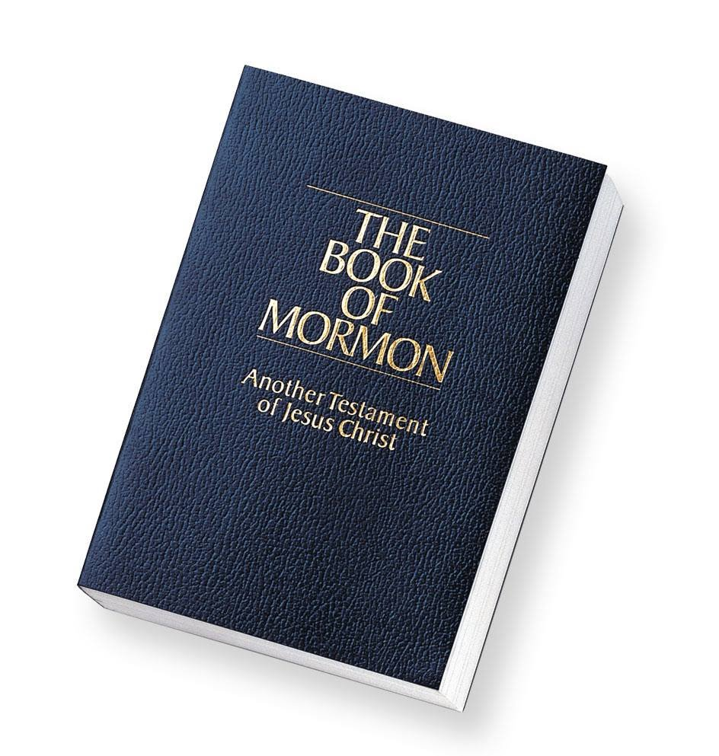
“Look to the book”
“For the faithful, the Book of Mormon itself is a type of Liahona for it contains ‘the word of Christ, which will point to you a straight course to eternal bliss’ (Alma 37:44). Like the Liahona, the Book of Mormon was in fact ‘prepared for [all people], that if they would look they might life’ (Alma 37:44).” Book of Mormon Reference Companion, p. 520

Slide 7
“Small and simple…”
Read 1 Ne 16:28-29
What are the “small means” to which Nephi is referring?
What “small” things must we do to receive “great things?”

Slide 8
“Light in the Wilderness”
Read 17:13
What important lessons do we learn from this one verse?
Read 17:14
What important point is made here?
How can we apply these things to our own lives?

Slide 9
Our “Wilderness”
M. Catherine Thomas:
“And so it is that Man, trailing glory into a darker sphere, commences a course in deep impact training. The memory of his premortal powers and glories tucked away, he begins to interact with his new surroundings through a veiled consciousness. As he grows in his new world, his consciousness begins to develop anew, influenced now primarily by his fallen environment. His mind is shaped by both accurate and inaccurate interpretations of the nature of things. With now memory of who he really is, he fixes on his emotional and physical survival, thus fostering self-absorption and anxiety. Flawed ideas take root in his mind, which cause him to react to life in unconscious, negative patterns. Conditional love and even hatred dog him. His perception is clouded by vain imaginings and faulty interpretations. He relates to the world through the lens of his own self-talk instead of perceiving reality directly. He sins and is sinned against. Fear threads its way through his life. His confused mind fashions his perception of a confused world. That is, the Natural Man suffers from a degree of insanity.” (Light in the Wilderness, p. 66)
Notes:
What are our “wildernesses?” Your list may include things like: raising children, being single, school, work, financial stress, or just life stress. It may include illness, opposition from others, mental illness, or just trying to live “in the world but not of the world” as the “great and spacious building” seems ever more present.
Sister M. Catherine Thomas explains another element I believe is a huge part of our “wilderness” experience. She calls this “the wilderness mind:”
Do you ever feel you “suffer from a degree of insanity?” Does your mind ever feel like it has a mind of its own? It does. And, bringing our minds and bodies into line with the Spirit is one of the biggest aspects of this wilderness life.

Slide 10
Brigham Young
“Until you can govern and control the mind and the body, and bring all into subjection to the law of Christ, you have a work to perform touching yourselves.”

Slide 11
Reflection
What is my “liahona?”
Is it working?
Why or why not?
What are my “wildernesses?”
What can I do to gain greater access to the Lord’s guidance in my life?

Slide 12
“The Lord chastens & forgives whom He loves…”
Nephi’s Bow
Crossing to the Promised Land

Slide 13
2) Nephi’s Bow
When have you responded to trials like Laman & Lemuel? Lehi? Nephi?
Nephi’s response 16:22-25;30-32)
“…Irriatation often precedes instruction.” (If thou Endure it Well, 1996, 128) Neal A. Maxwell.
No bow= no food (16:18-19)
It was made of fine steel (hard to come by) (16:18)
Even Lehi murmurs (v.20)
How does Nephi respond?
Notes:
1. This goes to show that severe stress (like being unable to feed your family) can lead to spiritual distress, and even the prophets are not immune.
2. This experience demonstrates Nephi’s true strength, humility, and character, once again. He could have asked the Lord himself, but he turned to his father, and in so doing, he provided his father with the opportunity to repent and become the spiritual leader once more. “And the voice of the Lord came unto my father; and he was truly chastened because of his murmuring against the Lord” (v. 27). Nevertheless, Lehi was humbled and did repent, and not only was Lehi shown where Nephi should go to find food (to the mountain, or the “temple”); a new writing also appeared on the Liahona, giving them “understanding concerning the ways of the Lord” (v.29). Essentially, they received even greater knowledge as a result of this experience. “And thus we see that by small means the Lord can bring about great things.”
Q: What are our “broken bows”? Do we inquire of the Lord, “Whither shall I go?” Do we turn to our parents and leaders and let them lead and guide us? Do we repent when we murmur? Do we have enough faith to learn the “ways of the Lord,” and to obey?

Slide 14
“Whom the Lord loveth, He chasteneth..”
Why does the Lord chasten Lehi? Why does he have to chasten us?
“God is not only there in the mildest expressions of His presence, but also in those seemingly harsh expressions. For example, when truth ‘cutteth…to the very center’ (1 Ne 16:2), this may signal that spiritual surgery is underway, painfullly severing pride from the soul.” ~Neal A. Maxwell (Ensign, Nov. 1987, 31)
Notes:
“The guilty taketh the truth to be hard” 16:2
Have you ever experienced the need for “spiritual surgery?” I believe we all have, and it isn’t easy. In fact, it’s painful. Still, as we put our faith in the Lord and let him “lead [us] toward the promised land,” (17:13), we will one day know He truly was cutting the cancer from our soul. He truly was preparing a better way.

Slide 15
The Lord Blesses & Strengthens those who Keep His Commandments
Journey/ Arriving in Bountiful

Slide 16
3) Bountiful
8 years! Why?
Arrive at Bountiful—blessed greatly!
Ishmael’s death/ Mourning of his daughters
16:37 Laman, Lemuel, sons of Ishmael want to kill Lehi & Nephi. Why? He “has taken it upon him to be our ruler and our teacher”
How can they lie so and become so wicked? (v. 38)
But…”the Lord was with us...” (v. 39)
Notes:
They’re letting Satan get hold of their thoughts, minds, words, and actions. They care more about their fear of Nephi being their “ruler”—his grand scheme to supposedly set himself up in the wilderness as their teacher and king—than about what the Lord has shown them. They’ve forgotten they’ve seen an angel and witness the power of God on multiple occasions. Now, they’re so low they’re willing to kill.
39—The Lord intervenes, chastening them and reminding them that He gives us ALL. Once they’ve repended again, they’re again blessed with food. It all comes from the Lord. Safety. Guidance. Motivation, Understanding, Learning, Food, Peace.

Slide 17
The Lord enables and empowers us…
Ship-building 101

Slide 18
4) Build a Ship
1 Ne 18:1-4 How did Nephi prepare?
The Lord showed Nephi how to build the ship “from time to time”. Why was this helpful? Why is it important for Nephi/us to follow the Lord’s instuctions before the Lord will teach us more?
How can we follow Nephi’s example and build a “life” that like his Ship, is “exceedingly fine” in the eyes of the Lord?
Notes:
He did not doubt. He knew the Lord would teach Him. He asks, “Whither shall I go…?”
We, too must Prepare to receive instruction, enlightenments, power!

Slide 19
Nephi writes to persuade us to “Come Unto Christ…”

Slide 20
Nephi writes to persuade us to “Come Unto Christ…”
Nephi clearly states his purposes in writing these scriptures: “that perhaps I might persuade them that they would remember the Lord their redeemer” (19:18).
Why is it important we know this?
How can we come more fully unto Christ through Nephi’s words?
Notes:
Isaiah…

Slide 21
Nephi & Isaiah
First, Isaiah saw Christ, as Nephi and his brother Jacob did (2 Ne 11:2-3).
Second, Isaiah writes almost exclusively of Jesus Christ. He and Nephi share the same purpose in their writing.
Jesus Christ likewise commands us to study the words of Isaiah (3 Ne 23:1-3)!

Slide 22
Nephi & Isaiah
1 Ne 19:23-4 “liken all scriptures”
The Lord refines us through the “furnace of affliction” (1 Ne 20) 1-17)
How can the furnace of affliction help us be faithful to the Lord?
The Lord will never forget us…(1 Ne 21:13-16)
His love is great and for us all.

Slide 23
Personal Inventory
Revisit each question in this lesson. Set aside time to write in your journal honestly, answering each one.
What can you do to “find and follow” the light? What is one thing you can do to “be led” through your wilderness, to your promised land?
Ask yourself, “Can I feel the love of Christ as I study these chapters?” If not, what is standing in your way? If so, what does it feel like? Write about it in your journal.

Slide 24
Next Week
2 Ne 1-10, Student Manual chapters 7-9
Looking Ahead: Oct 18- 2 Ne 11-30 Isaiah! SM 10-13

