Slide 1
Sibling Grief
Lifelong Healing:
What Everyone Should
Know
Christina G. Hibbert, Psy.D.
www.DrChristinaHibbert.com
Instagram: @drchristi_hibbert
Twitter: @DrCHibbert
Facebook.com/drchibbert

Slide 2
We all have a story…
“What does that mean anyway—strong?...Perhaps being truly strong simply means being vulnerable enough to allow our story to be written…”
“We all have a story…but will it be a great one?” Will we...be created by the twists and strengthened by the turns?...”
(This is How We Grow, p. 11)
Notes:
p. 11 TIHWG

Slide 3
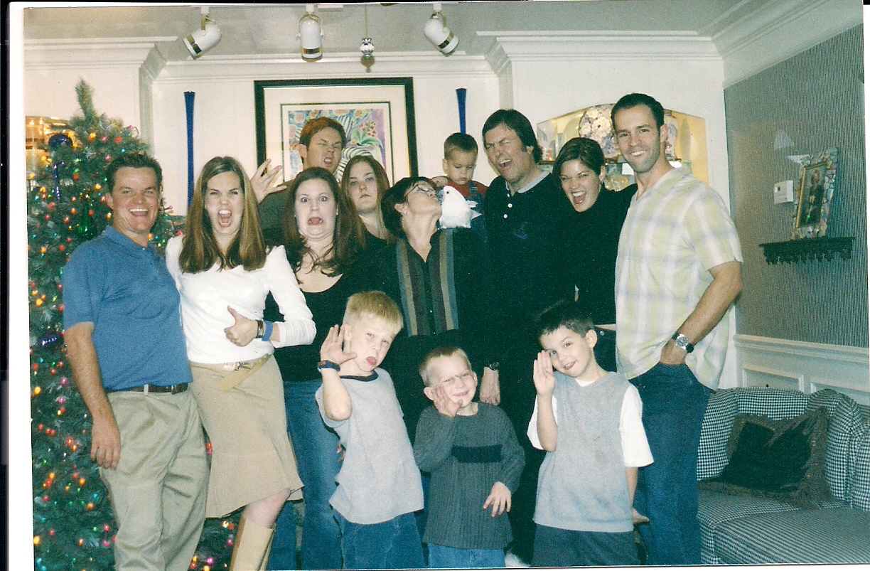

Slide 4
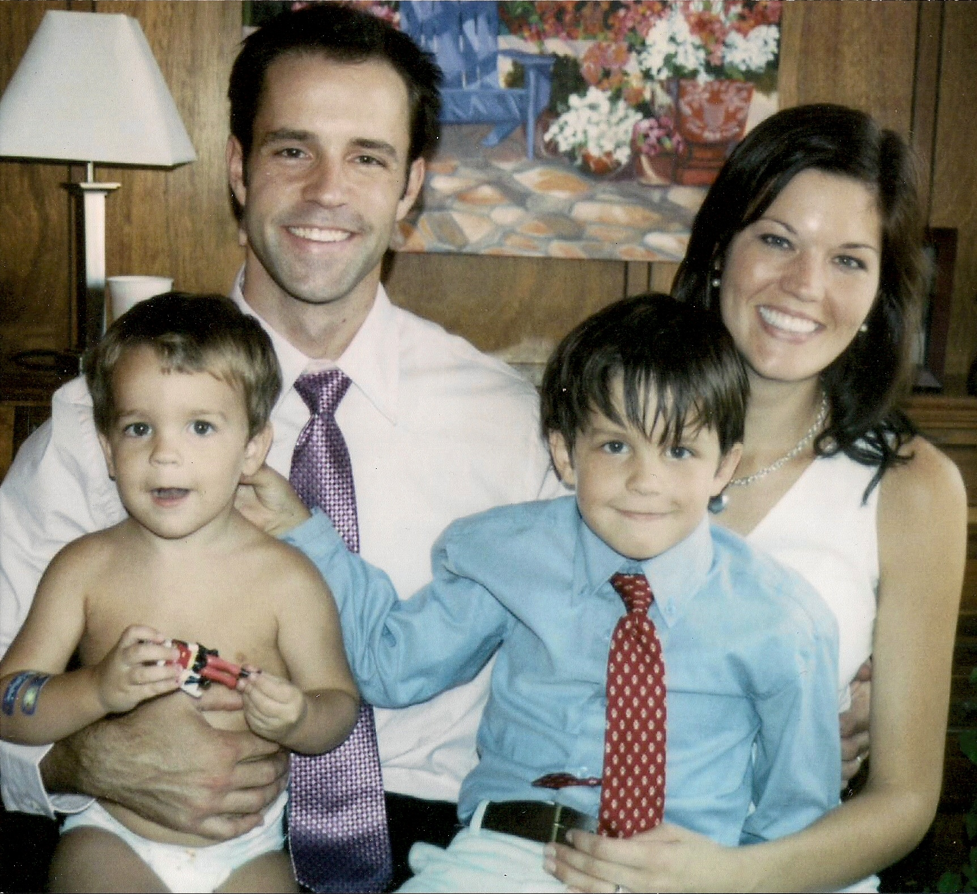
Notes:
I do know the trauma of having the police call, not teling you what’s happened, and finding out later that they don’t exactly know what did happen. I know the expectation and disappointment of waiting months for the autopsy report to see how my sister died…

Slide 5
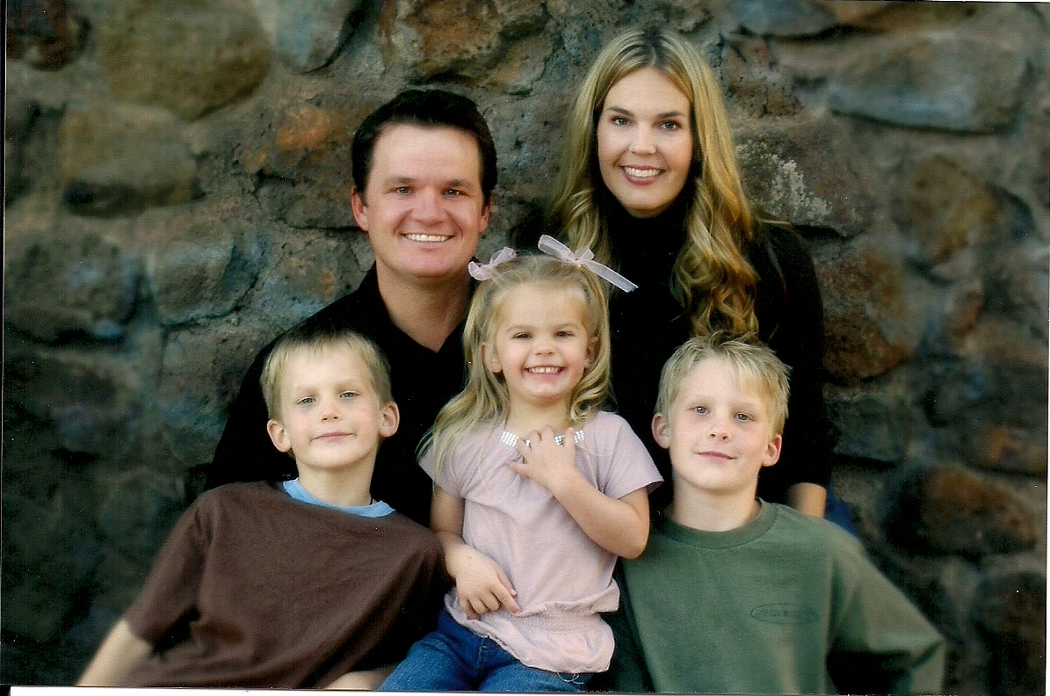

Slide 7
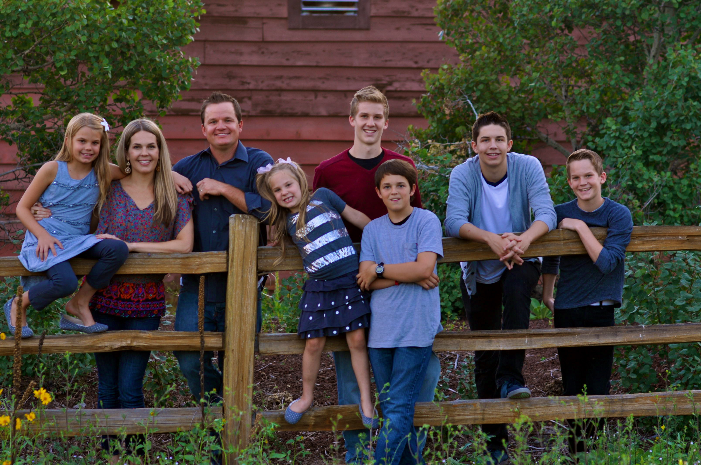

Slide 9
Understanding Loss
“…His whole way of life will be changed. All sorts of pleasures and activities that he once took for granted will have to be simply written off. Duties too. At present I am learning to get about on crutches. Perhaps I shall presently be given a wooden leg. But I shall never be a biped again.”
(C.S. Lewis, A Grief Observed, p. 53)
Notes:
First, I want to help you understand the nature of loss, grief, and trauma, and then we will focus on how to deal, cope, and heal…

Slide 10
LOSS
Primary
Secondary
Obvious
Hidden
Physical: (tangible)
Symbolic: (psychosocial)
Notes:
With children, some losses are obvious, like the tangible losses adults experience (death, moving, lose a friend). Many losses are hidden, however. These are sometimes secondary losses and often the parents and family don’t even realize the child has been affected. Example: financial loss in a parent can affect the child: Parents fighting= child’s sense of security and peace may be off, etc.

Slide 11
Trauma
Emotional response to a terrible event
Any event that makes you feel threatened or overwhelmed
The more frightened/helpless you feel, the more likely you are to be traumatized
Immediately after, shock and denial common
Longer term: unpredictable emotions, flashbacks, strained relationships, physical symptoms or nausea

Slide 12
Causes of Emotional/Psychological Trauma
One time event
accident, injury, natural disaster, violent attack to you/ loved one…
Ongoing, relentless stress
Often overlooked causes
surgery, sudden death of loved one, loss of significant relationship, humiliating, shameful, or deeply distressing experience
HelpGuide.com, Emotional & Psychological Trauma

Slide 13
GRIEF “Grief is the process that allows us to let go of that which was and be ready for that which is to come.” Therese Rando, 1984, p.17

Slide 14
GRIEF
“Grief can only be described as a time of craziness when all the rules that govern life are suspended, when coping mechanisms that used to work no longer do, when the foundation and rhythm of your days are shattered into an unrecognizable crazy-quilt.”
(Bernstein, 1997, p.5)

Slide 15
“Normal” Grief
Wide range of reactions
Over 100 possible symptoms, including:
Sadness, anger, guilt, anxiety, loneliness, numbness, fatigue, lack of energy, somatic symptoms, tightness in chest/throat
Confusion, inability to concentrate, poor memory, sleep disturbance, changes in appetite, restlessness
(Walsh-Burke, 2006)

Slide 16
Complicated Grief
Failure to work through grief tasks
Types:
Delayed Grief
Masked Grief
Exaggerated Grief
Chronic Grief
Ambiguous Loss
Disenfranchised loss
Factors influencing complicated grief:
Circumstances around the loss
Perceived lack of support
High profile losses
Multiple stressors
Walsh-Burke, 2006
Notes:
Or Complicated Mourning
It’s actually “normal” for a complicated situation!!
Delayed: Loss is insufficiently mourned because loss or grief not supported by others in system—appears later in life
Masked Grief: Grief is absent right after loss but appears later as a physical or psych. Problem
Exaggerated Grief: Normal grief then goes beyond normal to a clinical level or depression or anxiety
Chronic Grief: Mourner is stuck in grief process, sometimes for many years
Disenfranchised loss: Loss around a stigma results in lack of support or acknowledgement of grief (AIDS, drunk driver, suicide…)
Death of a child: one of the most severe losses and grief often more severe- out of the “:norm” expected for life events
Denial of loss may occur surrounding the loss itself, the meaning of the loss, and/or denial of the irreversibility of the loss (Rando, 35).

Slide 17
Unresolved Grief
Forms of:
Absent grief
Inhibited grief
Delayed grief
Conflicted grief
Chronic grief
Unanticipated grief
Abbreviated grief*
Can lead to long-term physical and mental health consequences. (Rando, 1984)
“It is as if with every grief we do not feel, we stuff another handful of our vitality underground, until we are numb or sick or embittered.”
Elizabeth Lesser
Notes:
Absent: feelings of grief and the mourning process are totally absent, as if the death never occurred at all. Mourner either totally denies death or remains in state of shock.
Inhibited grief: lasting inhibition of many manifestations of normal grief, with some other symptoms, such as somatic complaints, in their place.
Delayed: this occurs esp. if there are pressing responsibilities or the mourner feels she cannot deal with the process of grief at the time. A full grief reaction may eventually be triggered by a subsequent loss.
Conflicted: exaggeration or distortion of one or more of the manifestations of normal grief while other aspects of grief may be suppressed. Two most common; extreme anger and extreme guilt. These reactions can be prolonged, esp. if a previously dependent or ambivalent relationship with deceased.
Chronic: Mourner continuously exhibits intense grief reactions that would be appropriate at early stages of loss. May seem as if the mourner is keeping the deceased alive through grief.
Unanticipated: occurs after sudden, unanticipated loss and is so disruptive that recovery is usually complicated. Mourners are unable to understand the full implications of the loss. Adaptive capacities are seriously assaulted. Suffer extreme feelings of bewilderment, anxiety, self-reproach, depression that render them unable to function normally in any area of their lives.
Abbreviated: *often mistaken for unresolved grief. Actually a short-lived but normal form of grief. May be due to immediate replacement of deceased or insufficient attachment or if a significant amount of anticipatory grief was completed prior to death.

Slide 18
Parenting & Grief
“One of the most difficult roles for a mother or father…is to continue being a parent…. Unfortunately, many…children suffer because their parents were unable to fulfill this responsibility, and the effects of their inability can be lifelong…..” ~Harriet S. Schiff, The Bereaved Parent
Notes:
Altered relationships with surviving children: Overprotection- emotional distancing
Subsequent children can be healing: though they are a part of the now-changed family history, they are also removed from the deceased person and, for better or worse, less connected with their memory.
Replacement children: any child conceived in an attempt to avoid dealing with the grief over the loss: “ any attempt to turn back the clock is doomed”. bernstein

Slide 19
Children & Grief
A child’s grief response is often shaped by the adults around him/her
Myths:
Don’t feel bad
Replace the loss
Grieve alone
Be strong
Keep busy
Time heals all wounds
Notes:
Imagine hitting yourself with a hammer on accident. Would it be helpful for someone to come up and say, “Don’t feel pain. After all, you didn’t do this on purpose.”? Explain to children it’s normal and healthy to feel bad when something bad happens. Also, teach Joy and sorrow can coexist in life!
Children need to feel bad when a loss has happened. Don’t try to fix them with a replacement. Also, help children who are older understand the importance of feeling bad for lost relationships. Don’t encourage, “There’s more fish in the sea”. Teach them to go through the grief and loss.
Multigenerational pass-through: we teach what we know. Become aware of family patterns for coping with loss and make sure to do what is healthy and right for your children. Most people want to grieve alone for fear of embarrassment, being misunderstood, or harming others with their grief. The Savior teaches, “mourn with those who Mourn.”
This has two meanings, “Be strong for your children or parents” and “Be strong for others”. Instead, Either be strong or be human! Pick one! Real strength= natural emotions; being willing to go through grief as part of human experience and to teach family how to do the same.
Although it seems a healthy alternative to grief, keeping too busy does not produce a healthy end-product because you have effectively not dealt with the loss and grief at all. This can lead to unresolved grief down the road!
Time doesn’t heal. Imagine having a flat tire. Pull up a chair and wait for time to pass. Does the tire suddenly inflate and work again? No. Working on healing heals all wounds over time. In fact, forget the use of “time zones” with grief. It is unfair to put time frames on how long grief will last. It depends on so many factors. The important thing is, yes, time heals all wounds, if you work on the healing during that time.

Slide 20
Siblings & Grief
Sibling grief
“has been almost entirely overlooked in the literature on bereavement” (Becvar, 2001, p. 130)
Siblings often experience:
Guilt
Abandonment
Loss of Innocence
Family fallout
Somatic Symptoms
Burden of caring for parents
Notes:
Siblings may feel “trumped” by the grief of other family members, since the focus is usually on the parents if a young sibling dies and on the surviving spouse or children if an older sibling dies.
“Survivor guilt”; guilt for provocative behavior; for unacceptable feelings (jealousy); Young children- wish my parents or siblings were dead!- don’t know it’s not real;
Fallout: Surviving children do unfortunately end up taking the fallout from parents’ mistakes and even siblings and other family members’ emotional blowups or neglect
Somatic: siblings may manifest somatic symptoms of grief, including symptoms that mimic deceased sibling’s symptoms

Slide 21
Bowen’s Emotional Shock Wave
“…series of underground‘aftershocks’ …that can occur anywhere in the extended family system in the months or years following serious emotional events in the family.”
Symptoms can be anything, including physical, psychological, social, spiritual
Important to expect these and look for shock wave
Bowen, 1976
Notes:
Murray Bowen, Family Therapy, 1976
Understanding this can help therapists understand the emotional interdependence of families and long-term complications of death in the family
At first, symptoms appear to be coincidence: Symptoms: illness, colds, onset of diabetes or allergies, surgery; full range of emotional symptoms: behavioral issues, depression, phobias, to psychotic episodes; social dysfunctions: drinking, failure in business, financial loss, abortions, illegitimate births; Spiritual: change in beliefs, changes in religious habits/ patterns, searching, etc.

Slide 22
Social Ties and Grief “Many times a wedge is driven between those suffering the loss and very dear and close friends. We can refer to this as a ‘wedge of ignorance’—ignorance about the great importance of open…communication.” ~Ronald J. Knapp, Beyond Endurance
You may feel:
Misunderstood, Isolated, Judged, Alone
Forms of support include:
Family
Friends (“Filtering Friendships”) (Bernstein, 1997)
Church/ Faith community
Professional counseling
Support groups
Notes:
People do not know how to handle grief, so most of us do not handle it well. It ends up making the mourners feel isolated, judged, misunderstood and alone
Seeking support is very important but can be a challenge
Family: May be grieving too much to help: May expect you to continue to perform your “role”:
Friends: Many bereaved describe a change in their circle of friends after the mourning process. They filter out those who were absent or insensitive emotionally and those whose values seem shallow or who lack perspective.
Professional counseling: Make sure you are comfortable working with grief. Some therapists do not know how to handle, so they turn it to something more familiar—”depression”, “relationship problems”, “parenting issues”, but underneath you will see grief is the root.
Support groups: very helpful to feel understood, connected, consoled, you are not alone: Downside: new mourners can be hard to take once moved on; dynamics of group may not be as helpful;
Point: Keep seeking til you find the right source of support for YOU!

Slide 23
Religion, Spirituality, & Grief “God may become the answer & the question.” (E. Grollman, 1995)
Common symptoms related to spirituality include:
Blaming (God, victim, self)
Minimizing
Rationalizing
No Answers
Anger with God (Bernstein, 1997)
Spiritual Numbness
Feeling Judged
Questioning Worthiness (Ashton, 2001)
Notes:
When questioning, ‘Why did this happen?” There are no real answers and none that can easily take away the pain of loss; This and Anger toward God can leave the person feeling isolated, unworthy, alienated and even begin to blame selves for being a “sinner” to question God or be angry.
Religious rituals can be healing, whether they are immediately apparent or not

Slide 24
MOURNING
“Mourning is the external part of loss. It is the actions we take, the rituals and the customs.
Grief is the internal part of loss, how we feel.”
(Kubler-Ross & Kessler, 2005, p. 115)

Slide 25
Mourning & the Family
Families teach us how to grieve/mourn (Byng-Hall, 2004)
As a sibling, did your family teach you well?
Notes:
Family systems perspective views loss as a “transactional process involving the dying and deceased with the survivors in a shared life cycle that acknowledges both the finality of death and the continuity of life”. P.3 walsh and McGoldrick, 2004

Slide 26
Measuring & Comparing Grief
“Griefworthy”
(Hibbert, 2008)
“All loss is experienced at 100 percent.
There is no such thing as half grief.” (James, Friedman, Matthews, p. 9)
Notes:
Griefworthy
I’ve noticed that, in general, the world around us does not understand the grief process and thus may attempt to define for us how “griefworthy” our loss may be. For instance, the loss of a grandparent is to be “expected”, due to their advanced age, and seems therefore less “griefworthy” than the loss of a parent. The loss of an aunt or uncle is not nearly as griefworthy as the loss of a grandparent. The loss of a parent is less griefworthy than the loss of a sibling. And the loss of a child seems to trump all losses. While there may be some truth to this reasoning for some people, this is not a “one size fits all” process that can be so easily defined. In fact, the intensity of grief depends on so much more, including one’s perceived relationship with the loved one, one’s developmental stage in life, and so forth. Thus, we must beware not to judge these losses for others, for each loss is unique and personal and carries with it its own meaning for the individual experiencing it.

Slide 27
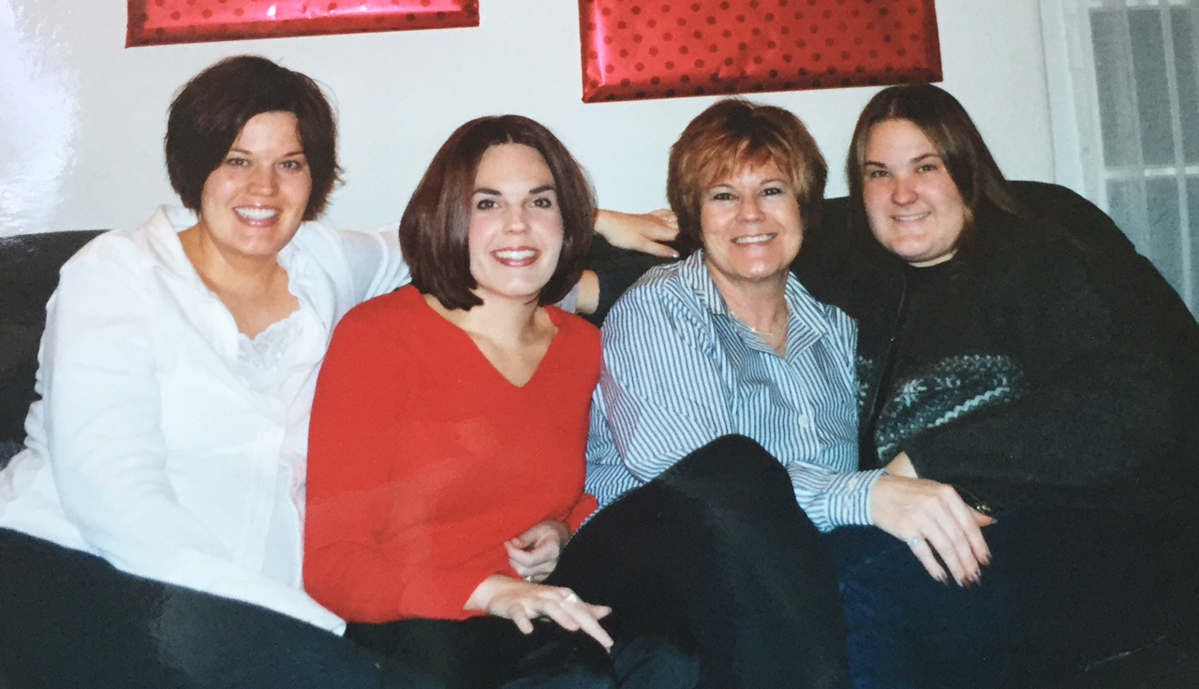
Siblings & Mourning
Mourning the loss of...
A sister or brother
A best friend
A lifelong companion
The past
The present
The future
What could have been

Slide 28
Grief Work Models
Kubler-Ross
Denial and Isolation
Anger
Bargaining
Depression
Acceptance
Worden’s Four Tasks:
To accept the reality of the loss
To experience the pain of grief
To adjust to an environment in which the person/thing is missing
To withdraw emotional energy and reinvest it in another relationship

Slide 29
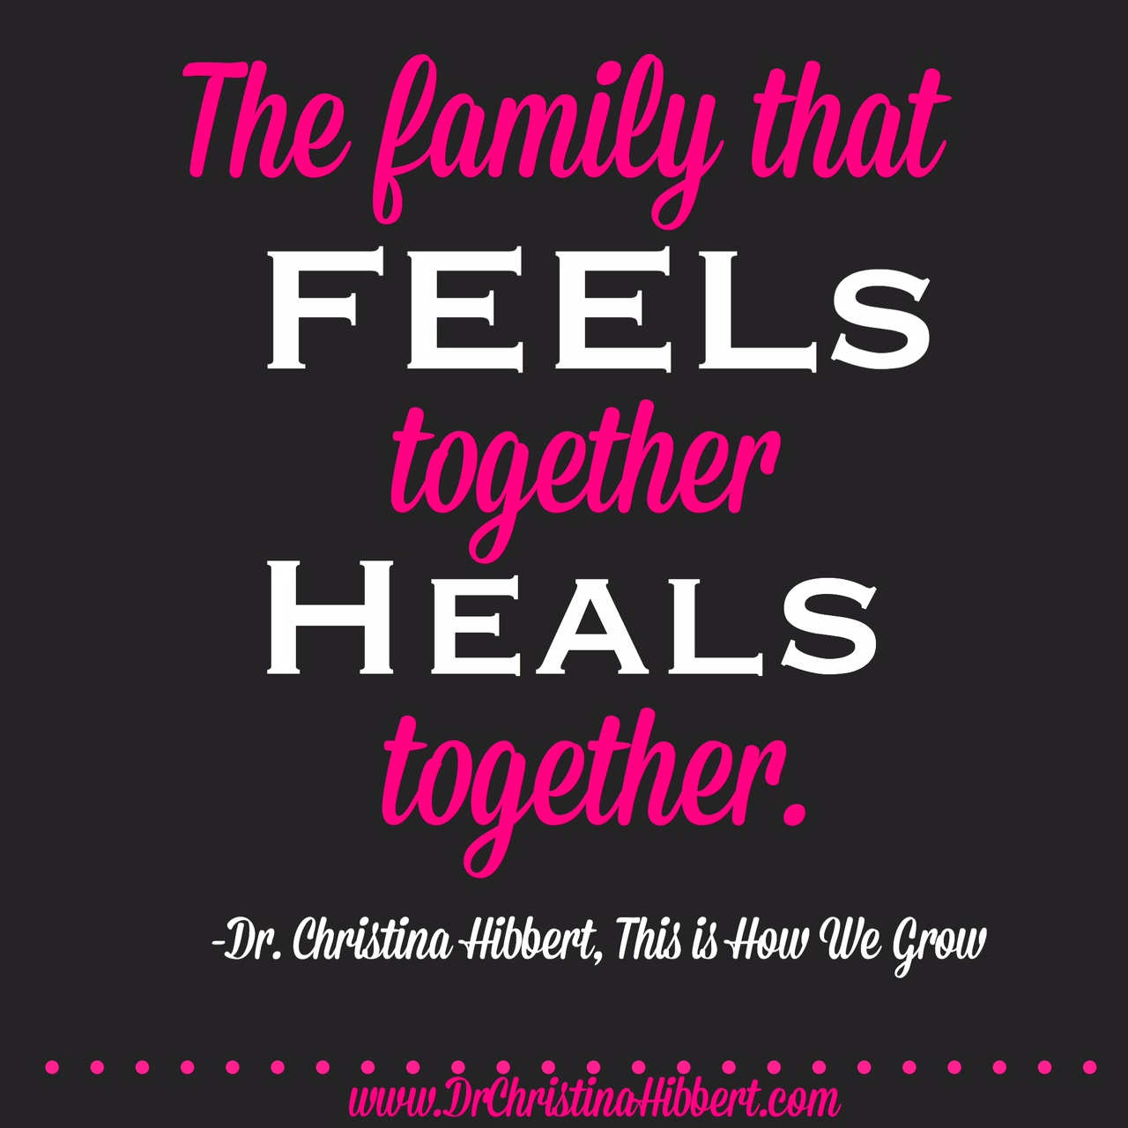
Family Grief Work… As siblings, we don’t always get this
Notes:
So, we not only have the need to begin grief work individually but also there is grief work that must take place as a family in order to heal the entire family unit.
Sharing the experience of the loss in whatever ways families can is crucial in the healing process (talk, visit grave, funeral). Family communication is vital!
“When mourning and communication are blocked, it is likely to surface as behavioral problems in children”.
May “scape goat” or extrude members who express unacceptable feelings
Families may express grief in a fragmented fashion- each member expressing a different emotion (sad, angry, numb)…

Slide 30
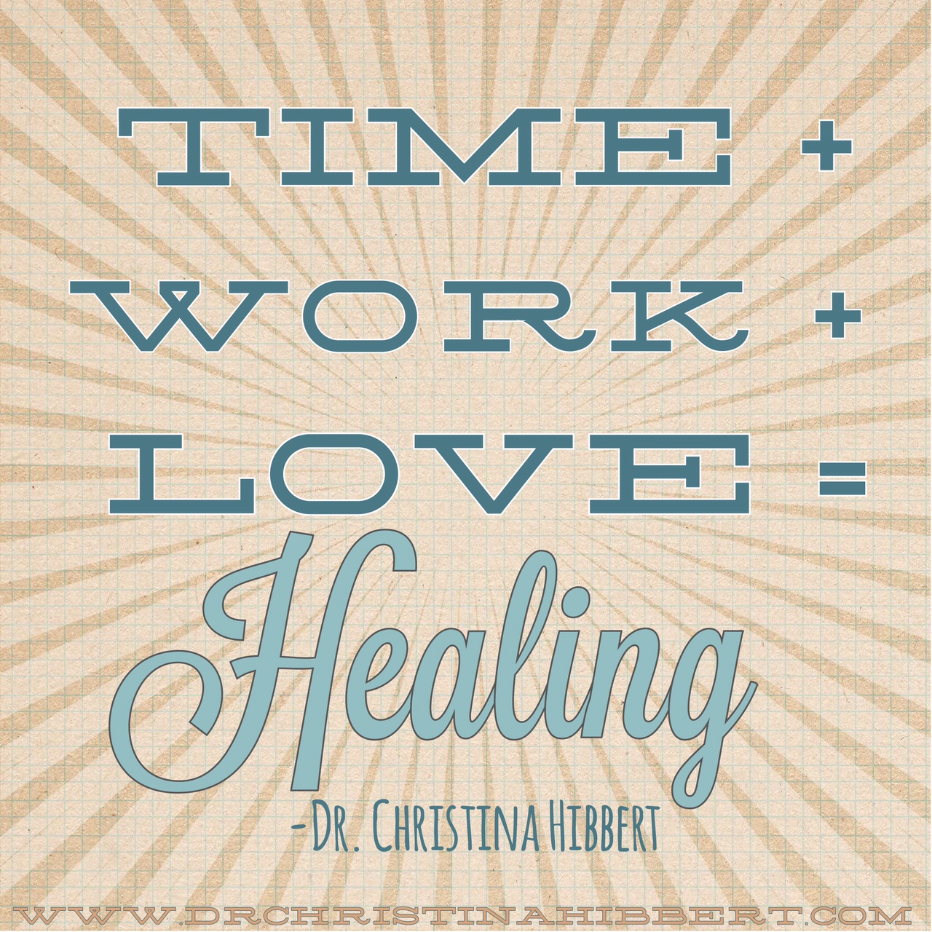
Lifelong HEALING
Notes:
I say “lifelong,” because that’s how long it will take. It’s like waves after a shipwreck…
TIHWG pg. 347 Analogy of Flat Tire
Or submarine...

Slide 31
HEALING
“…grief, or any major trauma for that matter, is never overcome nor does recovery take place. The course of healing involves integrating that trauma, not overcoming it.”
(Bernstein, 1997, p.xv)
Grief Work

Slide 32
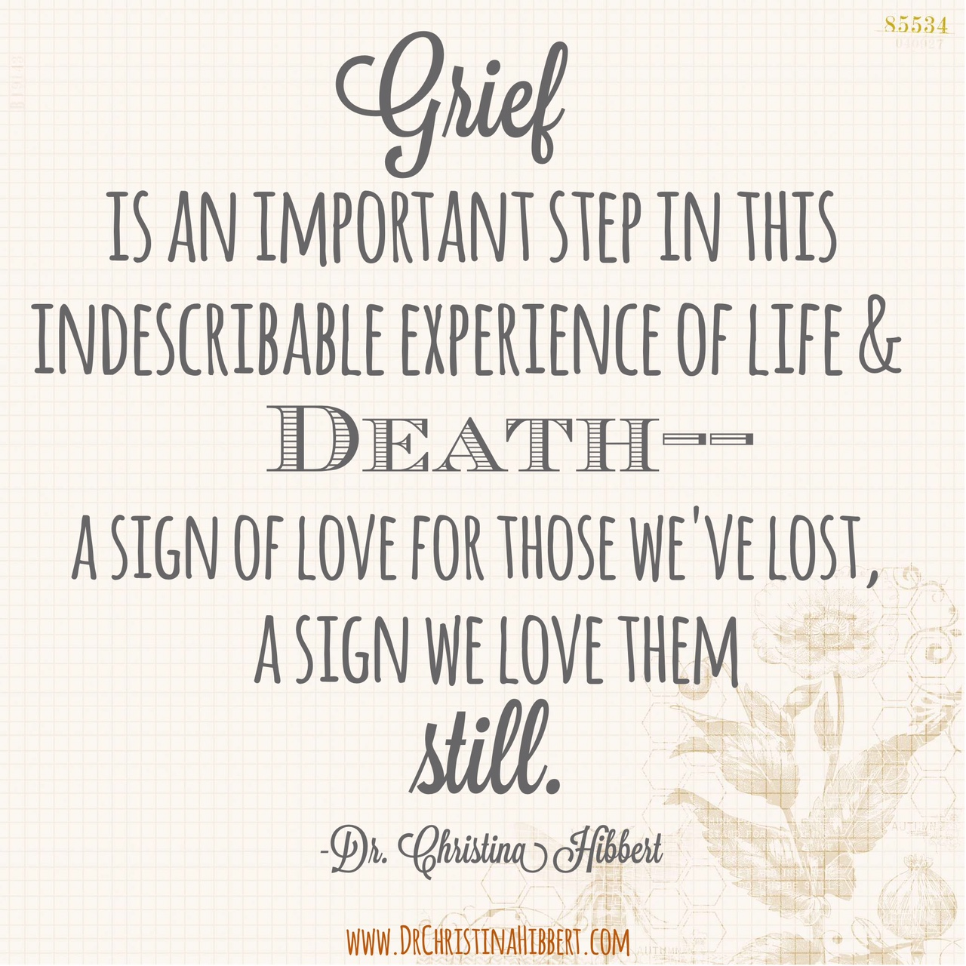
“How do I (we) grieve?”
TEARS (Hibbert, 2007)
Talking
Exercise
Artistic expression
Recording emotions & experiences
Sobbing
Notes:
Record: Can include writing a letter to the deceased to help grieving
“Understanding the personal nature of grief is important. The perceptions you have about your loss and your grief are more important. The role of perception is the number-one factor in successful grief recovery.” (P.62). ”

Slide 33
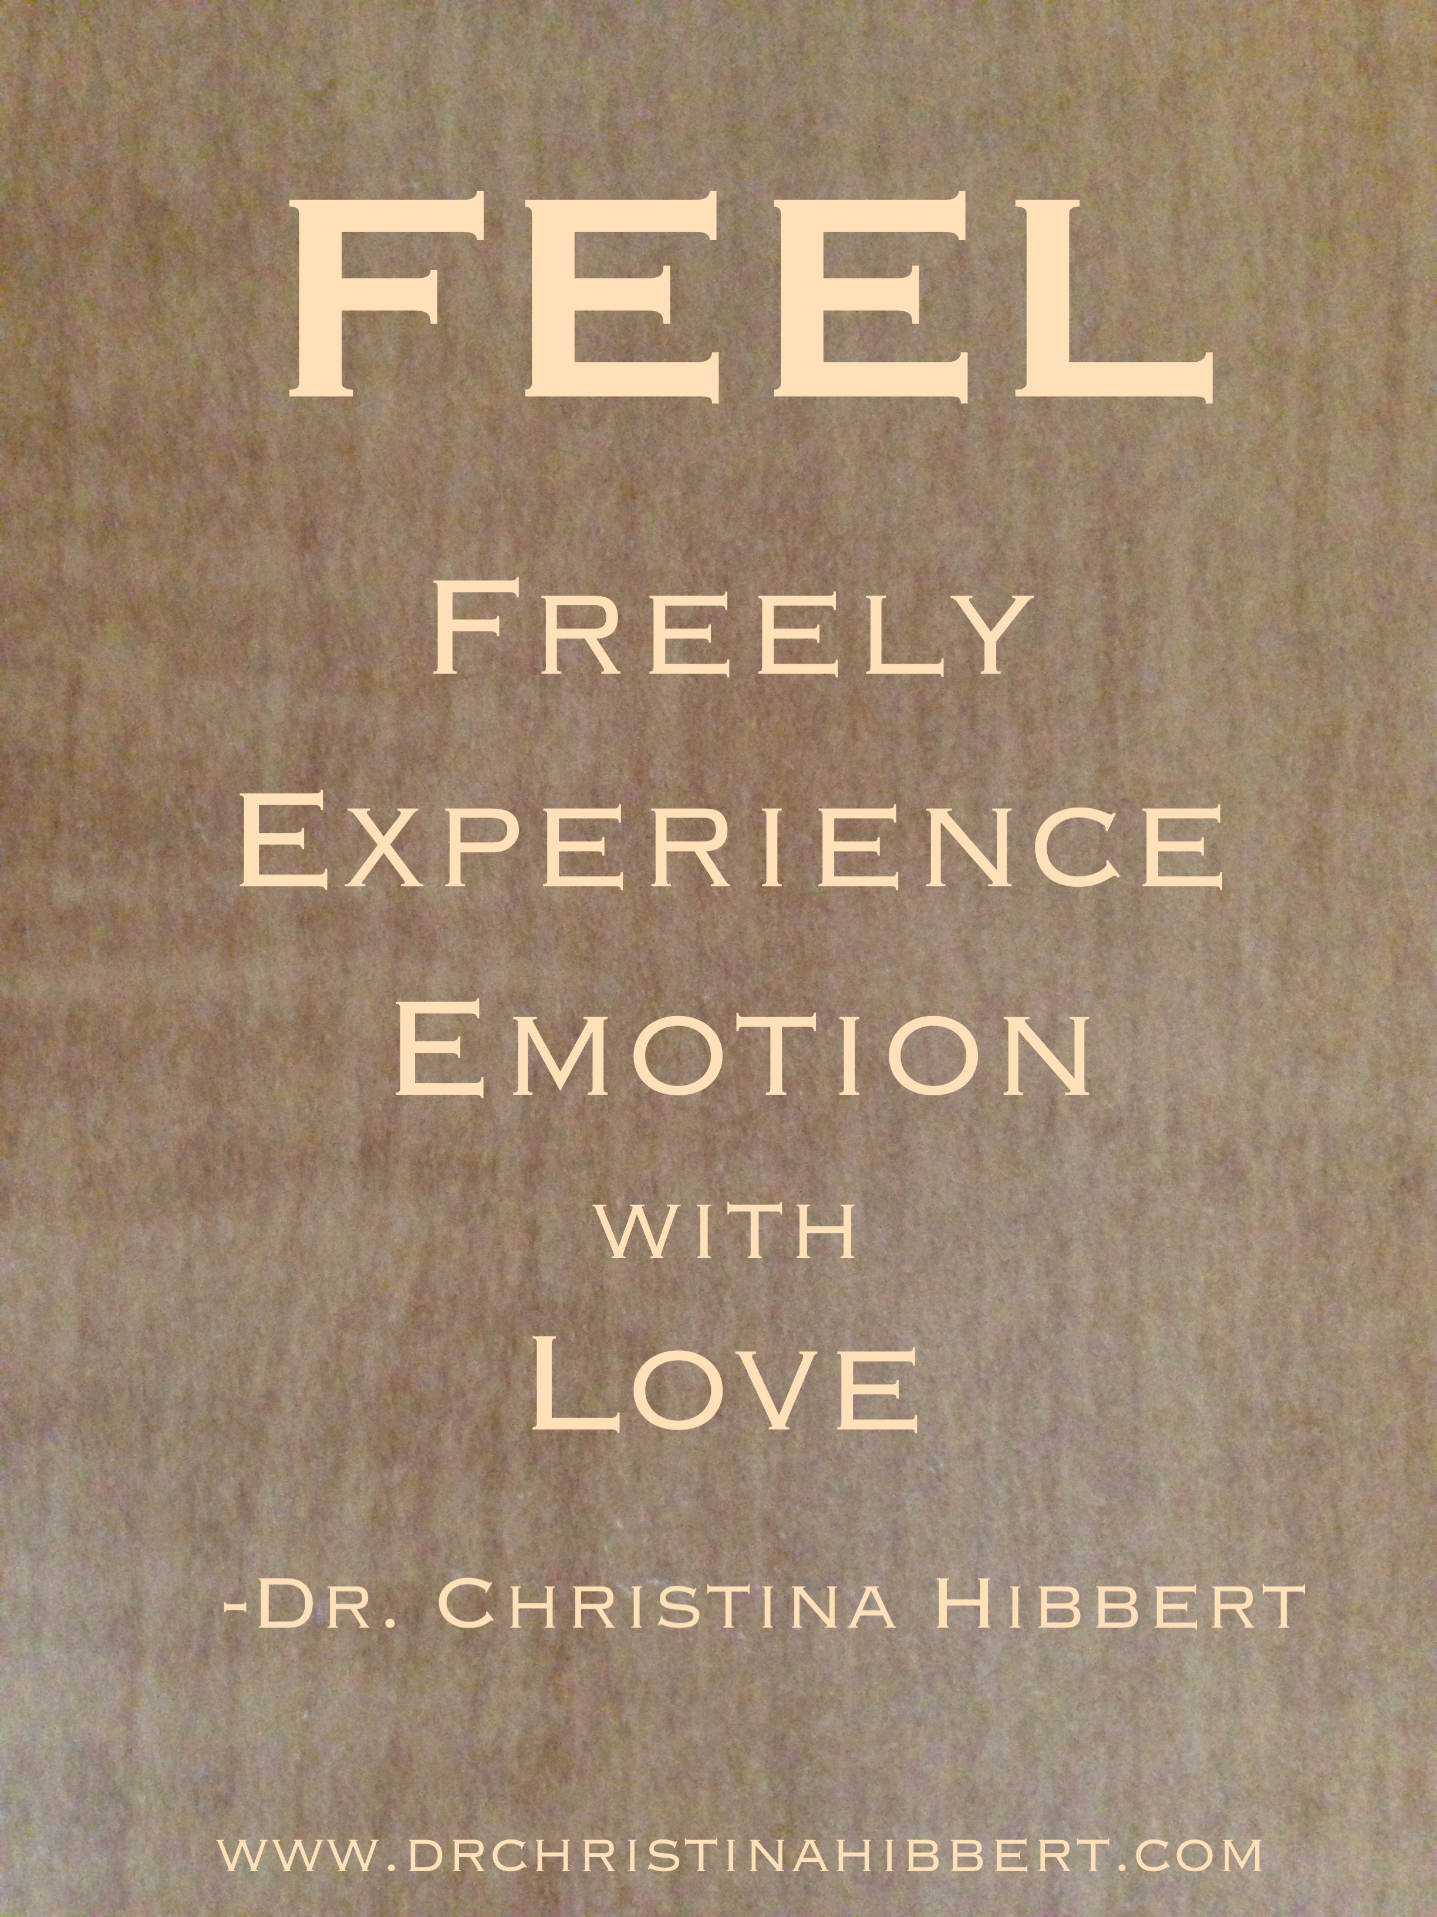
FEEL
How to handle tough emotions
Anger
Guilt
Fear
Depression
FEEL whatever comes
“The way out of grief is through it.”
(Deits, 2004)

Slide 34
Self-Esteem & Self-Worth
Being compared to lost sibling
Feeling you must “measure up”
Feeling like “all eyes are on you”
Self-Esteem
vs.
Self-Worth
Who Am I Without You?, 2015
8 Keys to Mental Health Through Exercise, 2016

Slide 36
Powerful Self-Care Self-care is crucial to coping and healing!
Oxygen Mask
Self-Care is a Strength
Involves: Physical, Mental, Emotional, Spiritual, Social Care
Put self on list- Allow time for self, “life,” and relationships
Allow time to FEEL, cry, grieve
Identify priorities: “What matters most?”
Can you do any of these if you are not healthy?
Notes:
4 Steps to getting needs met…

Slide 37
Have You Cared for Your Brain Today?
NURSE
Program
file://localhost/.file/id=6571367.2025810

Slide 38
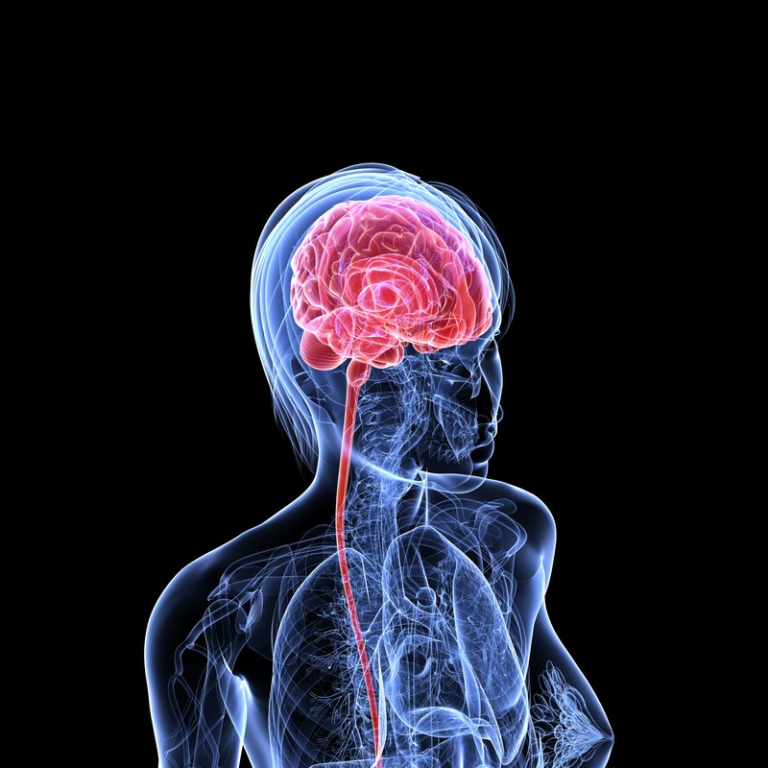
Caring for your Brain with NURSE:
N= Nourishment & Needs
U= Understanding
R= Rest & Relaxation
S= Spirituality
E= Exercise
-Sichel, D. & Driscoll, J.W.

Slide 39
Exercise
Physical Benefits:
Improved quality of sleep
Greater energy
Lowers cancer risk
Lower risk of heart attack, stroke, diabetes II
Mental Health Benefits:
Works like a medicine for the brain!
“Treats” depression, anxiety, PTSD, GRIEF!…
Lifts mood, decreases stress, improves relaxation,
Improves mental clarity, efficiency, learning, memory, insight, thinking
Enhances intuition, creativity, assertiveness, & enthusiasm for life!
Improves family and social relationships
Improves self-esteem/worth
Increases spiritual connection…
Hibbert, 2016

Slide 40
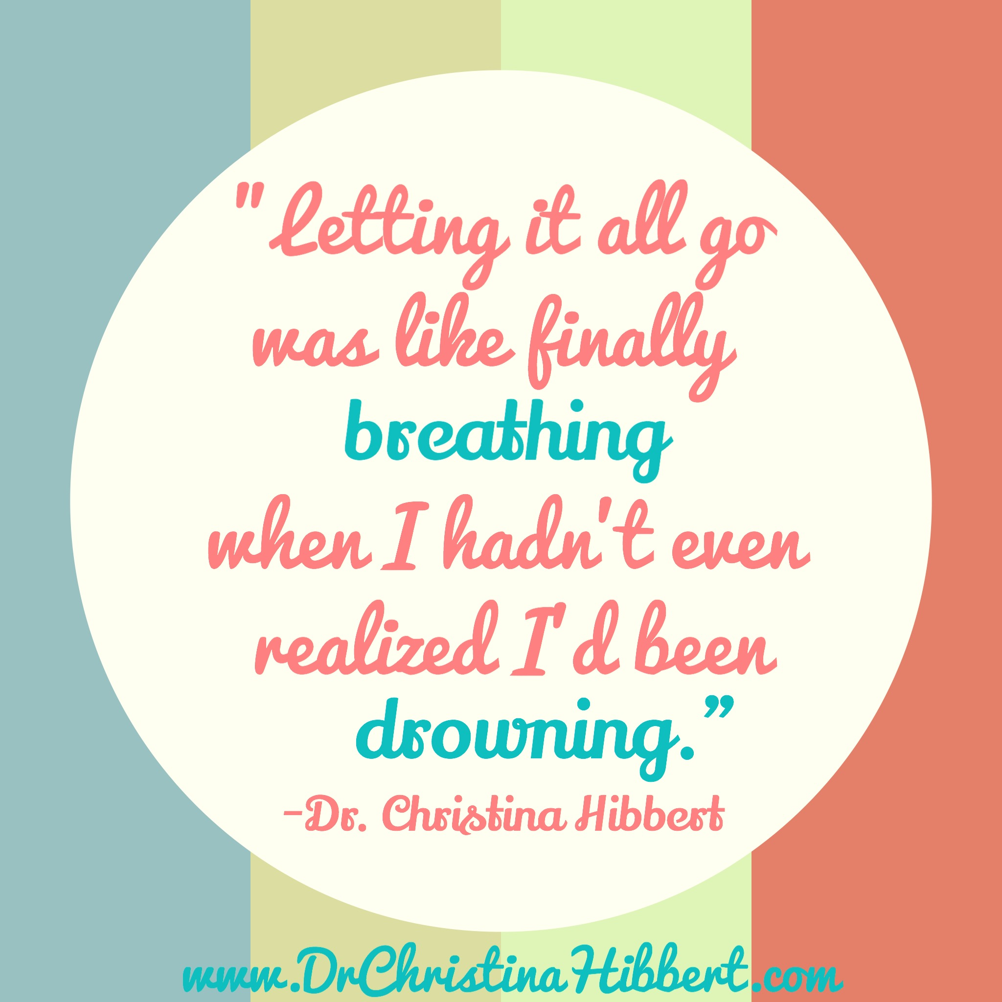
Letting go of…
Worry
Fear
Anger
Guilt
Depression
Anxiety
Notes:
Letting go is a process. A daily habit we must develop!
Worry tree
FEEL fear; fear prevents good
Anger-primary vs. secondary emotions
depression- thought management
Anxiety- thought management and mindfulness

Slide 41
Mindfulness
Deep breathing
Meditation “Spirit Meditation,” whoamiwithoutyou.com
Awareness of present
Progressive muscle relaxation
Hypnotherapy
Notes:
Walking meditation, notice with all your senses. This moment, everything is okay.

Slide 42
Support
We need each other
“Solitude vs. isolation”
Do you “bridge” or “isolate?” (Hibbert, 2013)
Reaching out
Letting help in
Focus on relationships
Remember you’re not alone.

Slide 43
You’ve Got an Angel
Christina G. Hibbert
Verse 1:
That’s right- life’s not fair.
Sometimes the load you’re asked to carry seems too heavy to bear.
Ooh, and I know that sometimes
it seems there’s not a soul in sight.
But if you look a little deeper,
then you’ll begin to see the light.
Chorus 1:
‘Cause you’ve got an angel
helpin’ you lift that load.
With arms around you, love’s surrounding you—more than you’ll ever know.
You’ve got an angel
makin’ your weakness strong—
sendin’ you dreams, lendin’ you wings and helpin’ me sing you this song.
Verse 2:
Sorry to say, you’re right.
Life’s not fair.
Sometimes the road you’re travellin’ takes a turn just when you think you’re almost there.
Ooh, and I know that sometimes it seems there’re countless miles to climb.
But if you’ll trust a little deeper
you’ll find you’re given wings to fly.
Chorus 2:
‘Cause you’ve got an angel
helpin’ you walk that road.
With arms around you, love’s surrounding you, whispering where to go.
You’ve got an angel movin’ your feet along—
sendin’ you dreams, lendin’ you wings and helpin’ me sing you this song.
Bridge:
Ooh, help is a breath away,
sent with a Father’s tender care
to remind you He is always there.
Chorus 3:
You’ve got an angel, sent from your heavenly home.
With arms around you, love’s surrounding you, whispering “you are known”.
You’ve got an angel takin’ your burdens on—
Sendin’ you dreams, lendin’ you wings and helpin’ me sing you this song.
Sendin’ you dreams.
Lendin’ you wings.
And helpin’ me sing—
sing you this song.

Slide 44
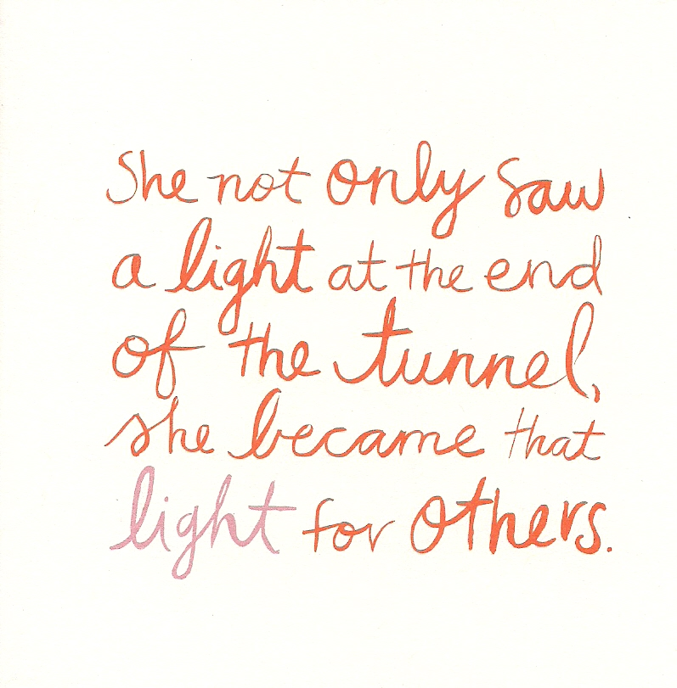
Overcome. Become. Flourish.

Slide 45
Thank you!
www.DrChristinaHibbert.com
Books:
“This is How We Grow” (2013)
“Who Am I Without You?” (2015)
“8 Keys to Mental Health Through Exercise” (2016)
“Motherhood” Radio, iTunes, SoundCloud, YouTube
Connect with me!
Facebook.com/DrCHibbert
Instagram: @drchristi_hibbert
Twitter: @DrCHibbert
YouTube: DrChristinaHibbert

Slide 46
References
Becvar, D.S. (2001). In the Presence of Grief: Helping family members resolve death, dying, and bereavement issues. New York, NY: Guilford Press.
Bernstein, J.R. (1997). When the Bough Breaks: Forever after the death of a son or daughter. Kansas City, MO: Andrews McMeel Publishing.
Bowen, M. (1976). Family Reaction to Death. In Walsh, F. & McGoldrick, M., (Eds.), Living Beyond Loss: Death in the family, 2nd Edition. New York, NY: W.W. Norton & Co.
Byng-Hall, J. (2004). In Walsh, F. & McGoldrick, M., (Eds.), Living Beyond Loss: Death in the family, 2nd Edition. New York, NY: W.W. Norton & Co.
Deats, B. (2004). Life After Loss: A practical guide to renewing your life after experiencing major loss, 4th Edition. Cambridge, MA: Lifelong Books.
DiCiacco, J. A. (2008). The Colors of Grief: Understanding a child’s journey through loss from birth to adulthood. London: Jessica Kingsley Publishers.
Dossey, L. (1993). Healing Words: The power of prayer and the practice of medicine. New York, NY: Harper Paperbacks.
Kubler-Ross, E. & Kessler, D. (2005). On Grief & Grieving: Finding the meaning of grief through the five stages of loss. New York, NY: Scribner.
Lesser, E. (2005). Broken Open: How difficult times can help us grow. New York: Villard Books.
Lewis, C.S. (1961). A Grief Observed. New York, NY: HarperOne.
McGoldrick, M. (2004). Gender and Mourning. In Walsh, F. & McGoldrick, M., (Eds.), Living Beyond Loss: Death in the family, 2nd Edition. New York, NY: W.W. Norton & Co.
Rando, T. (1984). Grief, Dying & Death: Clinical Interventions for Caregivers. Champaign, IL: Research Press Co.
Walsh-Burke, K. (2006). Grief and Loss: Theories and Skills for Helping Professionals. Boston, MA: Pearson Education, Inc.
Worden, W. (2002). Grief counseling and grief therapy: A handbook for the mental health practitioner. (3rd ed). New York: Springer Publishing Company.

